Slide 1

Hampshire Futures
Tutor Training
Making your learning objectives and learning goals
SMARTER
Lorraine Hounsell and Tom Shrimpton
Monday 22nd February 2016 1.30 – 4.00pm
Broadlands Room,
2nd Floor EII Building,
Winchester

Slide 2
Welcome
Introductions
Housekeeping
Agenda

Slide 3

Aim and Objectives for this session
Aim: To provide practical and theoretical approach to writing aims and (SMART) objectives to support planning for learning.
Objectives: At the end of the session you will be able to:
Create an aim and a set of workable objectives for a baking class
Identify the meaning of SMART
Demonstrate and create SMART objectives in your own subject area
Create 3 learning goals

Slide 4

Learning Aims and Objectives
Aim – is what you want the learner to achieve – covers whole topic
Objective – is how e.g. the breakdown of the topic and the indication of what your learners will do to achieve
Learning Objectives
Give the learner a clear idea of what to expect and what is expected of them
Give the tutor a goal to achieve in presenting the content of a session
Can be used to evaluate the success of the session

Slide 5
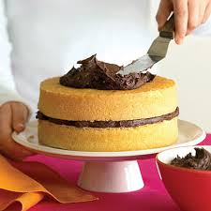
Your starting point
Task 1: Work in pairs
Read the session plan for a baking class and create/generate the following,
1. The aim of the session
2. At least 4 learning objectives

Slide 6
Learning objectives should be S.M.A.R.T
S – Specific - says exactly what the learner will be able to do
M – Measurable – to allow for evidence and proof of the achievement
A – Achievable – to be within a scheduled time and specified conditions
R – Relevant - to the needs of the learner
T – Time-bound - can dates/times be met?

Slide 7

Performance: All SMART learning objectives must describe what the learner will know or be able to do in specific, measurable terms
Conditions: SMART objectives may describe the circumstances under which the learner will learn such as tools, settings, restrictions
Criteria: SMART objectives may describe the required level of quality of performance (accuracy, productivity level, degree of excellence).

Slide 8


Learning goals

Slide 9


Slide 10


Slide 11
Group Discussion:
Course | Goal
Employability Course | Write a letter to apply for a job
Health and Fitness Course | Improve their fitness
Bookkeeping Course | Learn to budget their money weekly

Slide 12






SMART GOAL WORKSHEET

Slide 13
Integrating Functional Skills
English codes are as follows:
ER= English Reading
EWGC= English Writing Grammar and Composition
EWP= English Writing Punctuation
EWS= English Writing Spelling
ESLC= English Speaking Listening and Communication

Slide 14
Integrating Functional Skills
Maths codes are as follows:
MN= Maths number
MF= Maths Fractions
MD= Maths Decimals
MM= Maths Measures
MSS= Maths Shape and Space
MHD= Maths Handling Data

Slide 15
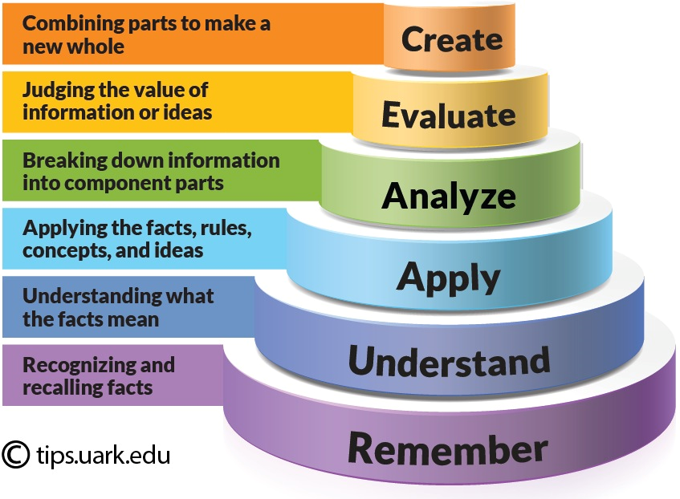

Slide 16
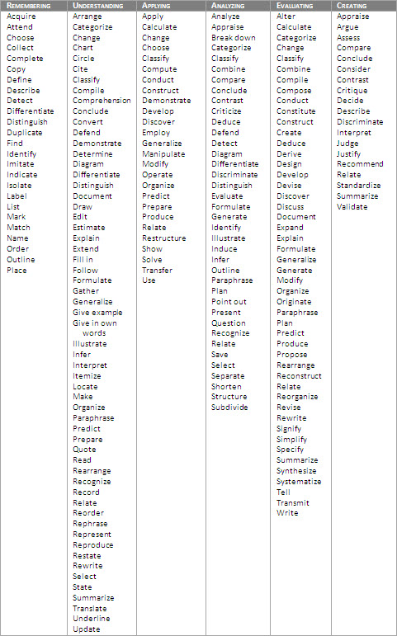

Slide 17
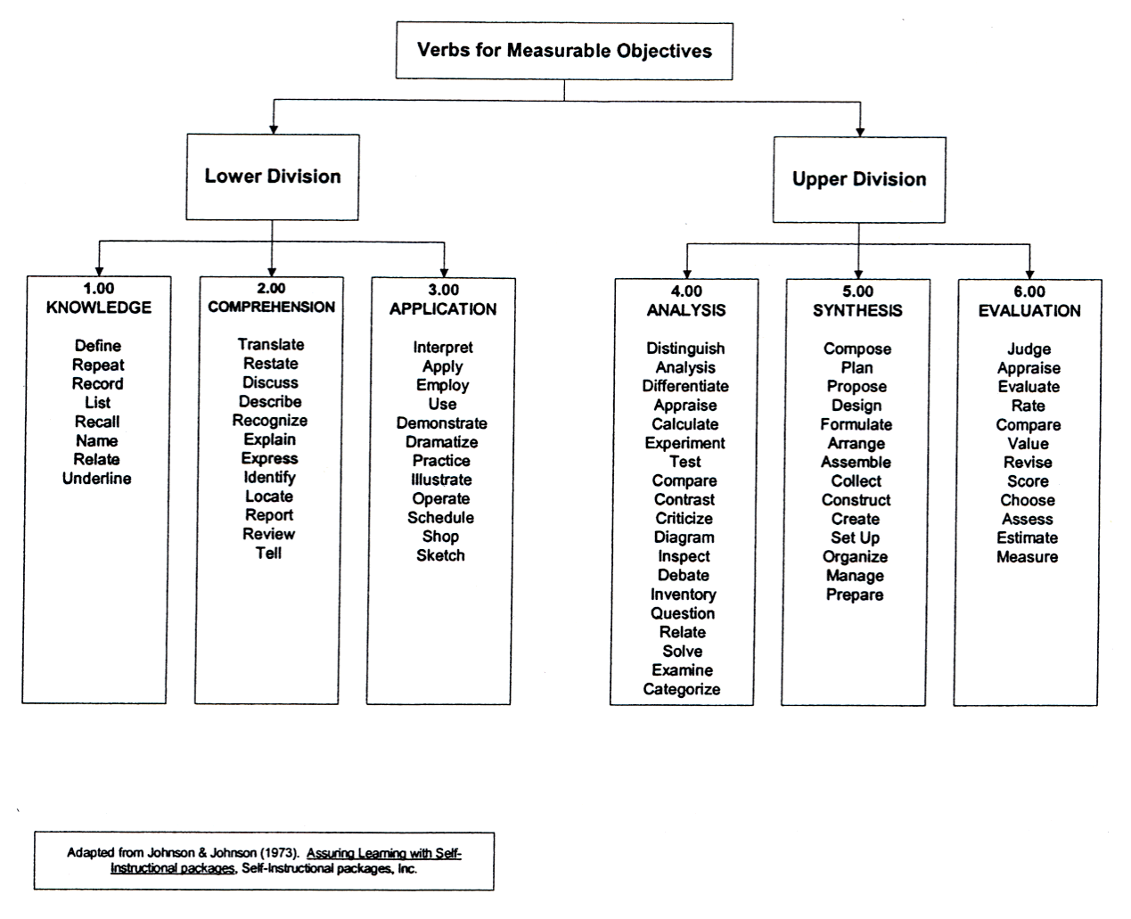

Slide 18

Plenary

