Slide 1
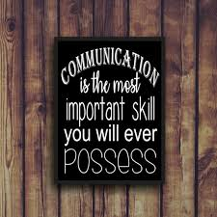
Communication Skills

Slide 2
What you will learn: 1. recognise the definitions of the words: values, attitudes, skills and knowledge 2. List the factors can affect clear and effective communication between certain groups 3. Find out how miscommunication can happen 4. Identify the various forms of communication (as communication is not just about what you say!) 5. Find out how you can improve your active listening skills 6. Identify the three different styles of communication: childlike, parentlike, adultlike and which type of communication is most effective to use in a personal and working relationship 7. Be able to compare ‘constructive communication’ with ‘destructive communication’ techniques

Slide 3
Definitions
Values = the regard that something is held to deserve; the importance, worth, or usefulness of something (e.g. I value my freedom and family)
Attitudes = a settled way of thinking or feeling about something, a way of feeling or acting toward a person, thing or situation (e.g. I hate maths)
The following can be learnt…
Skills = ability, able to apply knowledge in a practical manner, the ability to do something well; expertise (e.g. I am skilled at driving a car, I can play the violin, I am good at writing essays)
Knowledge = facts, information, and skills acquired through experience or education; the theoretical or practical understanding of a subject (e.g. I have a good basic knowledge of how to fix engines)
Notes:
Skills can be learnt!

Slide 4
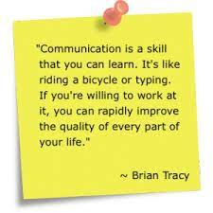
Skills = ability, able to apply knowledge in a practical manner, the ability to do something well; expertise. Communication is a SKILL that you can LEARN and IMPROVE If you are willing to work at it, then you can rapidly improve the quality of every part of your life
Notes:
Ask learners to give examples of skills they have learnt (such as playing an instrument). Practice is required to become competent at a specific task…and this is the same for communication skills.
When we are discussing communication SKILLS, remind learners that skills CAN BE LEARNT, so communicating effectively can be learnt and, like learning an instrument or driving a car, it takes practice.

Slide 5
Question…
What factors can affect clear and effective communication between the following groups of people?
Work colleagues in a busy office environment
Communication between a couple in a long-term relationship
The England Football Team
Parents/carers and teenagers
The biggest communication problem is that we do not listen to understand…
we listen to reply
Notes:
Divide learners into groups with a flip chart to discuss factors that could affect clear communication. You may wish to rotate the flip chart after a couple of minutes so learners get the chance to contribute to each sheet.
Representative to feedback discussion notes.
You may wish to give some starter ideas such as: distance between the people who are communicating, language barriers, imbalance of power, boredom etc.
Many problems in both working and personal relationships occur due to communication issues. As it is proven that effective communication and conflict resolution abilities have a strong link.
Good communication skills makes people feel valued, respected, involved, safe and at ease.
Effective communication skills not only improves productivity but also creates a happier and more efficient working environment
It is a skill and can therefore be learnt, improved and developed

Slide 6
How miscommunication happens…
https://youtu.be/gCfzeONu3Mo
Notes:
4.32 mins
Summary:
How to avoid miscommunication
passive hearing and active listening are not the same
2. listen with your eyes, ears, and guts
3.take time to understand as you try to be understood
4. be aware of your own perceptional filters

Slide 7
What are the different ways we communicate? ps: it’s not just about what we say!
Notes:
GROUP DISCUSSION
Verbal Communication. Verbal communication occurs when we engage in speaking with others. ...
Non-Verbal Communication. What we do while we speak often says more than the actual words. ...
Written Communication. ...
Listening. ...
Visual Communication

Slide 8
Non-verbal communication
This is the way a person expresses themselves through movement, posture, eye contact, gestures, proxemics and facial expression
It is possible to send one type of verbal message and at the same time, a very different message through non-verbal communication
Non-verbal communication is very powerful and can often be misinterpreted (for example a child hiding behind the legs of an adult whilst saying they are not scared of the big dog!)
Notes:
What do you think the non-verbal communication telling you about how these people are feeling?

Slide 9
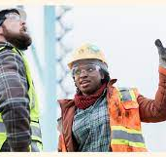
Facial Expression & Body Language
In any role that involves working with people, you will need to develop skills to be able to ‘read’ body language, including people’s gestures, facial expression, posture, gestures and other cues
This has been more of a challenge since 2020 due to…
Face masks
Remote working
Social distancing
Notes:
Quickly pick up with learners that is much harder to identify ‘emotions’ when you can only see a person’s head and shoulders - as non-verbal cues can be demonstrated all over the body. For example the way someone is standing or sitting, what they are doing with their hands or arms, if they are leaning in or away from you. If they are making eye contact, if they are fidgeting etc.
In a team or in certain jobs/situations reading facial and body language cues can be especially useful as you may be dealing with someone who is growing angry, frustrated, confused or even perhaps scared. But you must always be mindful that the person may also have underlying difficulties with verbal communication that may not be apparent such as language barriers.
If you can read the non-verbal cues that demonstrates that someone is getting angry or upset, you can adapt the tone, volume and pace of your speech to try to defuse the situation.
Staying calm and in control can help you to deal more effectively with complaints and conflict …and not take it personally (as it’s rarely the employee the person is angry about!)
How would you tell that someone is getting angry and frustrated other than the tone and volume of their voice? What other ‘cues’ might you pick up?

Slide 10
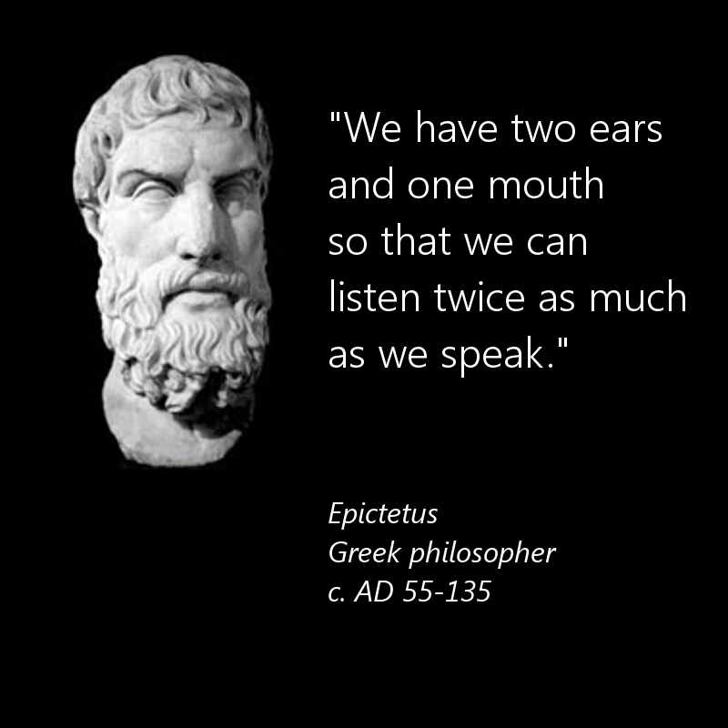
Active Listening
Notes:
Introduction
We have two ears and one mouth – and they are in that proportion for bloomin’ good reason.
We should aim to listen twice as much as we speak as this is an effective way to quickly improve our communication skills.
However….it takes patience, perseverance and a little bit of effort to actively listen!

Slide 11
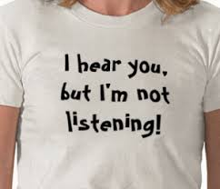
Active Listening
The way to improve your communication skills is to practice "active listening." This is where you make a conscious effort to hear not only the words that another person is saying but, more importantly, the complete message being communicated.
In order to do this you must pay attention to the other person
very carefully
You cannot allow yourself to become distracted by whatever else may be going on around you, or by forming counter arguments while the other person is still speaking. Nor can you allow yourself to get bored, and lose focus on what the other person is saying….
…and it’s not easy!
Notes:
Given all the listening that we do, you would think we'd be good at it! In fact, most of us are not, and research suggests that we only remember between 25 percent and 50 percent of what we hear. That means that when you talk to your boss, colleagues, customers, friends or partner for 10 minutes, they pay attention to less than half of the conversation.
Turn it around and it reveals that when you are receiving directions or being presented with information, you aren't hearing the whole message either. You hope the important parts are captured in your 25-50 percent, but what if they're not?
Clearly, listening is a skill that we can all benefit from improving.
By becoming a better listener, you can improve your productivity, as well as your ability to influence, persuade and negotiate. What's more, you'll avoid conflict and misunderstandings.
All of these are necessary for workplace success!

Slide 12
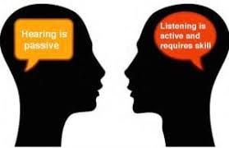
Active Listening Activity 1
For this activity you will only need your ears and try to listen to the story carefully (so you can answer the question at the end)
Are you ready?
Notes:
Read out the bus driver story.
Ask the final question to see if anyone listened to the first sentence (e.g YOU are the bus driver)
Remind learners that we often miss key information at the beginning, middle and end of a conversation so we can only make sense of the parts our brain receives. We also tend to make assumptions about what a person is going to say, so our brain ‘jumps to conclusions and fill in the gaps…and not always correctly.
For example if someone starts talking about a large grey animal with tusks, you may automatically picture an elephant because your brain creates a picture of the object that person is discussing by makes instant neural connections.
Then you discover they are talking about a walrus! Our brain has a habit of filling in the gaps very quickly…and often incorrectly!
Take care as jumping to assumptions can lead to some serious cases of miscommunication. Never be afraid to ask open questions if you don't understand something or need clarification.

Slide 13
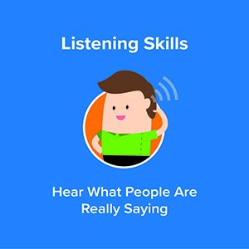
Video link – Active Listening
https://youtu.be/t2z9mdX1j4A
Notes:
Check if anyone need subtitles

Slide 14
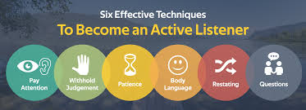
5 Tips for Active Listening
Five ideas to develop your active listening skills:
Pay attention - be patient with the speaker
Show that you’re actively listening – use body language, eye contact, gestures and affirmation
Try not to give a judgement or solutions – don’t interrupt, tell your own story or change the subject (this is easier said than done!)
Respond appropriately – look interested and ask open questions
Ask for clarity to ensure you have understood what is being said; repeat back to what you think you have heard and ask for feedback
Notes:
Another extension activity could be carried out before displaying this slide (if the session is carried out as an extended teaching session/tutorial).
Divide learners into pairs. Ask them to choose a number from either Number 1 or Number 2.
Number 1 learner is asked to talk for exactly 2 minutes on a subject of interest (for example a holiday or hobby) and Number 2 is to actively listen using positive affirmations, facial expression and body language. They are not however permitted to interrupt.
Ask Number 1 learners how they felt talking about their hobby/holiday. What did they notice.
Then change the activity
This time Learner Number 2 is to talk for two minutes about a subject of interest (holiday or hobby) and Number 1 is to purposely ignore them. They can look away, look at their phone, tap their fingers … basically do the opposite of actively listen.
Ask Learners from group 2 what happened (often the room goes silent within the first 60 seconds) and how they felt to be ignored. What message can they all take from this exercise?

Slide 15
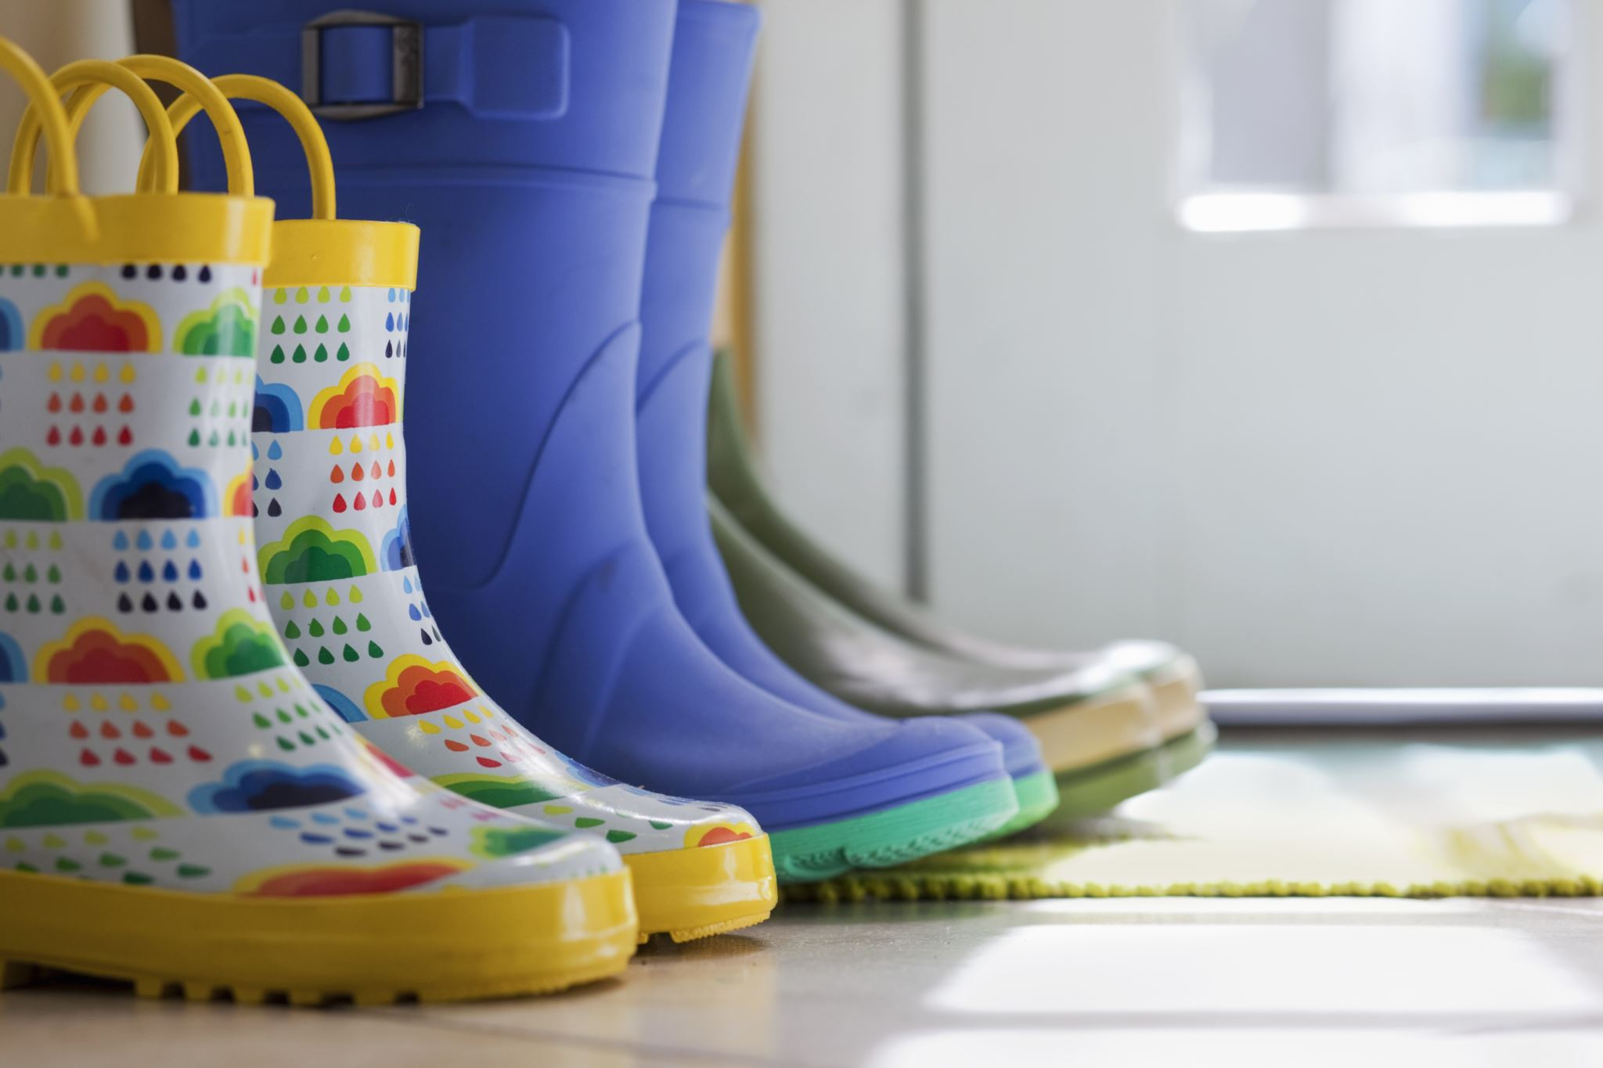
“I” Messages
Another useful tool to improve your communication (and diffuse any potentially conflict situations) is to use “I” messages. This is very simple and effective. Simply explain how an action makes you feel and replace the word “You” with the word “I”.
For example:
“You always leave your boots in the doorway!” (…which sounds accusatory and could lead to an argument
Replace with
“It upsets me when you don’t put your boots away because I trip over them when I come through the door”
Notes:
Give learners a chance to make up their own “I messages” for the following:
You never do the washing up!
Do you have any idea how stupid that sounded? (this one is a little tricker)
You don’t ever listen!
You’re rubbish at giving compliments!
Can they rephrase these so they sound less accusatory using the “I message” technique?

Slide 16
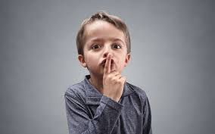
Child-like
Parent-like
Adult-like
What is you communication style?
Notes:
On the next three slides we will take a look at three types of communication styles and which one is the most effective in personal and working relationships

Slide 17
Child-like Communication
This is a very immature method of communication and the least effective to use when you are an adult
There is no listening involved!
Self-centered Not listening
Whining Name Calling
Verbal abuse Giving orders
Interrupting Acting out of Control
Yelling Throwing Tantrums
Notes:
This is the easiest and most natural communication we use. (You’ve been using it since you were a child!)
We all do this at times and often slip into this communication style when we are stressed, unsafe or threatened

Slide 18
Parent-like Communication
This type of communication tries to direct others’ behaviour
It is effective only because you usually get someone to comply or act a certain way
It is one way, or dictatorial communication
There is no listening involved!
Giving Instructions Directing Not Listening
Demanding Ordering Punishing
Notes:
This has NOTHING to do with being a parent - in fact, most two-year olds are experts at this!
Occasionally this style of communication is required and useful, for instance for dealing with an emergency situation such as evacuating a building or road traffic incident. However, it is not useful for building effective relationships!

Slide 19
Adult-like Communication
This is the highest level of communication
It is the most effective and desired
It does take time to learn and use this type of communication, but it does not happen overnight
It not only involves communicating, but ACTIVE LISTENING as well!
Open, two-way communication
Both parties take responsibility for comments or actions
Those involved remain calm
Both show respect for the other’s feelings and opinions
Both want to solve the problems with a “win-win” attitude
Both try to control strong emotions while communicating and discussing issues

Slide 20
(Optional) Communication & Teamwork Activity
Rules:
You will work in small teams to construct a model
You will need to nominate a team leader (your ‘project communicator’)
The team leader must not touch the construction materials
Only the team leader is permitted to visit to the ‘sample model’ no more than 3 times
The builders have 5 minutes to complete this task
The winning team will build an exact replica of the sample model in the other room
Notes:
If time allows include this simple communication activity:
Create a simple structure out of different coloured Duplo bricks and place it somewhere in the room where it can’t be seen until the activity begins.
Divide the group into teams of 3. Each team should be given a set of bricks to build an exact copy of the Lego structure you have already built.
The rules are that only one person (their nominated leader) from each team is allowed to go and have a look at the structure. When they come back to their team, they cannot touch the bricks, but they can tell the others how to build a copy of the building. Be sure to emphasize that the goal is for each team to complete an exact replica of the model. However, the leader will only allowed to go and look at the model three times and communicate what he/she sees to the team verbally. They have only 5 minutes to build their model.
Questions to ask at the end of this task:
How did the teams get on?
How did they deal with any conflict or difficulties?
Did they notice any of the three categories of communication taking place (childlike, parentlike or adultlike)
How important was clear and effective communication in this activity?
Summarise that this exercise is totally dependent on verbal communication skills and active listening
Active listening is a key skill in building your communication toolkit. It will be essential to develop your skills about how to reduce barriers to communication as you may be dealing with people with limited vocabulary, people with learning difficulties or disabilities, people with memory problems, people who have English as a second, third or even fourth language.
Another key skill is the ability to keep a cool head! Let’s summarise the sort of communication that is useful, and the sort of communication that is not useful when working in a team

Slide 21
Summary - destructive communication technique
Destructive communication “tears down” others and discourages open, adult communication as follows:
Insults, harassment, teasing, bullying (and banter)
Threatening
Lying, blaming, using accusing “You” messages
Swearing, getting angry or defensive
Sarcasm (when a person says one message, but nonverbal communication and tone of voice says another)
Gossiping
Not listening, talking over the other person, interrupting, looking disinterested

Slide 22
Summary - constructive communication technique
Constructive adult-like communication contributes a meaningful exchange of ideas and/or leads to understanding as follows:
Give positive, constructive or encouraging messages
Send clear, calm, concise messages
Keep the confidence of other people
Use tact: (e.g. communicating something sensitive without hurting or offending)
Ask open questions
Be honest and open
Speak with respect
Be a good listener

Slide 23
Review of our learning
We found out that skills (such as good communication skills) can be learnt and developed with practice
We discovered how miscommunication can happen
We saw how important non-verbal communication and active listening skills are to adult-like, constructive communication
We finally considered the different styles of communicating and summarised key ‘constructive communication techniques’ including listening and “I” messages
Think about what one new piece of learning will you take away from today’s session?
Notes:
Any questions?

