Slide 1
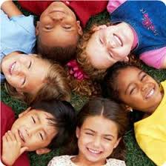
Embedding Equality & Diversity into Teaching and Learning
Teaching & Learning Conference
20th July 2017
Donna Beckford and Susie Higgs

Slide 2
Equality and Diversity HCC - Our vision
Hampshire County Council values diversity respects individual rights and expects others to take personal responsibility to do the same

Slide 3
http://www3.hants.gov.uk/equality.htm

Slide 4
Aims and Objectives
Aim:
To support tutors to look at their current use of equality and diversity in their teaching and learning resources
Objectives:
To explore and familiarise ourselves with the meaning of Equality and Diversity and Protected Characteristics; what it means to us and how we use it within our teaching and learning delivery
To work with other tutors to reassess the teaching resources we are currently using and develop strategies to confidently embed E&D into teaching and learning

Slide 5
Activity 1
Discuss:
What does Equality mean to you/us?
What does Diversity mean to you/us?
Notes:
As a group

Slide 6
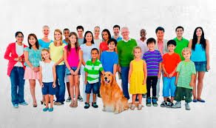
Equality & Diversity
EQUALITY: the state of being equal, especially in status, rights, or opportunities - treating all people with fairness, decency and respect.
DIVERSITY: It means, ‘understanding that each individual is unique, and recognising our individual differences – ‘valuing the differences between people.’

Slide 7
Protected Characteristics

Slide 8
Activity 3 - Case Study : In pairs (or threes) please discuss:
Fatima has been informed that one of the new students on her ‘Introduction to IT’ class ‘Marie’ uses a wheelchair
Marie also has a visual impairment and slightly reduced movement on her right side.
What should Fatima put in place before Marie joins her class in two weeks’ time?

Slide 9
Activity 4 – In pairs (or threes)
Take a fresh look at the resources you are currently using, or plan to use on your autumn term courses

Slide 10
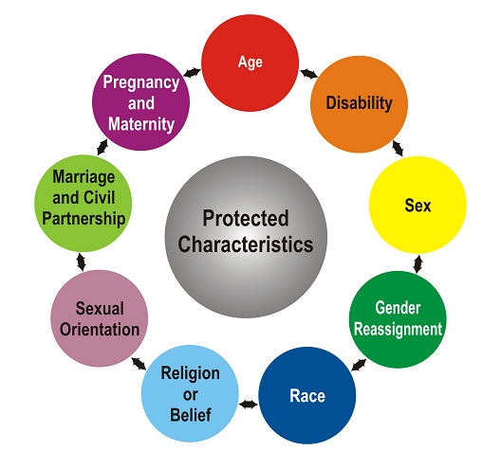
Reassess your teaching resources and activities:
Are they inclusive and aimed at covering the protected characteristics of:
Age
Disability
Sex
Gender reassignment
Race
Religion or belief
Sexual orientation
Marriage & civil partnership
Pregnancy and maternity

Slide 11
Do learners understand what they are learning and why?
Are all learning needs being met (e.g. SEN)?
Has the lesson been differentiated for various levels or abilities?
Is there clear integration of English and maths?
Is there a variety of teaching and learning strategies used throughout?
Does the pace of the lesson meet all needs?

Slide 12
How do you differentiate for students of all ages?
How do you support varying learner abilities within your group?
Is it inclusive;? i.e. are there references to different ages, genders, culture and faith etc, in your lessons & handouts?
Notes:
E.g. equal pension rights for a civil partnerships, politics, women’s football, politics (Donald Trump)?

Slide 13
Do you use technology that some learners may not be familiar with? How will you support this?
Do you have an element of ‘challenge’ or ‘opportunity’ within your teaching resources that takes your learners out of their comfort zone? i.e. discussion or debate?

Slide 14
Do you use current news articles, sports events, music influences?
Are the resources used current, sufficient, reliable, valid, accessible and reflect the construct of the group and the wider community?
Has there been a variety of assessment methods used throughout the lesson?
Have you provided feedback that stretches and challenges learners?

Slide 15
Useful Sources:
Visit Hampshire Futures VLE- ACL – Policies – Equality & Diversity
Society for Education and Training
(formally the Education and Training Foundation)
‘The Equality Act – What’s new for employers?’ an ACAS booklet available on the VLE
Learning link: http://www.hants.gov.uk/elearning/equalityandinclusion/presentation.html

Slide 16
Any questions?

