Slide 7
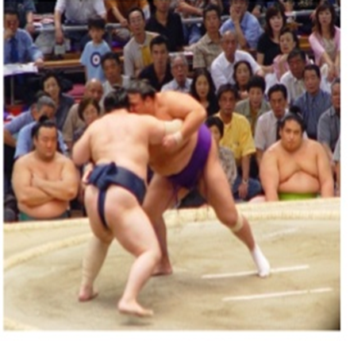
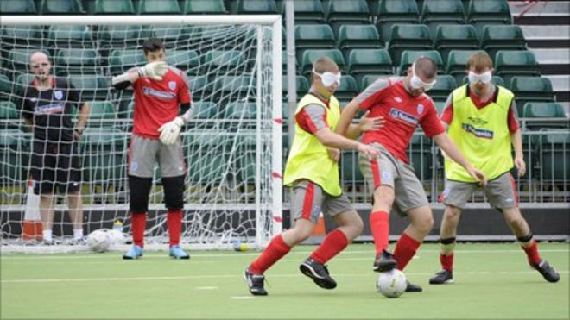
Diversity in Sport
Sumo wrestling-professional sport in Japan
Dame Tanni Grey-Thompson
11 Gold Medals on track in Paralympics
Coaching session for blind footballers

