Slide 2
Notes:
If teaching online learners can contribute words via chat function

Slide 3
Notes:
If teaching online learners can contribute words via chat function

Slide 4
Notes:
If teaching online learners can contribute words via chat function

Slide 7
Answer

Slide 8
Answer

Slide 9
Answer

Slide 10
Answer

Slide 11
Answer

Slide 12
Notes:
If you gamble you are more likely to participate in other risky behaviours e.g. drinking alcohol and/ or taking drugs

Slide 13
Notes:
Have you taken part in in any of the above? Opportunities for people to gamble have changed. Betting shops have seen and decline but online gambling has increased. Has working from home given people more time/ opportunity to gamble?

Slide 14
Notes:
A problem gambler occurs when life is disrupted and this can have a negative effect on family and friends. Don’t forget about the effect it is also having on the individual involved.

Slide 15
Notes:
4 stages of gambling. The losing stage can be where the gambler is secretive about their gambling. Desperation stage sees the person losing control but can’t quit and finally the hopeless stage can be where the person feels alone which can lead to suicidal thoughts. On average there are 550 suicides a year, 10 per week. The recovery stage sees the individual regaining control and rebuilding their life.

Slide 16
Notes:
There has been the introduction of the whistle to whistle ban however adverts are displayed on player shirts and on stadium hoardings. The ban does not apply to online streaming.

Slide 17
Notes:
Young people are also exposed through games. Everton is the only team so far to cease their relationship with SportPesa.

Slide 18
Notes:
53% 7 year olds have access to a smartphone and therefore gaming apps. Lots of seemingly innocent games allow players to collect virtual coins/ money.

Slide 19
Notes:
Under 12s have access to games like clash of the clans and slot machine type games.

Slide 20
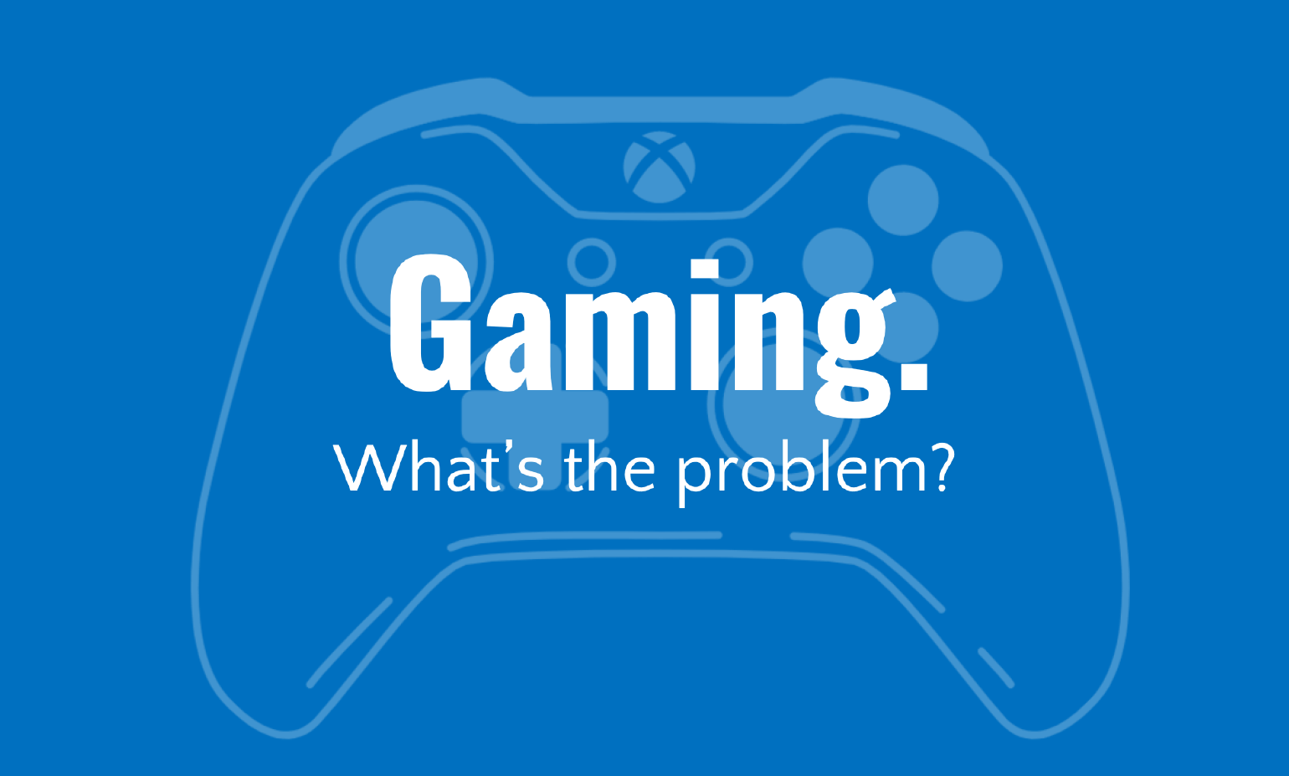

Slide 22
Notes:
What does esports stand for? Show video for championship highlights. https://www.youtube.com/watch?time_continue=10&v=PswnONyX23I&feature=emb_logo
Discuss with learners how they appeal to the audience. Appeals to non- sporting young people, dressing up as cult players, packed out venues, prize money. Discuss Jaden Ashman, 15 year old who came second at 2019 Fortnite Championships and won a million pounds with Dutch partner.

Slide 23
Notes:
Scholarships are offered for potential players.

Slide 25
Notes:
Bigger than Golf masters, Basketball championships and Tour de France

Slide 26
Notes:
There were plans just before the Olympics in Japan for an esports tournament to be held. YGAM aren’t anti gaming. Being an online gamer takes skill, time and patience. It is important to have meaningful conversations and be able to spots signs when it becomes harmful.

Slide 28
Notes:
Show video of loot box animation. https://www.youtube.com/watch?v=rG88hC0MrtU
Loot boxes are banned in some countries.

Slide 29
Notes:
Symmetra (£15) Messi card (£148.83) Raven’s Bite Axe (£135.97)

Slide 30
Notes:
Story of teenager who wears a nappy whilst gaming so he doesn’t have to stop to go to the toilet.

Slide 32
Notes:
Avoid shock or shame- this can reduce inclination for individuals to seek help or speak out. Set time limits 1-2hrs max a day, turn off an hour before bedtime.

Slide 34
Notes:
Shout- talk via text 85258
Parents.ygam.org

