Slide 1
Teambuilding and Trust

Slide 2
By the end of the session you will:
Be able to give a definition of the word ‘team’ and ‘team building’
Identify the stages of building a successful team (Tuckman)
Look at the different roles people take in a team (Belbin)
Identify why it is useful to have a mixture of personality types in a team (Colour Works Insights Discovery & Behavioural Types)
Take part in a team building activity
Notes:
Talk through these aims and how they will be achieved in this session. Mention to learners that these are ‘theories’, so they are not correct or incorrect…just a theory that has been put forward by the people in brackets.

Slide 3
What is a team?
In pairs, can you please write a short definition of the word ‘team’
Now expand upon this activity and write a sentence to define the term ‘team-building’
Notes:
Countable noun - A team is a group of people who play a particular sport or game together against other similar groups of people. You can refer to any group of people who work together as a team. (Collins Dictionary)
There is no actual definition of team-building in UK dictionaries, but it is generally known as a collective term for various types of activities used to enhance social relations and define roles within teams, often involving collaborative tasks.
So Team building is usually the process of turning a group of individual into a cohesive team; often carried out as activity days in the workplace. The activities are usually planned to encourage creative thinking, trust, reliability, cooperation and collaboration between colleagues.

Slide 4
Let’s have a go!
On the table you will find a page of a story book called ‘Zoom’ by Istvan Banyai.
As a group and working together quietly, please put the story book back together
Notes:
For this activity you will need to purchase the following book: Zoom” by Istvan Banyai and I would suggest that you laminate the pages so it can be used over again. Each learner should have a page of the book and needs to find the neighbouring page.
Please note that there is a new copy called Re-Zoom if you would like to carry out this activity again at a later date with the same group

Slide 5
Stages Team Development (Bruce Tuckman) Intro
https://www.youtube.com/watch?v=Hota_XQ_2zw
Notes:
In 1965, a psychologist named Bruce Tuckman said that teams go through 5 stages of development: forming, storming, norming, performing and adjourning. The stages start from the time that a group first meets until the project ends. Tuckman didn't just have a knack for rhyming.

Slide 6
Stages of Team Development - Activity
Forming
Storming
Norming
Performing
Adjourning (this was added to the model in the 1970s)
Notes:
Split learners in to four groups. Each group will be given a sheet of flipchart paper with the heading Forming, Storming, Norming and Performing.
Using the example of the English Rugby Team (or the Avengers if you wish) the teams should be asked to list the sort of behaviour they may see from teams and also from individuals during this stage of team development.
Encourage use of descriptive language and sentences rather than one word descriptions: e.g. for Forming – 1. the teams will be polite and respectful to one another. 2. the team may try to seek common interests and a purpose
You can either ask the groups to feedback their stage and ask for any comments or additions verbally, or you can circulate the sheets to the next group until they have contributed to all of the stages (allow 2 minutes for each sheet = total 8 minutes with time to feedback)

Slide 7
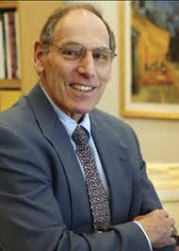
Notes:
Summarise Tuckman’s Model with this slide. Ask learners what the think might happen if people leave the team, or join the team halfway through?

Slide 8
What are the characteristics of an effective team
Think about a team you support or a team you belong to – what characteristics make it a GOOD team?
As a group, let’s see if we can identify the characteristics that make a good team…
Notes:
Whole group activity – writing on whiteboard or similar (you may wish to ask for a volunteer scribe to lead on this activity)
Include:
Successful teamwork is the ability to work together toward a common vision or goal
Open Communication. The greatest enemy of communication is non-communication or misunderstanding
Team Roles
Time Management
Practical Problem Solving
Bonding
Respect
Openness
Uses individual strengths
Trust

Slide 9
Belbin’s Team Roles
Research shows that the most successful teams are made up of a diverse mix of people and behaviours.
Dr Meredith Belbin and his team discovered that there are nine clusters of behaviour that they called the ' Belbin Team Roles’
These are broken down into three sections: Thinking roles, Action roles and People roles
https://www.youtube.com/watch?v=hMesDq_rNOw

Slide 10
Notes:
This is an optional activity – print out the handout and divide the header with the explanation. Ask learner (as groups) to try and match the description to the personality type.

Slide 11
What do you see?
Notes:
Perception test
On a piece of paper, ask learners to write down what they see in this picture.
Ask who can see an old lady in a fur coat and headscarf
Ask who can see a young lady with a choker and a feather in her hat
Remind learners that we are all different and therefore we see thigs from different perspectives; but that is what makes a rich mix of personalities with different ideas when we are working with others in a team.
Tell learners that we are now going to look at another model. Next slide

Slide 12
Insights Discovery Colour Model
The origins of personality theory can be traced back to the 5th century BC when Hippocrates identified 4 distinct behaviour energies
The Insights Discovery Model is built around the theory of personality of the swiss psychologist Carl Gutav Jung (1921)
Let’s carry out another activity – see next slide
Notes:
Let learners know that this model is one that is used at HCC and we will only be getting an overview, so it won’t be a full analysis of their personality type – but it might give them some insight into the differences between the group members/class.

Slide 13
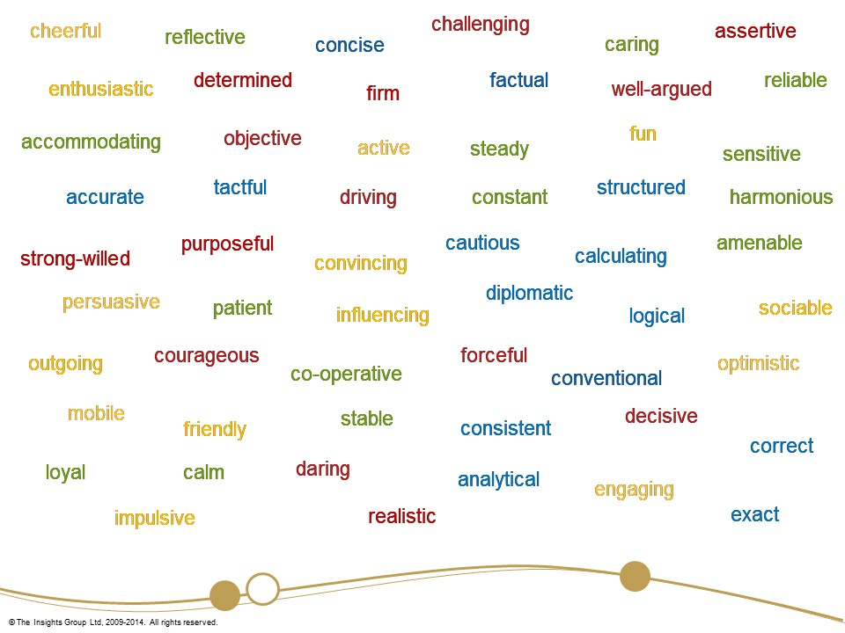
Notes:
Give out a colour printout of this slide to each learner. Give them a short time (2 minutes for instance) to circle all of the words they feel describes them on a GOOD day. No talking or collaboration is permitted, this is all of their own ideas.
Note that they may not understand all of the words, so choose the ones they do understand or be ready with a thesaurus if you wish to give a similar term.
Embedded maths - When the time is up ask learners to count up how may reds, how many blues, how many greens and how many yellows they have. Ask all the people to stand in the four corners of the classroom in a group with their most frequent colour group. So all the FIERY REDS should now be stood together in a group.
The other groups will be called the COOL BLUES, SUNSHINE YELLOWS and the EARTH GREENS
Remind the group that just because they are stood with the people who are in their predominant colour group, they will all be different and work in a team very differently.
Once all of the learners have had a chance to meet their similar personality types, ask them to return to their seats as we are going to break this down further. Next slide

Slide 14
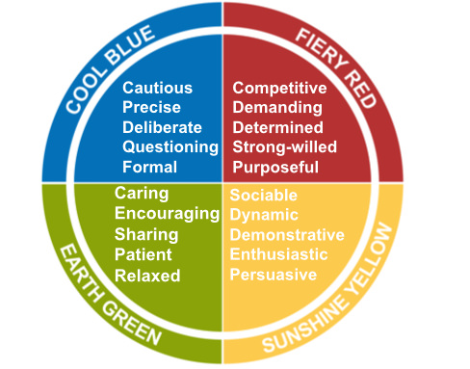
Insights™ Discovery Personal Profile
Notes:
Print out a copy of this slide for each learner (you may wish to laminate it so you can reuse the resource over again).
Cut the circle into four segments and ask the learners to use their read the description and pick out the one that describes them the best (this should be the colour identified in the previous activity e.g. red) .
Give out the handout that goes with this activity.
Now ask the learners to order the remaining segments into second, third and last place (i.e. the one that describes them the least) and fill in the front of the sheet.
Once this has done ask the learners to tell you what order they have put themselves and look on the second page to find their ‘type’

Slide 15
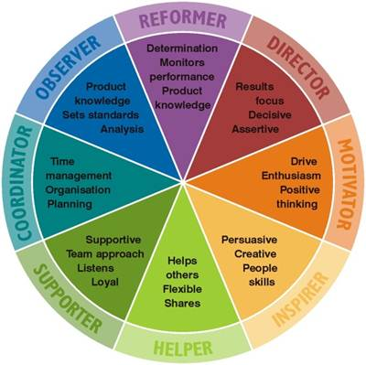
Notes:
Use this opportunity for a discussion – any surprises?
Colour Order
Red First Yellow First Green First Blue First
RGBY – Reformer (creative) YBRG – Motivator (creative) GRYB – Helper (creative) BYGR – coordinator (creative)
RBGY – Reformer YRBG – Motivator GYRB – Helper BGYR - coordinator
RYBG – Director YRGB – Inspirer GYBR – Supporter BRGY - Observer
RBYG – Director YGBR – Inspirer GBYR – Supporter BGRY - Observer
RYGB – Motivator YGBR – Helper GBRY – Coordinator BRYG - Reformer
RGYB – Motivator (creative) YBGR – Helper (creative) GRBY – Coordinator (creative)BYRG – Reformer (creative)

Slide 16
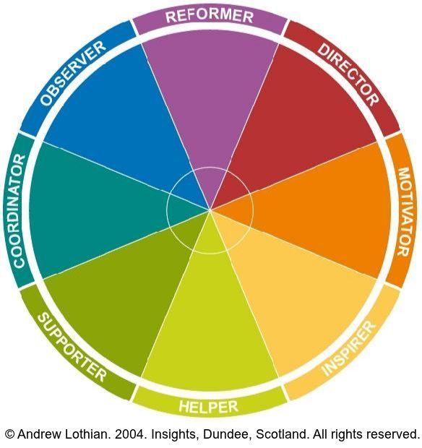
We all know that great teams trust, appreciate and support each other.
Embracing diversity, they work together towards a common goal.
However, knowing this does not make it easy to put it into practice (especially when the team first meets!) To truly becomes a great team we need to invest in relationships and understand, value and respect our difference.
Notes:
Tutor now asks the learners which category they fit into and this can be written into a blank wheel above (copy this onto a whiteboard or flip chart)
This exercise is about celebrating diversity and appreciating that everyone has a role to play in the team and all of these roles have equal importance.
Ask learners what they think the key message this exercise was trying to get across?

Slide 17
Notes:
You could have all of the most talented, incredible people in the world in your team – but it’s the contribution of each person to a shared goal and purpose and willing to sacrifice their own glory for the success of the entire team
Learners to think of a time they have been in a successful team – what was it that made them realise it was a SUCCESSFUL team?
What made it a good team to be in?
Use this opportunity to get some ideas about what a good team looks like, operates like and what is the measure of success before moving onto the summary slide

Slide 18
Summary
Here are a few qualities that successful teams possess:
They communicate effectively with each other
They focus upon working collectively towards a common goal or result and demonstrate resilience when things don’t go to plan
Everyone contributes their fair share – a collective, rather than an individual culture of blame e.g. one person messes up, we all mess up!
They offer each other support and encouragement
Team members are diverse and individuals are encouraged to use their strengths and talents and contribute creative and innovative ideas
There is good leadership with clear goals, targets and roles for everyone
They're organised & keep to timescales
They have fun!
Notes:
Read through, or ask learners to take turns to read each sentence to summarise learning and key points of the session
Remind learners that team work without the ‘team’ is simply ‘work’ …and that’s not half as much fun!

Slide 19
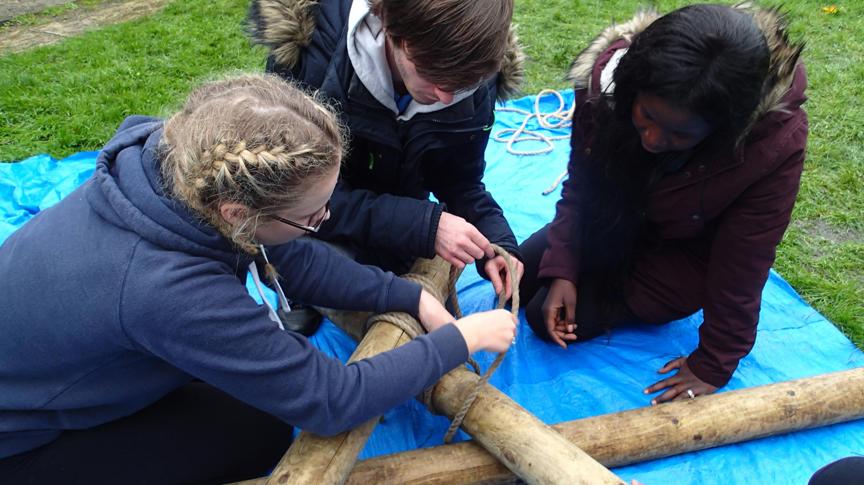
Any questions?

