Slide 1
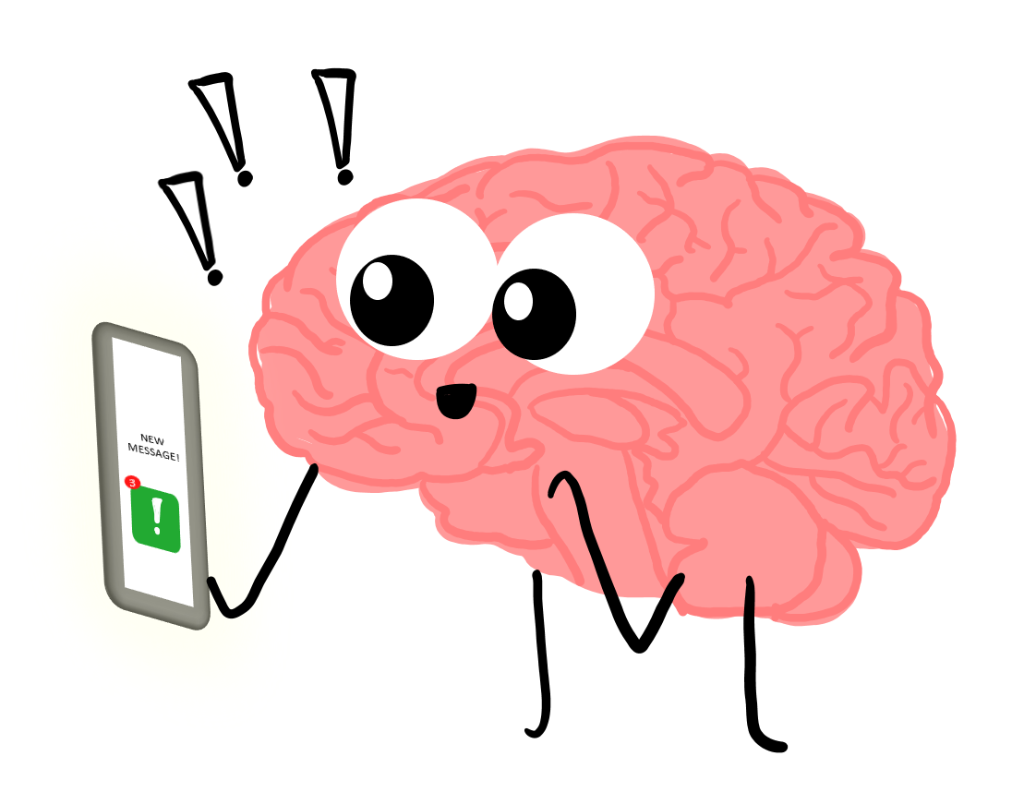
The Science of Stress

Slide 2
What are we hoping to cover in this tutorial?
Find out the definition of stress
Identify what happens to your body when you feel stressed/anxious
Discover why this happens
Identify at least four ways to help reduce anxiety and stress
Notes:
Is this what you are hoping to learn today?

Slide 3
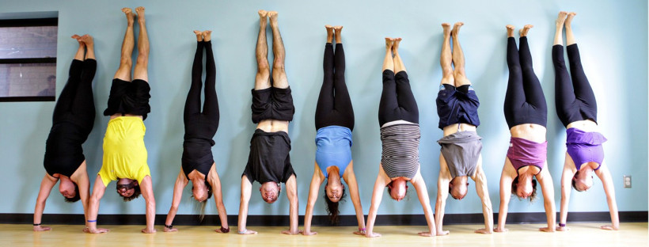
Warm-up exercise
Notes:
Hand around a roll of toilet roll and ask learners to pull off pieces of toilet roll (but don’t tell them why!)
When all learners have at least one piece of toilet, ask them to name one thing that causes them stress/anxiety for each piece of toilet roll they have removed.

Slide 4
What is stress?
In just one or two sentences – can you explain the word ‘stress’ to an alien visiting from another planet in the solar system

Slide 5
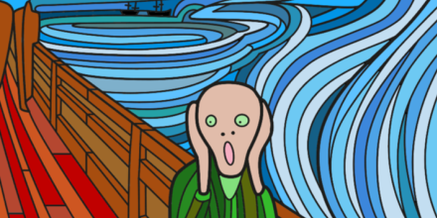
What is stress?
Cambridge Dictionary (online version) Noun:
“Great worry caused by a difficult situation, or something that causes this condition”
Louise is under a lot of stress right now.
It’s hard to cope with the stresses of raising a family.

Slide 6
What happens to your body when you get stressed?
In small groups draw a LARGE outline of a person on your sheet of paper.
Using your creative skills, draw or write as many affects of stress and anxiety on your picture.
Notes:
Encourage learners to look at all aspects of reaction to stress so tutor to facilitate ideas:
Needing to go to the toilet, flushed appearance, shaking, crying, tense muscles (clenched fists, hunched shoulders), unable to sleep/tired all the time, brain fog, rapid heartbeat, butterflies in the stomach, feeling sick, indigestion/heartburn, tension headache, fidgety, hyperventilating or shallow breathing, impotence, grinding teeth, fainting, panic attack

Slide 7
What are the signs of stress?
We all experience stress differently in different situations. Sometimes you might be able to tell right away when you're feeling under stress, but other times you might keep going without recognising the signs.
Stress can affect you both emotionally and physically, and it can affect the way you behave
"My head is tight and all my thoughts are whizzing round in different directions and I can't catch them."
"[It feels like] the world is closing in on me, I can't breathe and I'm running out of time."
Notes:
How you might be physically affected
shallow breathing or hyperventilating
you might have a panic attack
muscle tension
blurred eyesight or sore eyes
problems getting to sleep, staying asleep or having nightmares
sexual problems, such as losing interest in sex or being unable to enjoy sex
tired all the time
grinding your teeth or clenching your jaw
headaches
chest pains
high blood pressure
indigestion or heartburn
constipation or diarrhoea
feeling sick, dizzy or fainting.
How you might feel
irritable, aggressive, impatient or wound up
over-burdened
anxious, nervous or afraid
like your thoughts are racing and you can't switch off
unable to enjoy yourself
depressed
uninterested in life
like you've lost your sense of humour
a sense of dread
worried about your health
neglected or lonely.
How you might behave
finding it hard to make decisions
constantly worrying
avoiding situations that are troubling you
snapping at people
biting your nails
picking at your skin
unable to concentrate
eating too much or too little
smoking or drinking alcohol more than usual
restless, like you can't sit still
being tearful or crying.

Slide 8
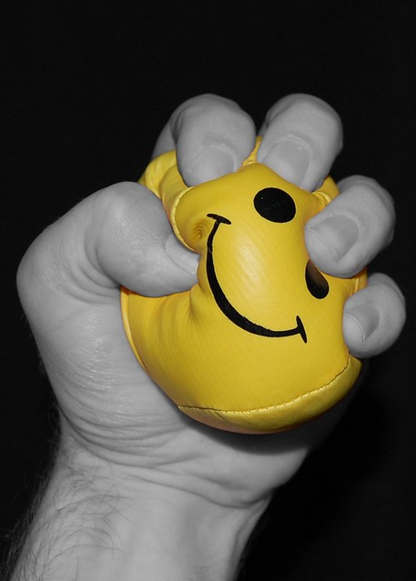
Stress
Some people do not realise that the brain interprets threat (like being chased by a bear) and stress in the same way.
This means that when you are stressed your brain prepares a ‘flight or flight’ response.
Stress also makes your brain freeze at the worst time, such as during a job interview!
Chronic Stress can cause many changes in the body can lead to depression, high blood pressure, strokes, heart attack and early death.
Notes:
Let’s find out why this happens

Slide 9
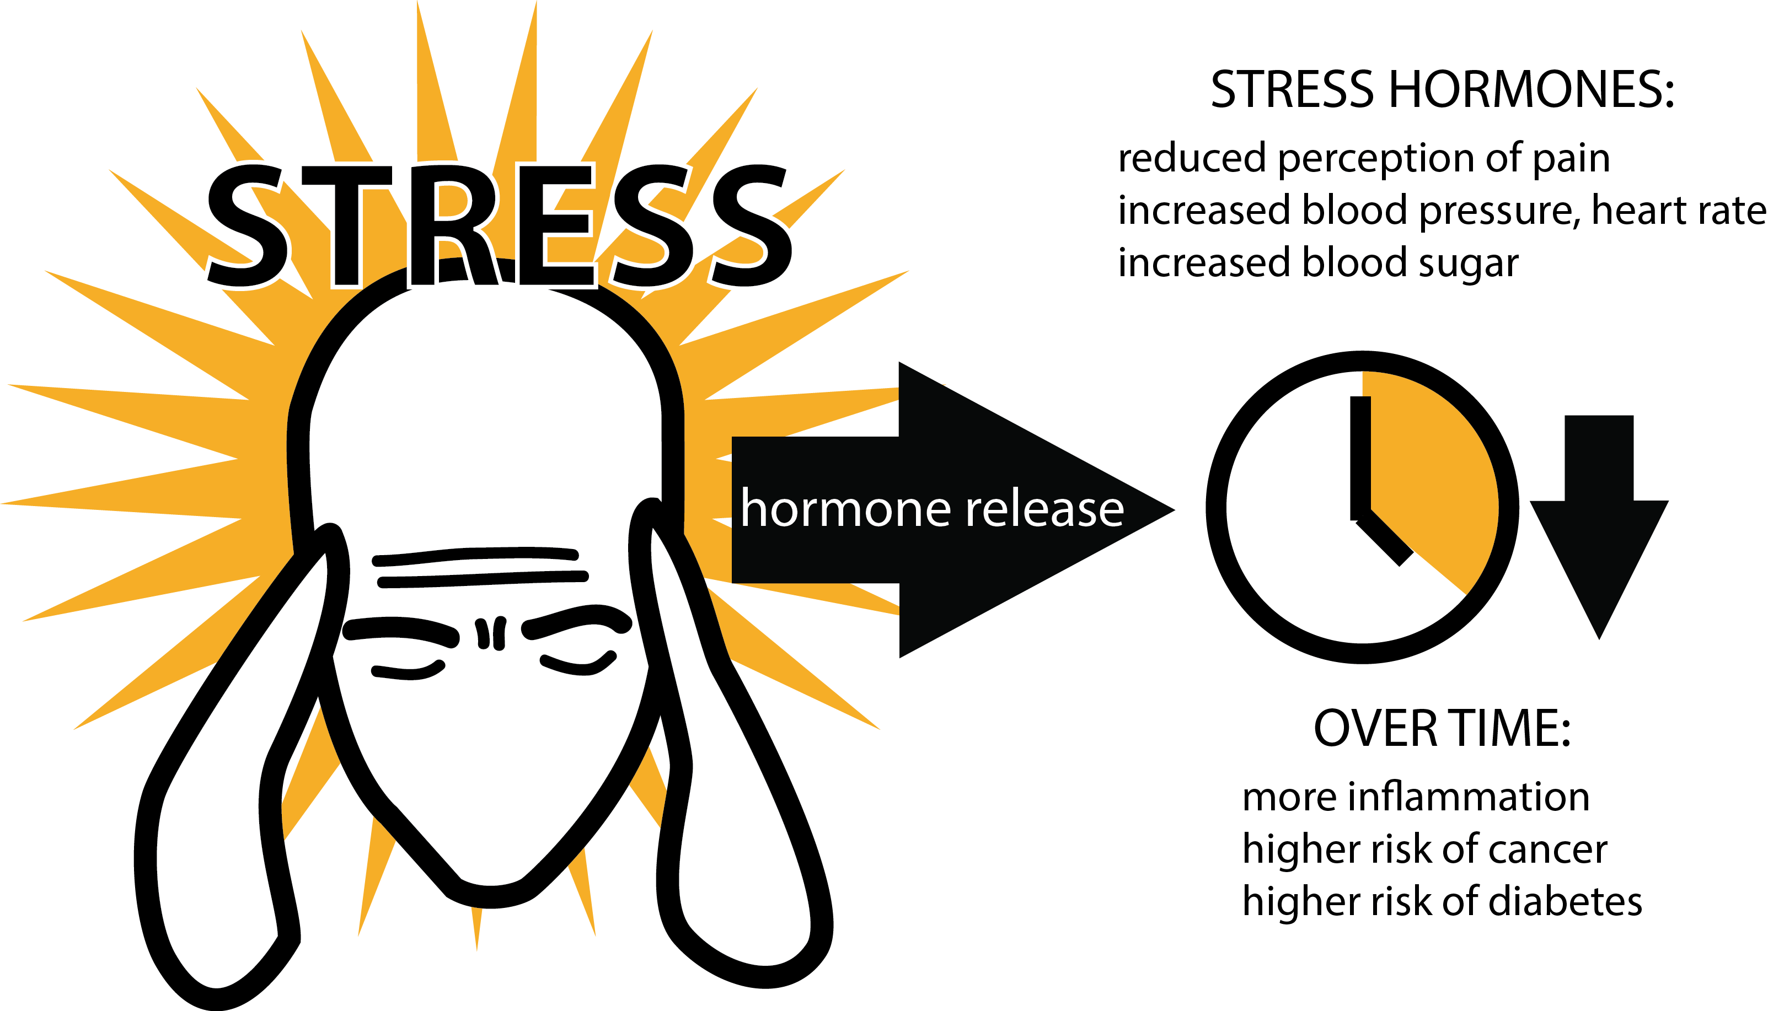
The affects of chronic stress
https://www.youtube.com/watch?v=v-t1Z5-oPtU
Notes:
Watch video (TED)

Slide 10
So what can we do to reduce the pressure?
There are various steps you can take to cope with being under pressure. The next few slides offer tips that people have told Mind UK they find useful, but it’s important to remember that different things work for different people. Only try what you feel comfortable with.
Here are some suggestions:
Identify your triggers
Organise your time
Address some of the causes
Accept the things you can't change
Notes:
Suggestions from Mind.Uk

Slide 11
What are your triggers?
Activity: Write down on the worksheet all of the things you can think of that make you stressed in everyday life.
For example: I get stressed when my bus is late, when I get a nasty comment on my Instagram photo etc.
Now divide this list into things you have NO control over…
and the things you DO have some control over
Notes:
Suggest that learner use different coloured highlighter pens to divide up their list

Slide 12
Working out what triggers stress for you can help you anticipate problems and think of ways to solve them. Even if you can't avoid these situations, being prepared can help. Consider:
Issues that come up regularly - and that you worry about, for example paying a bill or attending an appointment
One-off events - that are on your mind a lot, such as moving house or taking an exam
Ongoing stressful events - like being a carer or having learning difficulties
You might be surprised to find out just how much you're coping with at once. Remember that not having enough work, activities or change in your life can be just as stressful a situation as having too much to do!

Slide 13
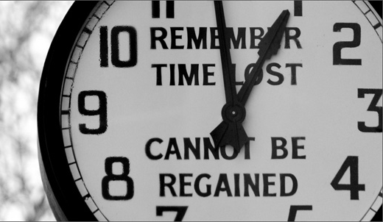
Organise your time
Group Activity:
How many times in a day do you find yourself wasting time?
Let’s try to identify the Top 10 time-wasting activities
This Photo by Unknown Author is licensed under CC BY-SA-NC
Notes:
According to Life Hacks these are the top 20 time-wasters:
Facebook — I don’t think I really need to explain this to any of you. If you’re reading Lifehack, you’re savvy enough to know that Facebook (and other social media) can be a huge black hole for time.
Photo taking, organizing, uploading, and posting — While we all love to share our best moments with our friends, if you start doing this a lot, it can be a huge time waster. Every photo needs to be uploaded, captioned, and share. Unless you are a professional photographer, limit the time you spend on photos.
Momento-gathering — This is an extension of the last item. You can waste a lot of time collecting and organizing momentos. Extra-special pieces are great, but just trash the boring stuff. Momentos can be electronic too, and if they need organizing, they take up your time.
Personal Grooming — Personal hygiene is essential but if you spend more than 5 minutes on your hair, you might think about how to reduce that time.
Exercise — Exercise itself is very important, but you don’t need to spend a lot of time on it. Go for an intense workout in 20-30 minutes, rather than a 2-hour affair. Which brings me to…
Affairs — If you want to keep more than one relationship on the go, well, all I can say is good luck with that! It’s not going to be easy and it’s going to take a lot of time.
Playing Games — It was Plants vs. Zombies for a while. Then Angry Birds… What games do you like to play? While a little bit of gaming is great recreation, just be aware of the time you spend. You might even want to literally log the time and see how much it adds up over a week. Decide how many hours you are willing to waste on your game(s) of choice and then limit yourself. Willpower required.
TV — This is, in my opinion, the worst culprit of all. 99% of the time, it’s not useful, helpful or recreational in the true meaning of the word. Lots of shows try to sell themselves as being informative or educational, but they aren’t. For example, how much do you really need to know about ancient battles? TV is an horrendous time waster. Don’t be one of those people who lose 20+ hours a week in front of the flatscreen!
Watching movies — This is a small step up from TV — at least you aren’t being bombarded with commercials. But one 90-minute movie a day adds up to 10.5 hours per week, and that’s a lot of time lost. Why not make watching a movie a special treat?
YouTube (or other online streaming video) — Need I say more? Either limit your raw time spent or limit the number of “related videos” you let yourself watch. Or go cold-turkey. YouTube is a cruel master!
Going for a Coffee — While you may love that espresso every day, how much time does it take to drive to the coffee shop, stand in line or wait in the drive thru, pay and then drive to wherever you were really going? You could save some time by getting really great beans and making your own at home or the office.
Being Sick — It is a better investment in your time to eat healthy and keep your immune system strong than lose time being sick. If you are sick, focus on getting well than just “biding the time” watching TV or complaining to anyone and everyone on Facebook!
Reading junky books — I hesitate to say this, but reading can be a time-waster. Think about what you’re reading and why. But please, still encourage young people to read anything and everything, just to improve their reading skills.
Commuting — Add up the time spent going to/from work every day and see if there is a way to reduce it. Carpool if you can — you can use the time spent riding to do things on the way. Or, see if your employer would agree to let you work one day a week from home, or work 35 hours in 4 days instead of 5. There are many options if your commute is a killer.
Shopping — We all need groceries, but do you need to drive across town to that bulk store and spend four hours on a Saturday filling a gigantic cart? Have you done the math to see how much money you are actually saving? Might your time be worth something? How about unnecessary clothes, gadget or phone shopping? Can you save some time going to a closer store rather than driving across town? This is especially important if you get into a habit of driving extra — time lost multiplies when you do something daily or weekly.
Online Shopping — This is a variation of the above point, but it bears mentioning separately. So you need to order this-or-that specific product online. Time yourself. Give it 5 minutes — get it done. Don’t be distracted by other products, or “other customers also bought” items. Don’t do any extreme product comparison or research (unless it’s something you’ve never bought before and you really need to). Shopping for apps can be a time-eater, too.
Accounting — Depending on your situation, your system and your accounting skill, it might be a major time saver to just pay someone to do it for you. Or, you might be able to streamline your system to do a little at a time rather than losing huge chunks of time in tax season.
Organizing/Moving files on your computer — Try to put things where they belong the first time, so that you don’t have to go searching for them later or spend time organizing them. On the other hand, maybe you lose time just “fiddling” with things on your computer — looking through your downloads folder or mucking around with folder hierarchies.
Cleaning House — Depending on your situation, it might be a good use of time to hire a maid to come in and keep your place clean. Think about time spent, check on the costs of a maid, and do the math. Before you buy a big house, consider the time it will take to clean it!
Obsessions — Whether it’s reading conspiracy theory websites or tracking down your 16th generation genealogy, our hobbies can become obsessions if we do them uncontrollably. Make sure that anything you spend a lot of time on hasn’t become an unbalanced fascination and if it has, try and cut the strings. Get help if you need to.

Slide 14
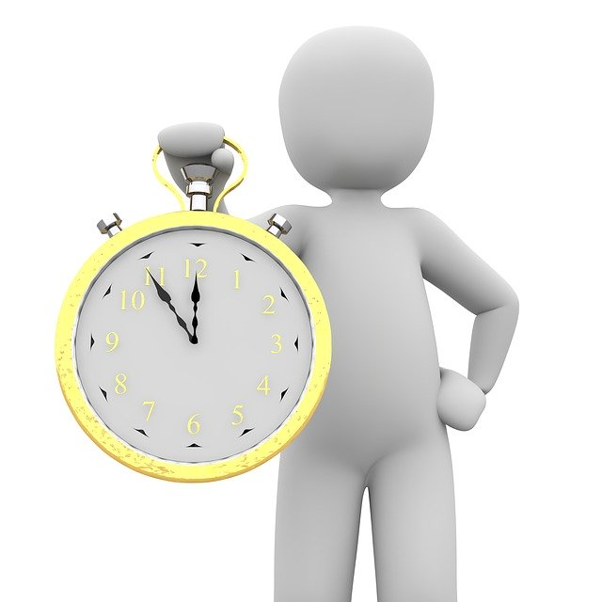
Making some adjustments to the way you organise your time could help you feel more in control of any tasks you're facing, and more able to handle pressure. Consider:
Identify your best time of day – are you an early bird or night owl?
Set smaller and more achievable targets (SMART)
Vary your activities
Try not to do too much at once
Take regular breaks and take things slowly
Ask someone if they can help
Notes:
Making some adjustments to the way you organise your time could help you feel more in control of any tasks you're facing, and more able to handle pressure.
Identify your best time of day, and do the important tasks that need the most energy and concentration at that time. For example, you might be a morning person or an evening person.
Make a list of things you have to do. Arrange them in order of importance, and try to focus on the most urgent first. Some people find creating a timetable useful so they can plan when they can spend time on each task. If your tasks are work related, ask a manager or colleague to help you prioritise. You may be able to push back some tasks until you're feeling less stressed.
Set smaller and more achievable targets. When you’re under a lot of pressure it’s easy to set yourself large targets that are often unachievable. This can make you feel more stressed and if you don’t reach them, it can make you feel disappointed and frustrated. Setting smaller more achievable goals can make you feel in more control and you can see your achievements more easily.
Vary your activities. Balance interesting tasks with more mundane ones, and stressful tasks with those you find easier or can do more calmly.
Try not to do too much at once. If you take on too much, you might find it harder to do any individual task well. This can make you feel like you have even more pressure on you.
Take breaks and take things slowly. It might be difficult to do this when you're stressed, but it can make you more productive.
Ask someone if they can help. For example, you could ask a friend or family member to help with some of your daily tasks so that you have more time to spend completing your tasks that are causing you to feel stressed.

Slide 15
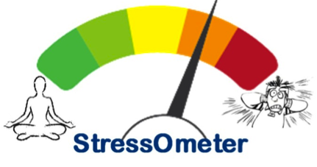
Address the causes of stress
Although there will probably lots of things in your life that you can't do anything about, there might still be some practical ways you could to resolve or improve some of the issues that are putting pressure on you.
You might find it useful to ask for help or find more information about how to deal with common causes of stress (such as money worries, relationship issues etc.)

Slide 16
Accept the things you cannot change
It's not easy, but accepting that there are some things happening to you that you probably can't do anything about will help you focus your time and energy more productively.
"Sometimes I take a minute to 'reply' to my stressy thoughts... it's hard to be stressed when you've got things in perspective! Most of the things I worry about are either things I can't change or things which aren't earth-shatteringly important."

Slide 17
What treatments are there?
Stress isn't a medical diagnosis, so there's no specific treatment for it. However, if you're finding it very hard to cope with things going on in your life and are experiencing lots of signs of stress, there are treatments available that could help. These include:
Talking treatments – talking to friends & family, CBT, MBSR
Ecotherapy – spending time in nature
Complementary and alternative therapies - mindfulness, yoga acupuncture, massage, aromatherapy
Medication - to access treatments, please talk to your GP first
Notes:
OPTIONAL SLIDE – tutors may want to remove this
Talking treatments
Talking with a trained professional can help you learn to deal with stress and become more aware of your own thoughts and feelings. Common types of talking treatments which can help with stress are:
Cognitive behavioural therapy (CBT), which helps you understand your thought patterns, recognise your trigger points and identify positive actions you can take.
Mindfulness based stress reduction (MBSR), which combines mindfulness, meditation and yoga with a particular focus on reducing stress. You can find out more from Be Mindful’s website.
Medication
Feelings of stress are a reaction to things happening in your life, not a mental health problem, so there's no specific medication for stress. However, there are various medications available which can help to reduce or manage some of the signs of stress.
For example, your doctor might offer to prescribe:
sleeping pills or minor tranquillisers if you're having trouble sleeping
antidepressants if you're experiencing depression or anxiety
medication to treat any physical symptoms of stress, such as irritable bowel syndrome (IBS), or high blood pressure.
Before deciding to take any drug, it's important to make sure you have all the facts you need to make an informed choice. See our pages on things to consider before taking medication and your right to refuse medication for more information. Our pages on coming off medication give guidance on how to come off medication safely.
Ecotherapy
Ecotherapy is a way of improving your wellbeing and self-esteem by spending time in nature. This can include physical exercise in green spaces or taking part in a gardening or conservation project.
(You can find out more about ecotherapy, including details of local programmes, in our pages on ecotherapy.)
"[It helps me to] spend time outdoors or doing crafts."
Complementary therapies
You may find certain complementary therapies help you manage feelings of stress. These might include:
yoga and meditation
acupuncture
aromatherapy
massage.
(See our pages on complementary and alternative therapies for more information.)
< Developing resilience

Slide 18
Summary:
Stress has short-term and long-term affects on both your physical and mental wellbeing
Look for personal triggers when you are entering red hot head mode; these will differ from person to person
Aim to maintain a blue calm head at all times – take deep breaths and simply let your thoughts come and go without dwelling on them, or letting them take over. Aim to live in the moment
Try to manage your time effectively so you don’t become overwhelmed
Be kind on yourself – try to turn off your ‘negative inner voice’
Be prepared to let things go – don’t sweat over the small stuff
You cannot change certain factors such as someone being rude or unkind … but you CAN choose how to respond.
Go outside into the natural world as often as possible – schedule it into your day
A good night’s sleep will help you prepare for stress and difficulties you encounter during your day

Slide 19
Any Questions?

Slide 20
Review of Learning Outcomes – have we?
Found a definition of stress?
Identified what happens to your body when you feel stressed/anxious?
Discovered why this happens?
Identified four ways to help reduce anxiety and stress?

