Slide 2
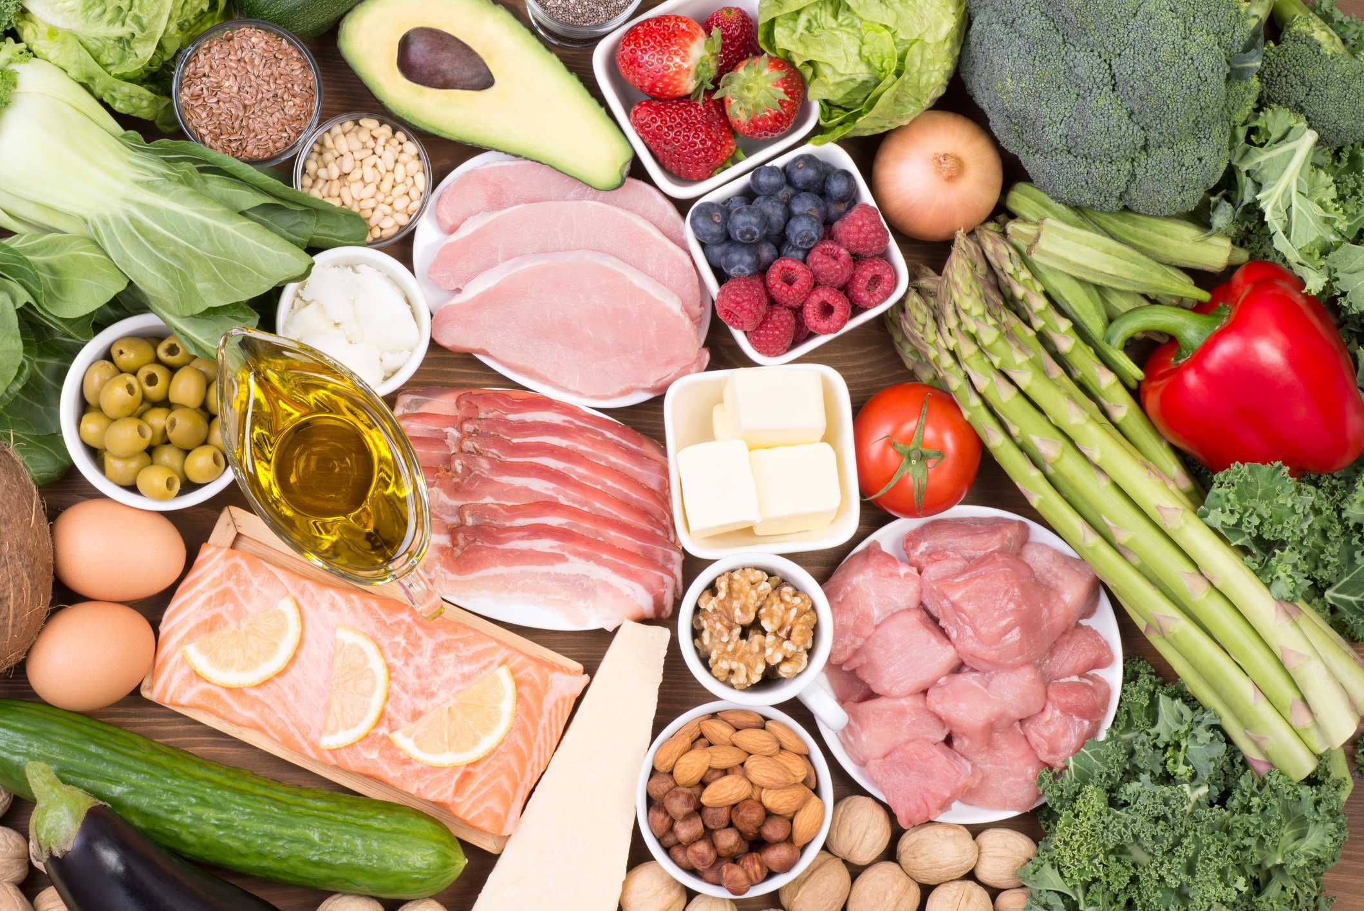
Nutrition

Slide 3
Aim (what I am going to do)
To understand the importance of good nutrition and its effects on your wellbeing.

Slide 4
Nutrition
What barriers do people face that will effect what they are eating?
What does nutrition mean?
Discussion Points
Have there been any trends in recent years to do with nutrition/food? Discuss whether these trends good.
What initiatives are out there to support people with nutrition/food choices? Are they all good?

Slide 5
Nutrition
Draw a person and jot down meals around the body. Break these food items/meals into two categories:
Meals that are nutritious
Meals that are not nutritious
Look at the meals you have come up with. How do they make you feel? Think both short term and long term.

Slide 6
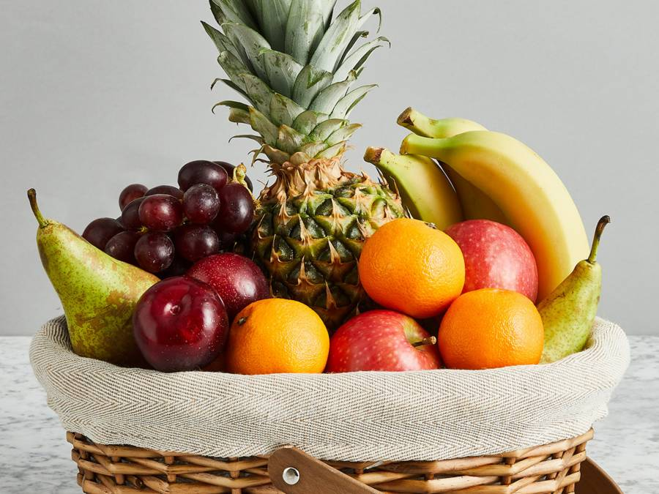
Nutrition
Using the same person, jot down all of the benefits of having meals that are nutritious.
Think about how it makes you feel, how it effects your body and any other benefit you can think of.

Slide 7
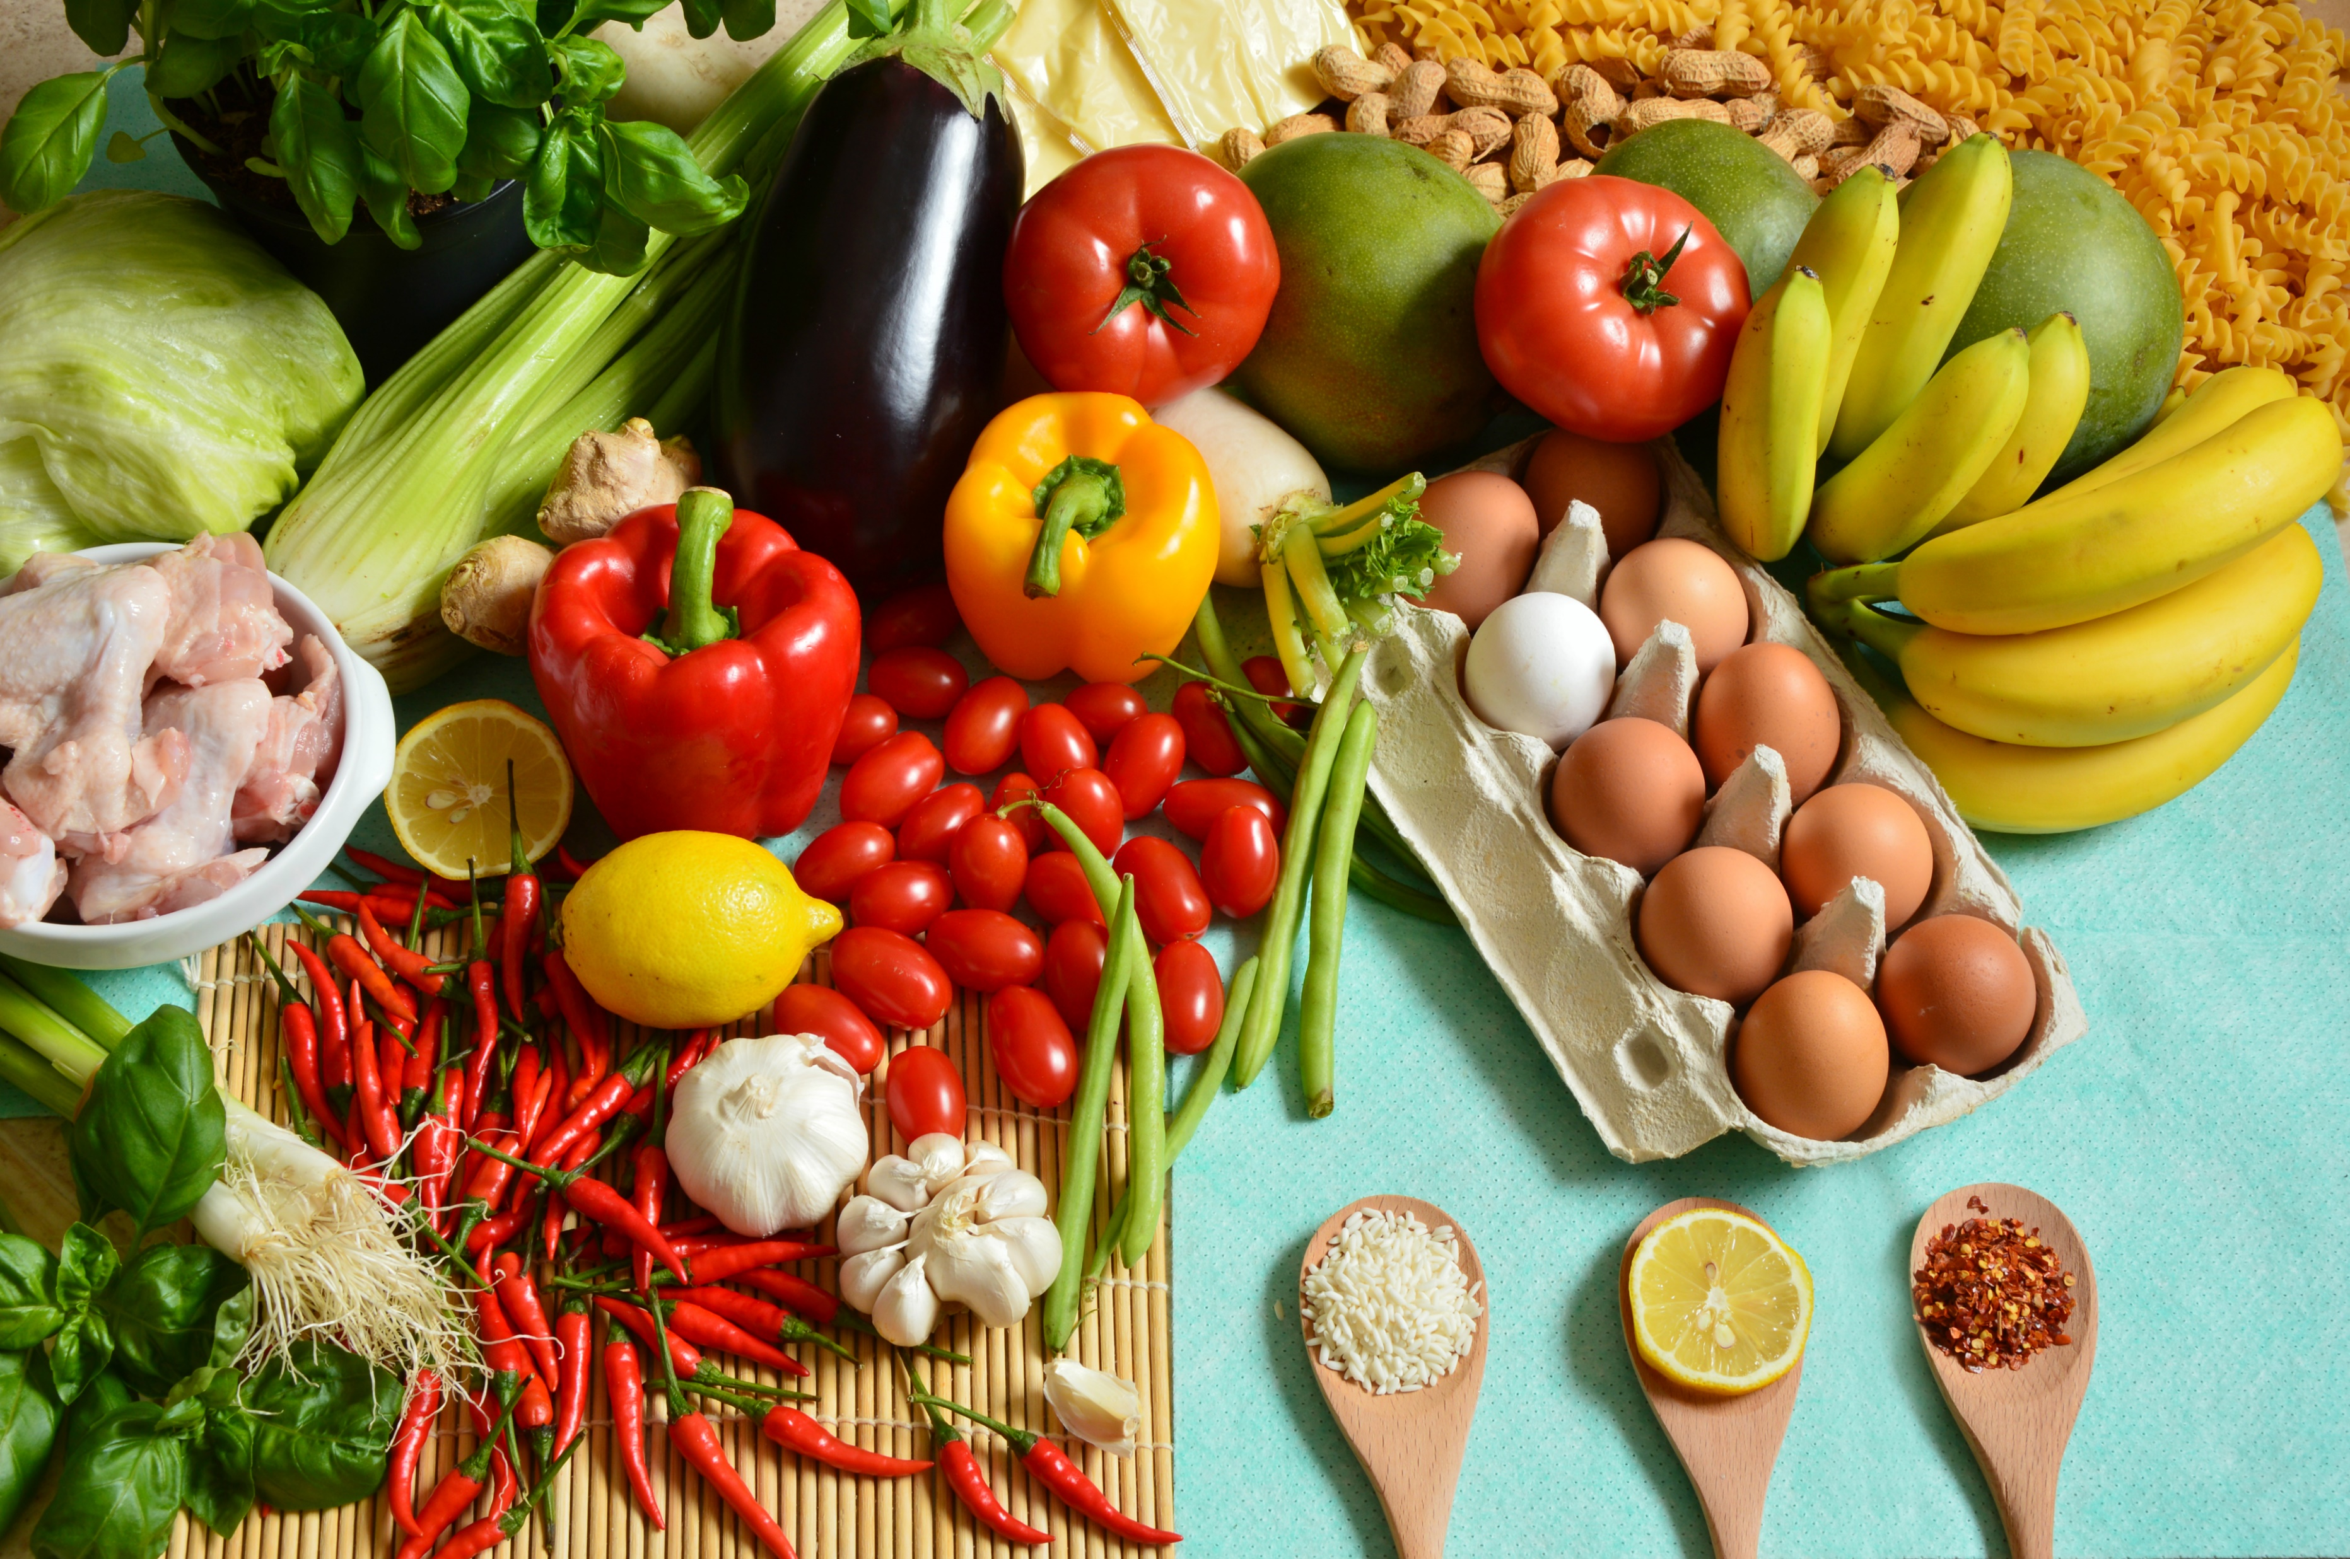
Nutrition
How can food affect mood?
Knowing what foods we should and shouldn’t be eating can be really confusing, especially when it feels like the advice changes regularly. However, evidence suggests that as well as affecting our physical health, what we eat may also affect the way we feel.
Improving your diet may help to:
improve your mood
give you more energy
help you think more clearly
Click me

Slide 8
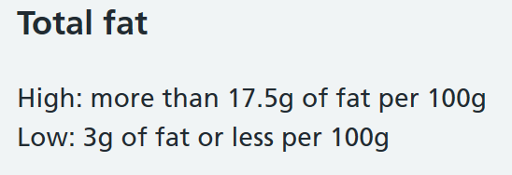
Understanding food labels
Food labels can be confusing and occasionally misleading. Here is some information to help you know if a food is high in fat, saturated fat, sugar or salt.
Click me

Slide 9
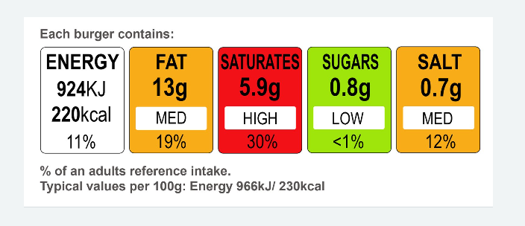
Understanding food labels
Most food label are displayed with a panel; these offer good advice as to whether the food choice is a healthy option or not.
Click me
What can you tell me about this food item?

Slide 10
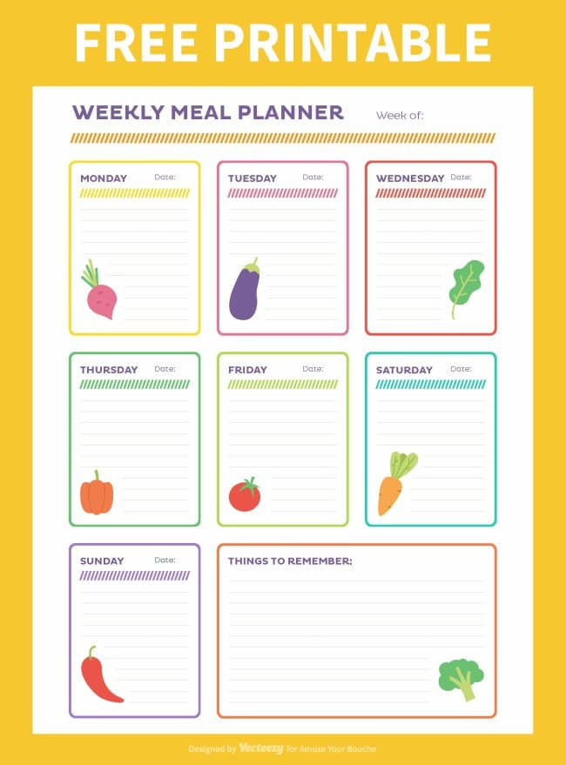
Healthy eating top tips:
Take small steps - Making changes can be really tough – especially if you’re feeling low. It might help to start by making small changes rather than changing your whole diet suddenly.
Plan ahead - Finding the time to eat well can often be really difficult. If you have times when you’re feeling well and enjoying preparing food, try making some extra meals to store.
Share meals and cooking - Preparing your own food might feel daunting but cooking with others can be a lot of fun.
Keep a food diary - Write down what you eat and make notes about how you’re feeling. Over time you might work out how particular foods:
make you feel worse, or better
keep you awake or help you
sleep

Slide 11
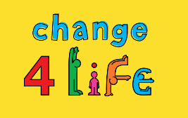
Challenge
Your challenge is to plan 5 days of meals that are nutritious. Remember this is NOT about going on a diet. This is about making good lifestyle choices. To help you, here are a list of useful websites and apps you may want to use:
https://www.nhs.uk/change4life (app available)
https://www.heartuk.org.uk/tasty-recipes/all-recipes
https://realfood.tesco.com/recipes/collections/healthy-dinner-ideas.html
Click me
Calculate how much it would cost to create one of the meals you have chosen.

Slide 12
Money saving tips
Does it have to be the branded option? We all have our favourite brands, but think about where you can choose an alternative.
If you eat a lot of chicken, think about buying a whole chicken and spreading it across more than one meal. It is far better value for money to by the whole bird.
Buy whole, fresh vegetables and fruits. You will find that you pay a premium if you by vegetables that have already been diced and prepared for you.
Be smart with your food wastage. Does it HAVE to go in the bin? Or could it be chopped and placed in the freezer?
Click me
Share any other tips that you have.

Slide 13
Further resources and learning
This website has lots of useful information about nutrition, and goes into more detail about the types of food we should be eating. It also features the food balance plate!
https://www.nutrition.org.uk/
This website is very useful and packed full of easy and tasty recipes. The app is free and extremely easy to use!
https://www.nhs.uk/change4life
If you are looking for a book, be careful! There are quite literally millions out there. Go into the book store to flick through the page and recipes, that way you wont waste your money.

