Slide 2
Fitness & Wellbeing

Slide 3
Aim (what I am going to do)
To understand the importance of fitness and its effects on your wellbeing.

Slide 4
Fitness
What barriers do people face that will effect how much exercise they get?
How much exercise do we need a day?
Discussion Points
Do you think you get enough exercise? If no, why not?
What initiatives are out there to support people with getting active?

Slide 5
Fitness
Thinking back over the last week, put together a diary log of all the times you think you have done anything that would be classed as exercise:
Monday:
Tuesday:
Thursday:
If you can’t think of anything, don’t worry. We will come back to this again later and you may be able to add more then.

Slide 6
Fitness
Draw a person and jot down ways we can get exercise around the body. It can be sporting activities, classes, things we can do at home, anything!

Slide 7
Fitness – Physical activity
What is physical activity?
Being physically active means sitting down less and moving our bodies more. Many people find that physical activity helps them maintain positive mental health, either on its own, or in combination with other treatments.
Is there anything you have missed on your drawing task? Go back and add it on.
Click me

Slide 8
Fitness – Physical activity
How can physical activity help mental health?
Better sleep – by making you feel more tired at the end of the day
Happier moods – physical activity releases feel-good hormones that make you feel better in yourself and give you more energy
Managing stress, anxiety or intrusive and racing thoughts – doing something physical releases cortisol which helps us manage stress. Being physically active also gives your brain something to focus on and can be a positive coping strategy for difficult times
Fact: When you exercise, your body releases chemicals called endorphins. These endorphins interact with the receptors in your brain that reduce your perception of pain. Endorphins also trigger a positive feeling in the body, similar to that of morphine.

Slide 9
Fitness – Physical activity
How can physical activity help mental health?
Better self-esteem – being more active can make you feel better about yourself as you improve and meet your goals
Reducing the risk of depression – studies have shown that doing regular physical activity can reduce the likelihood of experiencing a period of depression
Connecting with people – doing group or team activities can help you meet new and like-minded people, and make new friends.
If you want to start being more physically active but don’t know where to start. Click here.
https://www.mind.org.uk/information-support/tips-for-everyday-living/physical-activity-and-your-mental-health/choosing-an-activity/

Slide 10
Ideas
Stair climbing
Walk everywhere
Changes you can make
Home exercise
Couch to 5k
Click me
Walking football
Fitness classes
Cycle to work

Slide 11
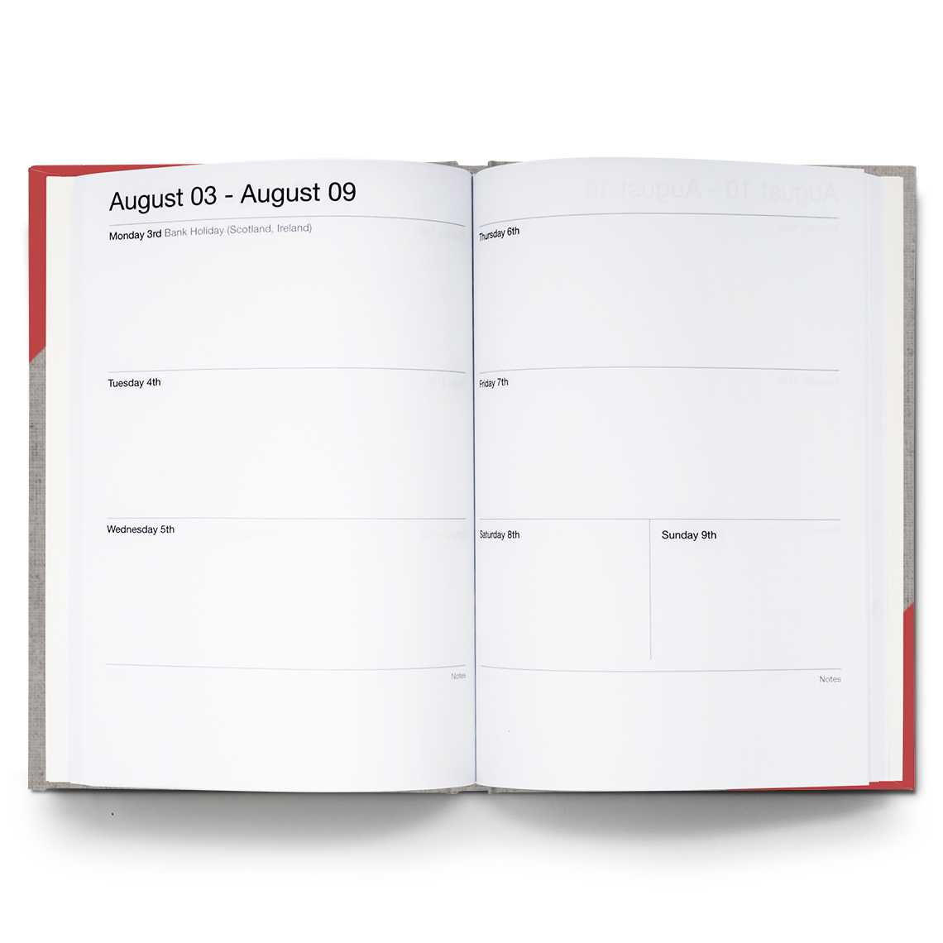
Fitness
Go back and look at your diaries you created, is there more that you can now add on. Sometimes we don’t realise how much we are doing.
Monday:
Tuesday:
Thursday:

Slide 12
Challenge
Your challenge is to plan 3 times in your week where you can squeeze in some extra physical activity. It does not have to be going out for a run, it can be anything that gets you moving more. Some ideas:
Gardening
Going for a walk
Joining a class with a friend
Clearing out the loft
Click me
Calculate many hours/minutes a week you plan to be physically active.

Slide 13
Further resources and learning
This website is mainly for meal ideas, but it does offer good advice and tips on getting children active.
https://www.nhs.uk/change4life/activities
The NHS website is very useful and packed full of easy ideas for getting fit and more active.
https://www.nhs.uk/live-well/exercise/free-fitness-ideas/
For more detail about how being physically active helps our bodies, look into this website.
https://www.heart.org/en/healthy-living/fitness/fitness-basics/why-is-physical-activity-so-important-for-health-and-wellbeing

