Slide 1
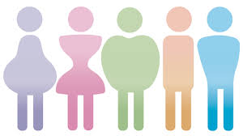
Body Image

Slide 2
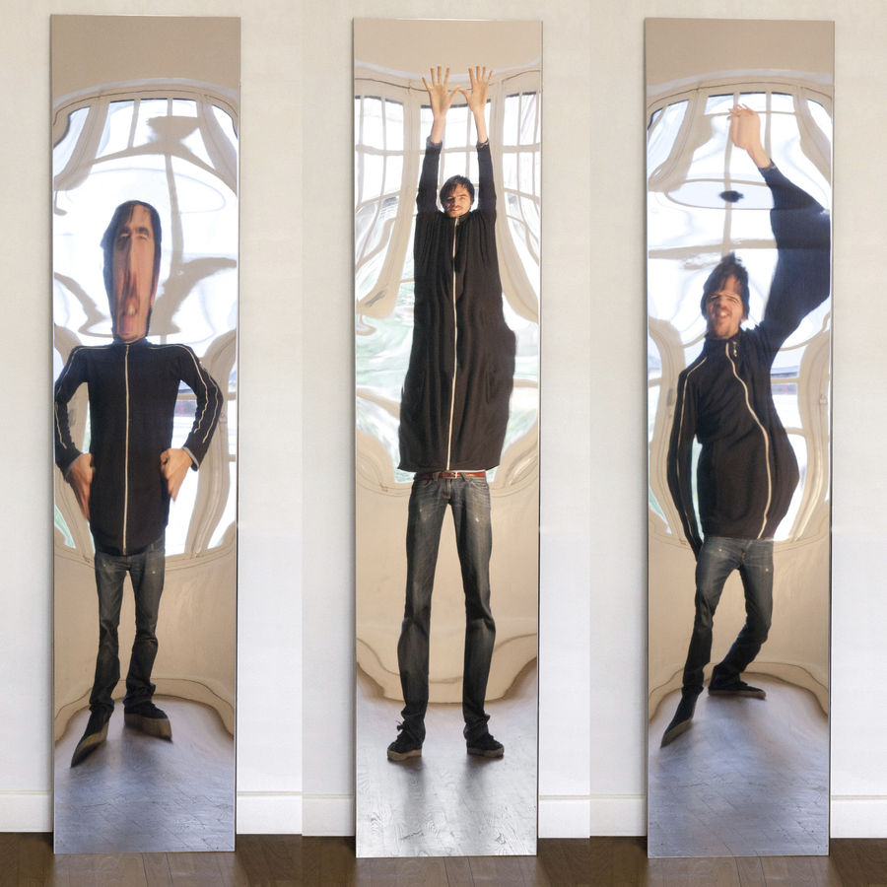
What are we hoping to cover in this tutorial?
To investigate the link between media and body image
To reflect upon how you feel about your own body image and why
Notes:
Is this what you are hoping to learn today?

Slide 3
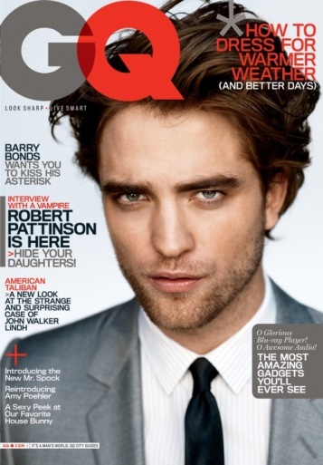
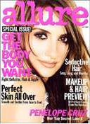
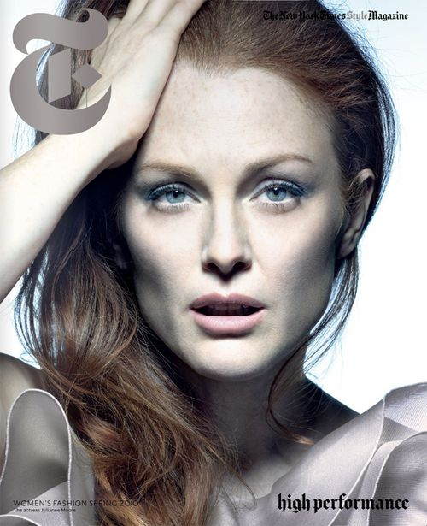
How much do you think the media (film, TV, magazines) influences the way people want to look?
1 2 3 4 5 6 7 8 9 10
Not at all
Very much
Notes:
Ask learners to all stand up then read out the following:
I am going to ask you to sit down when I read out something that describes you:
I’m wearing socks that don’t match
I love gherkins
I’m a vegan or vegetarian
I need to wear glasses
I have an older brother or sister
I have blue eyes
My favourite pastime is reading
I can speak another language
I was born in another country other than the UK
I have a reptile, or reptiles as a pet
I have been bullied at some point in my life
My best subjects at school is (or are) sports, dance or art
I have at least one piercing
I struggle to do long-division
I have never watched Game of Thrones
After each time a person sits down, give them a card or post-it note in a different colour. At the end, see how many categories each person fits into. Who has the most cards? What do the learners think this exercise is trying to tell them?

Slide 4
Body Image
Body Image refers to a person's perception of the attractiveness of their own body.
It’s about how you see yourself, not what you actually look like.

Slide 5
How do you feel about yours?
How do you feel about yours?
Give your body a mark out of 10
What are the best parts?
Which bits would you change?

Slide 6
Group Task
In your group look at the magazine images
What do you think about the images?
What makes the photos different to ones you might have of yourself, for example?
What are the positive things about the images?
What are the negative things?
Notes:
The trainer will need to provide a selection of images (male and female) for this task

Slide 7
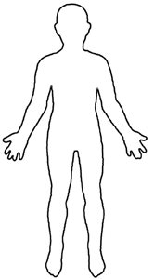
Now you have looked at the images…
Annotate the body outline with what the media portrays as ‘ideal’ features
For example:
You can choose a man or a woman
muscles

Slide 8
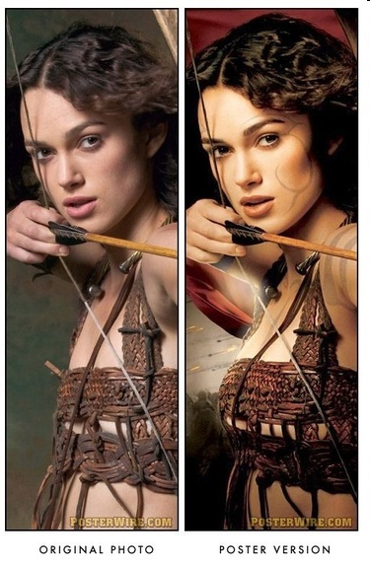
Does editing make a difference?

Slide 9
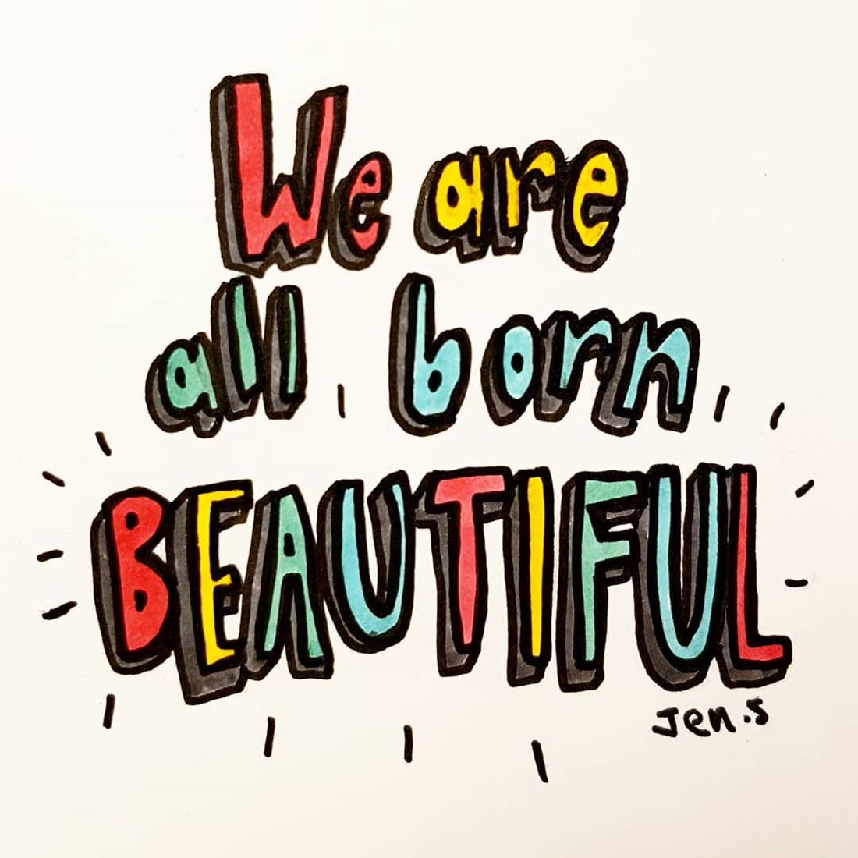
http://www.youtube.com/watch?v=iYhCn0jf46U
What’s the message in this video?
Are you surprised?

Slide 10
Complete these sentences
I think that the media does/does not affect people’s body image because…
One thing I have realised that I didn’t know at the start of this lesson…
What one thing would you change about the way the media deals with things like body image?

Slide 11
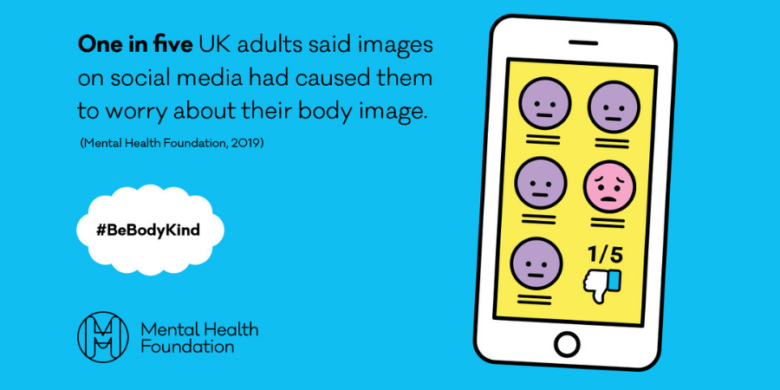
What do you think now?
How much do you think the media (film, TV, magazines) influences the way people want to look?
1 2 3 4 5 6 7 8 9 10
Not at all
Very much

Slide 12
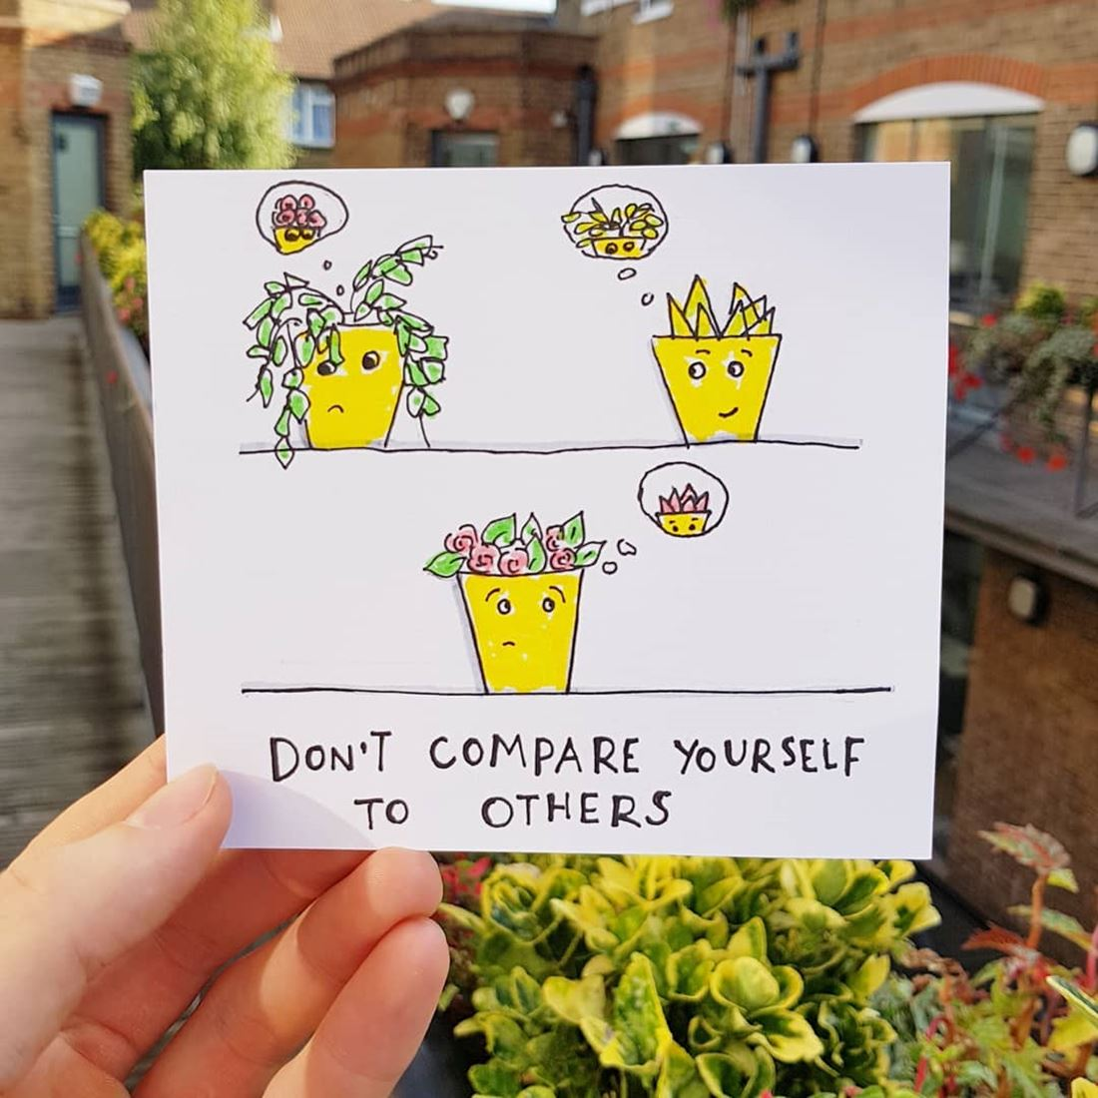
Review of session…
The media and body image:
What problems can come out of this?

Slide 13
What to do if you're worried about how you look
Be kind to yourself and try not to compare yourself to the many images you see online and in magazines, which are often digitally changed to make them look ‘perfect’ – they don’t reflect how people look in real life!
Focus on the things you like about yourself, and the parts of your body that you like
Spend time with people who make you feel positive about yourself. Remember that people value you for many reasons, not just the way you look!
Think about what advice you would give a friend if they told you they were struggling with the way they look, and remember that advice whenever you start having negative thoughts
Talk to someone you trust. It could be your parents, wider family members, a teacher/tutor, a neighbour, close family friend or someone from a club you attend. If you feel unable to cope, or particularly worried about one part of your body, talk to your GP about how you’re feeling
Notes:
Many people feel insecure about the way they look at some point in their lives. It's important to remember that there isn’t a single type of beauty - everyone sees it differently. And there simply isn’t a right or a wrong way to look. But if you're struggling, here are some things you can do:

Slide 14
Links to information and help:
https://www.mentalhealth.org.uk/your-mental-health/getting-help
Samaritans
Rethink Mental Illness
Mind
https://youngminds.org.uk/find-help/feelings-and-symptoms/body-image/
NHS Choices
https://hampshirecamhs.nhs.uk/issue/body-image-self-esteem/
The Mix
Youth Access Directory of Services
Youth Wellbeing Directory

