Slide 1
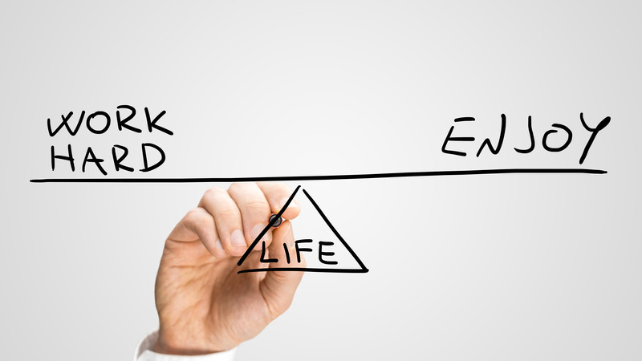
Resilience and Wellbeing Tutorial 2

Slide 2
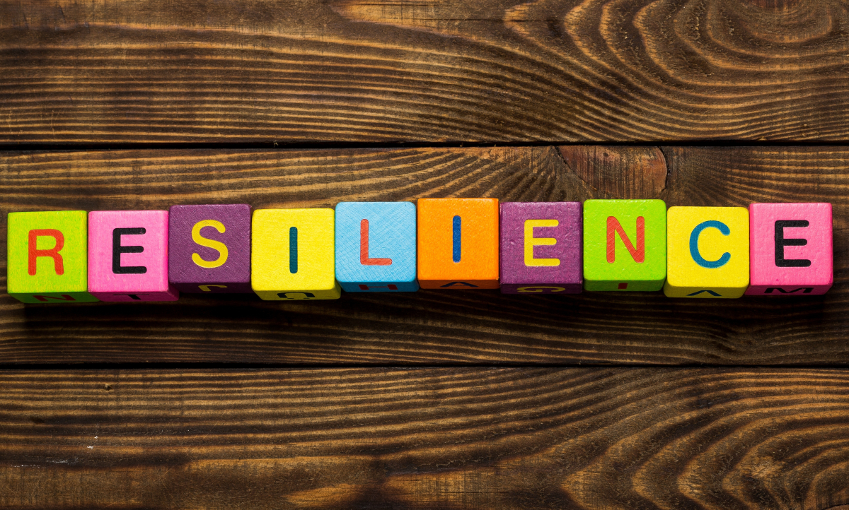
What are we hoping to cover today?
Review what we already know about resilience
Discover some practical tools to help you care for yourself, reduce stress and build your personal resilience
Notes:
Is this what you are hoping to learn today?

Slide 3
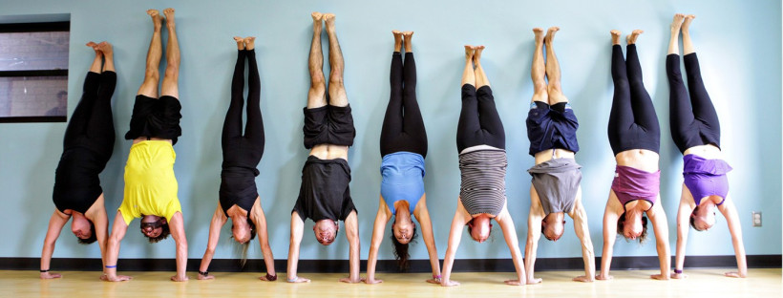
Warm-up exercise
Notes:
ESLC group activity – in turns take one of the wellbeing question cards and think about your response to the situation. Share your thoughts with the group.
Tutor to prepare question cards in advance (see resources)

Slide 4
Review of previous session
Individual activity:
Please complete the worksheet, filling in the blanks using the selection of words at the top of the sheet.
Notes:
Allow learners 5 -10 minutes to complete the worksheet. Individual support for reading and writing can be provided for learners with SpLD
Group mark the worksheet and review the vocabulary to re-familiarise learners with new language

Slide 5
The Goldfish Bowl
This Photo by Unknown Author is licensed under CC BY-NC-ND
Notes:
At the last session you looked at the things that created stress in your lives. At today’s session we are going to look at ways to reduce the affects of stress on your body and help build your resilience.

Slide 6
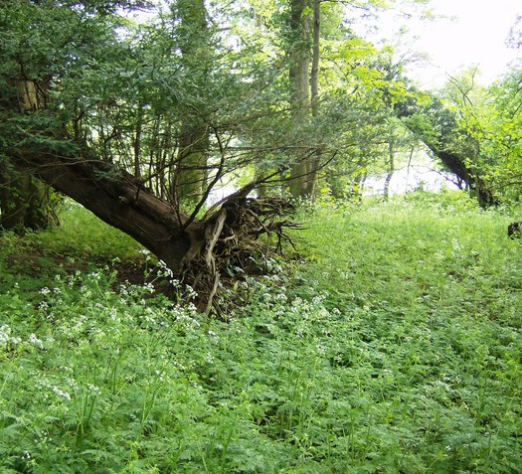
What things do you think could help reduce stress and build resilience?
Please note down as many factors you can think of that might help you to build personal resilience
Notes:
Note to learners that one clue is in the picture (spending time outside into nature, going for a walk or run)

Slide 7
Resilience and Health
Research has also shown that five healthy lifestyle habits have a significant affect on health, wellbeing, lifespan and overall resilience:
Smoking
Healthy Body Weight
Optimum Physical Activity Levels – 30 mins daily
Moderate Alcohol Intake
Healthy Balanced Diet
Sleep

Slide 8
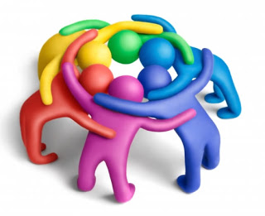
Resilience & Relationships
The World Economic Forum recently reported (2019) that research shows that relationships have the biggest effect on our mental and physical health
Research tells us time and time again that resilience is improved through a solid network of friends and colleagues

Slide 9
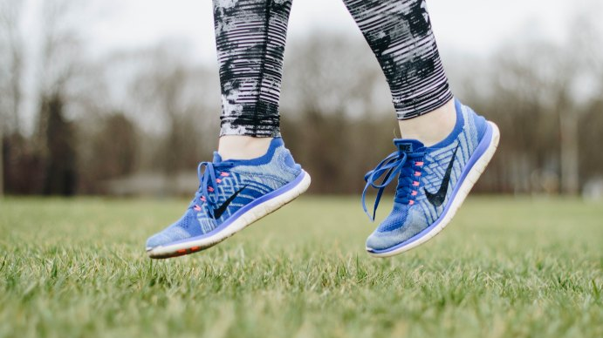
Sport & Exercise
Research tells us that exercise is beneficial to our health, helps to reduce stress and build our resilience
Group exercise
Why do you think this might be?
Name as many reasons why you think sport and exercise is good for reducing stress and building your resilience
This Photo by Unknown Author is licensed under CC BY-SA-NC
Notes:
Learners to note down the benefits of exercise.
Review their responses and remind learners that the release of endorphins (feel good hormones) during sport and exercise helps to reduce anxiety and depression

Slide 10
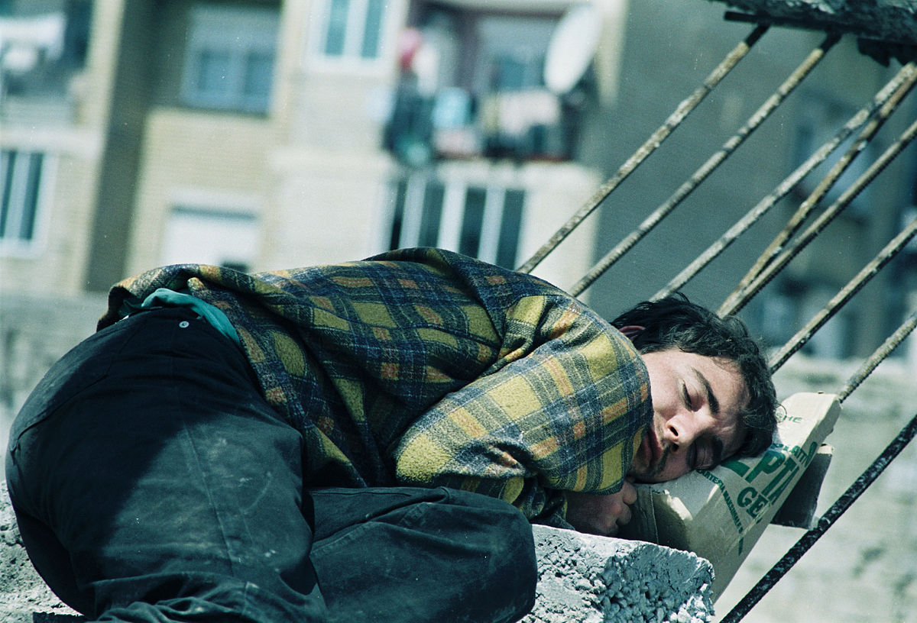
Resilience & Sleep
Decades of sleep-research has shown how an overtired brain and body make us vulnerable to the following:
Alzheimer’s disease
Anxiety and depression
Cancer
Obesity
Stroke & heart attacks
Chronic pain
Diabetes
Tiredness has also been linked to botched surgeries, road traffic accidents, potentially life-threatening conflict and errors at work
Notes:
Scary?
So how can you overcome insomnia?

Slide 11
How to get to sleep in 2 minutes:
https://www.youtube.com/watch?v=EiYm20F9WXU
This Photo by Unknown Author is licensed under CC BY-NC-ND

Slide 12
Reminder:
Stress has short-term and long-term affects on both your physical and mental wellbeing
You CAN build your personal resilience and ability to bounce back
You cannot change certain factors such as someone being rude or unkind … but you CAN choose how to respond
A good night’s sleep will help you prepare for stress and difficulties you encounter during your day
Good relationships (in work and at home) are one the most important factor for your personal wellbeing
Look for personal triggers when you are entering red head mode; these will differ from person to person
Aim to maintain a blue head at all times
Avoid negative self-talk. Would you talk to your best friend the way you talk to yourself? If the answer is “No” then consider how you can be kinder to your inner voice.
Notes:
Resources available on the VLE

Slide 13
Review of Learning Outcomes – have we?
Discovered some practical tools and advice to help you to care for yourself, reduce stress and build personal resilience?
Final Review Question
Can you identify one thing YOU have learnt from the workshops
Can you name ONE thing you are going to change as a result
Notes:
If learners are confident – please ask them one thing they have learnt and one thing they will change as a result
If learners are reluctant to discuss their action plan – then this can be carried out as a written task

