Slide 1
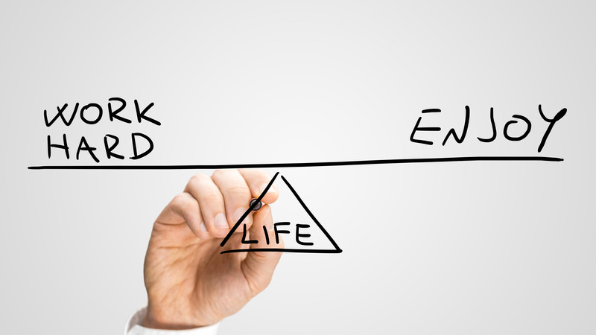
Resilience and Wellbeing Tutorial 1

Slide 2
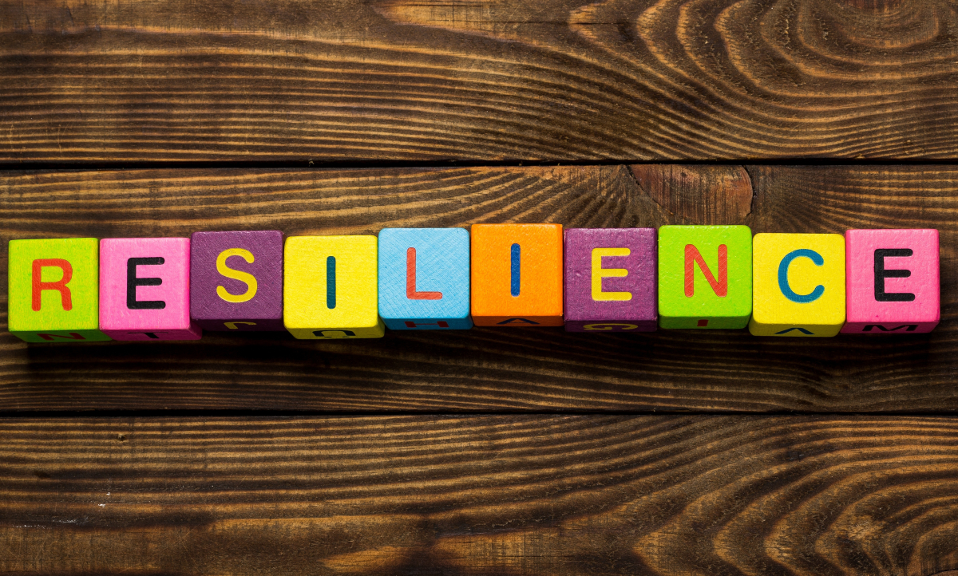
What are we hoping to cover today?
Identify factors linked to personal resilience and wellbeing
Discover how resilience is linked to personal performance
Identify how we respond to stress
Notes:
Is this what you are hoping to learn today?

Slide 3
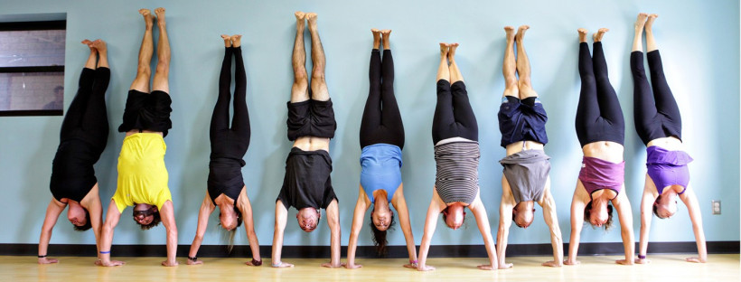
Warm-up exercise
Notes:
ESLC group activity – in turns, using the alphabet (A,B,C) take it in turns to state one item linked to personal wellbeing and resilience. For example S = stress, Y = yoga

Slide 4
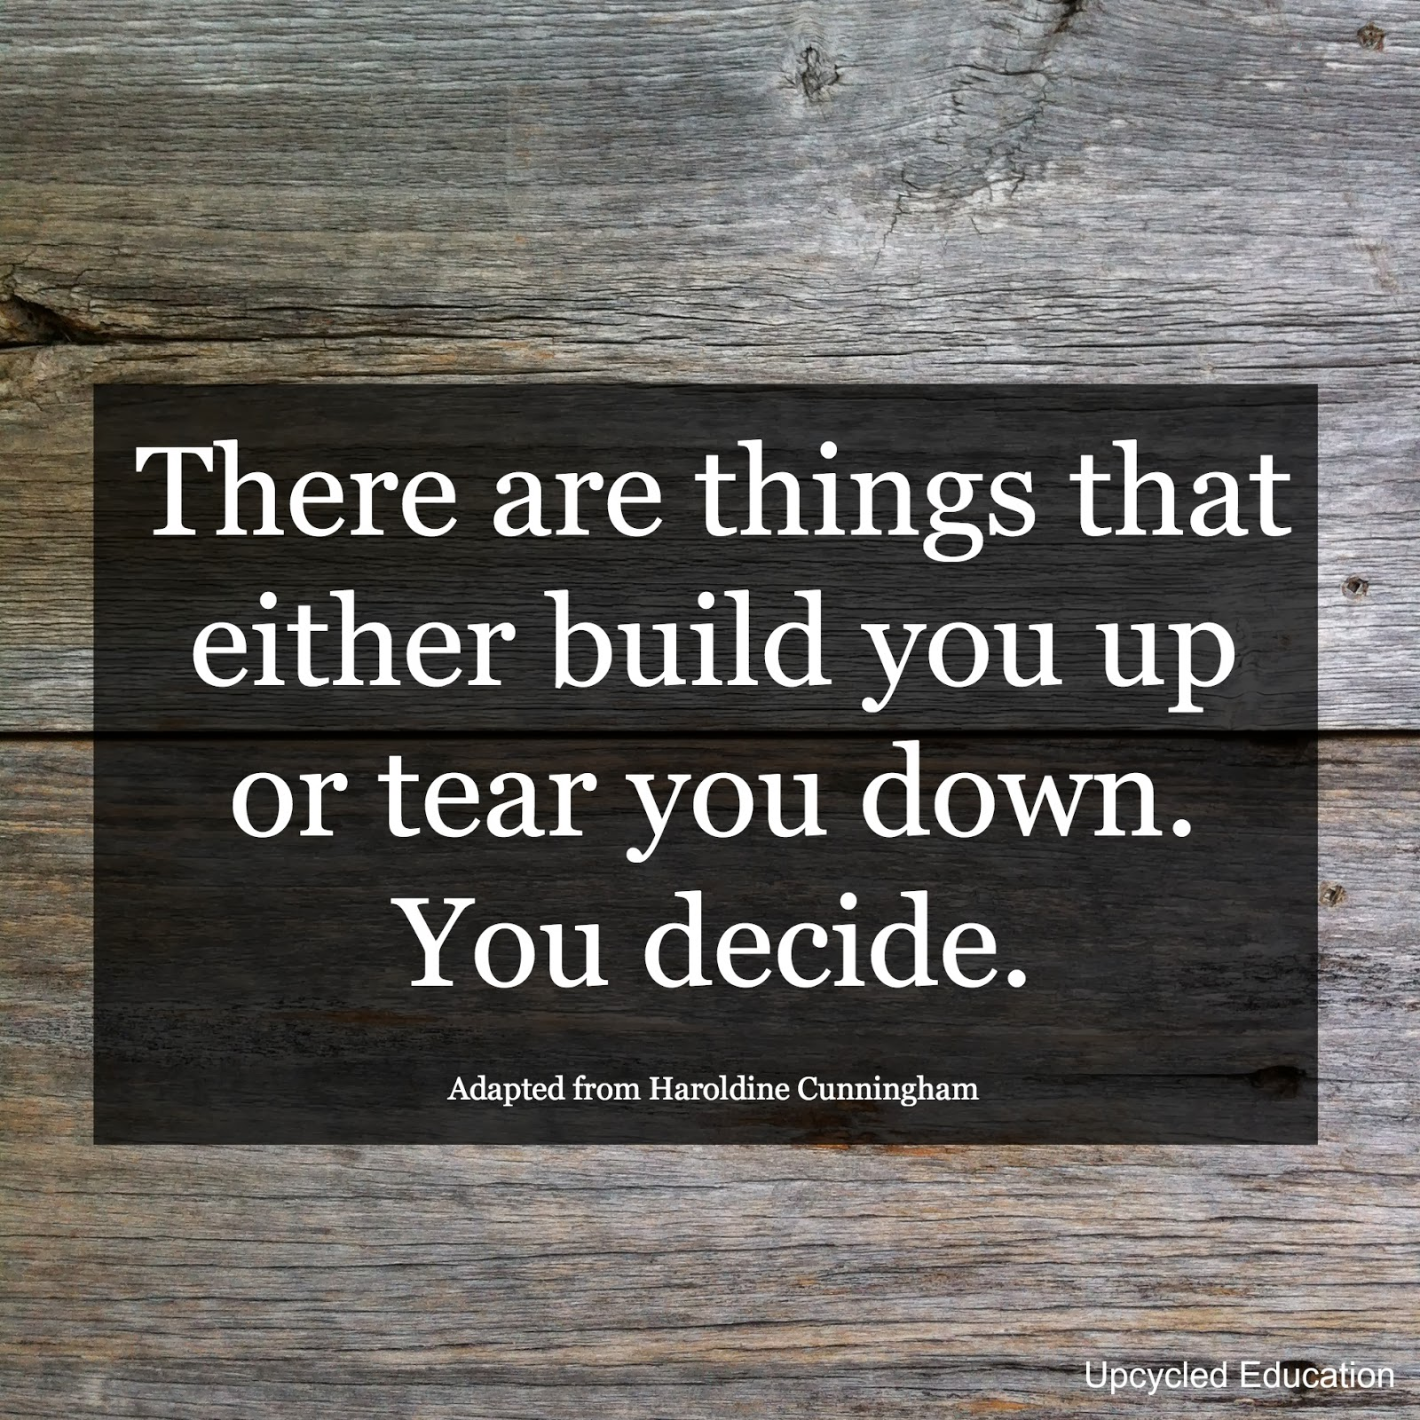
What is Resilience?
Individual task
In a single sentence – how would you describe resilience?
Notes:
Ask learners to come up with a definition of personal resilience…encourage the use of full sentences including capital letters and full stops

Slide 5
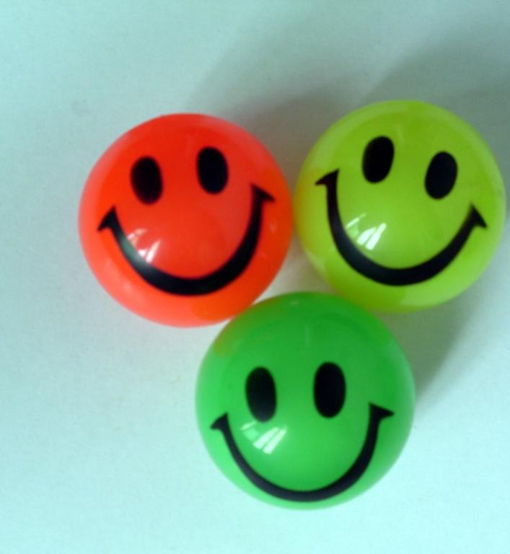
What is personal resilience?
“Resilience is that quality that allows some people to be knocked down by life and come back stronger than ever. Rather than letting failure overcome them and drain their resolve, they find a way to rise from the ashes.”
(Psychology Today)
In a nutshell, resilience can be defined as the ability and tendency to “bounce back.”
Notes:
Resilience is a person's capacity to respond to pressure and the demands of daily life. ... In short, resiliency affects our ability to 'bounce back’ from failure, difficulty or rejection

Slide 6
Personal Resilience Exercise
Please look back over your life and remember those times when you needed to be resilient. What happened? What helped you get through the difficulty?
Personal
Education
Economic
Personal:
Relationships, Family, Bereavement, Health, Home, Coping with Change
Education/Career:
School Experience, Learning Opportunities, Bullying, Work Experience, Coping with Change
Economic:
Finances, Savings, Debt, Responsibilities, Unemployment, Coping with Change
Notes:
Allow Learners 5 minutes to identify two examples of when they have needed to be resilient in their lives that they are prepared to share with the group. Remind learners that ‘what is said in the room should stay in the room’ and not shared with others as trust is essential when sharing our personal stories

Slide 7
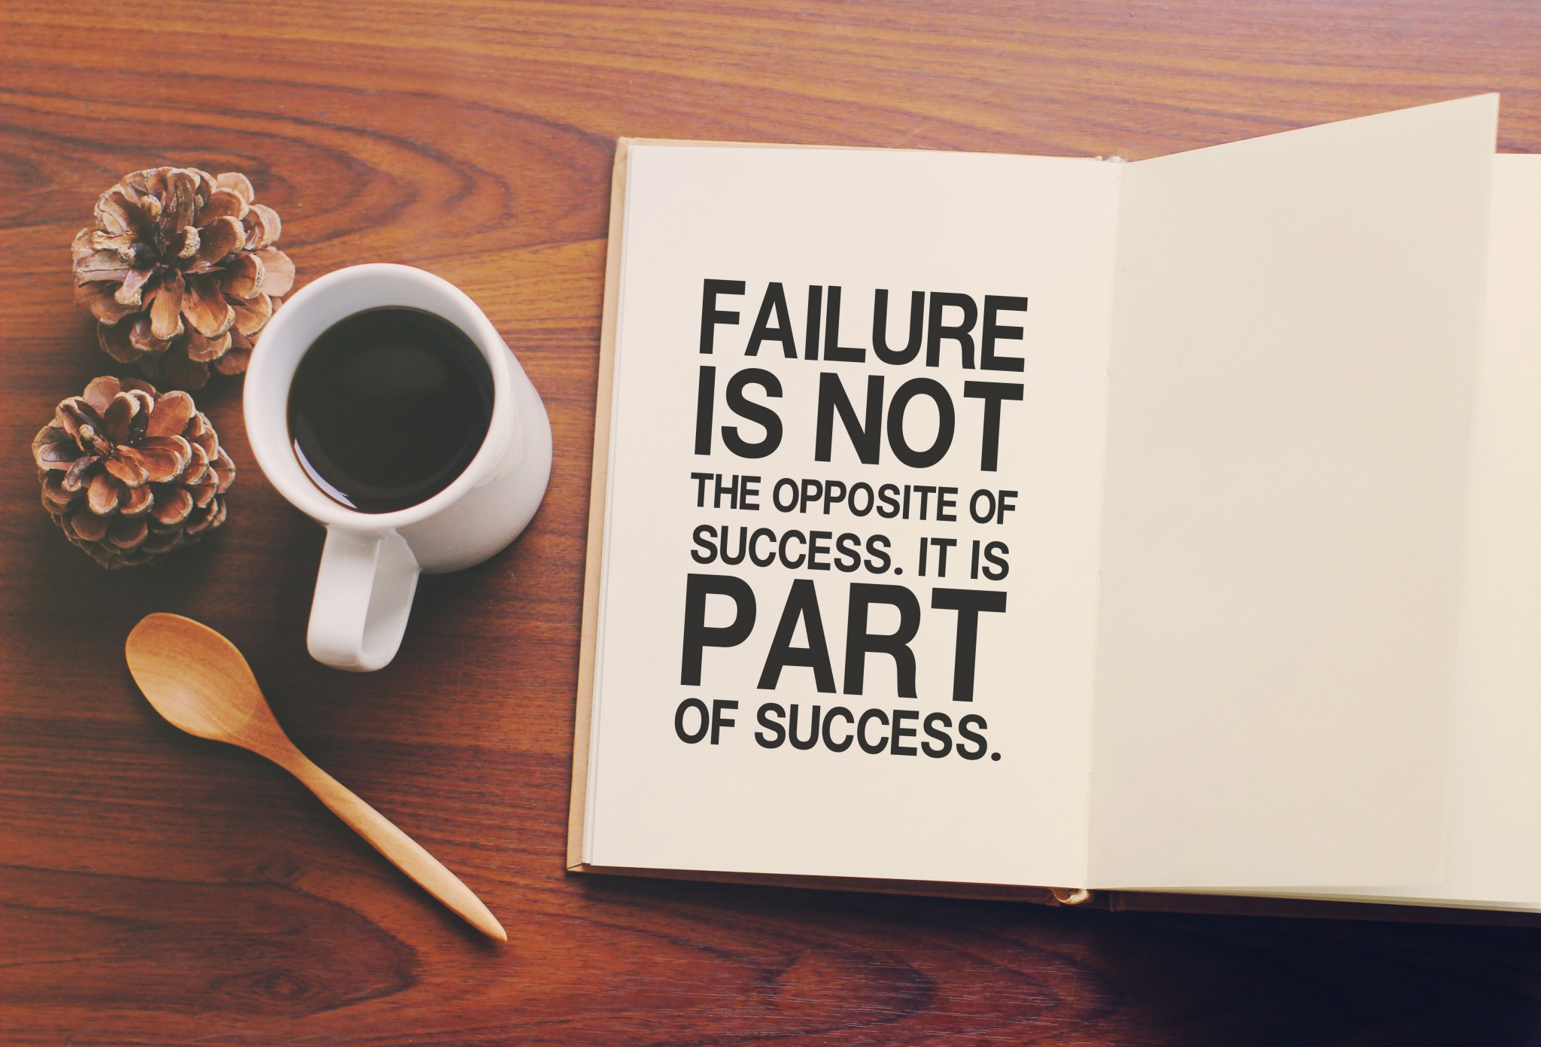
Personal Resilience Exercise
Is there a time when you are particularly proud that you succeeded against all the odds?
Notes:
Identify if any of the group would like to share what they learnt about themselves as a consequence

Slide 8
Resilience Myths & Facts
Myth | Fact
You should never show emotions | You manage your own emotions & responses
If the going gets tough you should just ‘put your head down’ and ‘get on with it’ | Being resilient is about building relationships, networks, teamwork and sharing responsibilities
You’re either resilient or you’re not! | Being resilient is about better thinking and making better choices
You should be bulletproof, ‘tough it out’ and power through times of stress and illness | Always believe that you are able to bounce back, adapt and prepare for the future – be kind to yourself
You should ‘multi-task’ and try to do everything quickly to meet targets | You need to listen to your body and know when to slow down and take time out – you’re not superhuman!
It’s all about the destination – getting the job done! | It’s all about the process – life happens!
Notes:
Emotional and physical resilience is, to a degree, something you're born with. Some people, by nature, are less upset by changes and surprises – this can be observed in infancy and tends to be stable throughout one’s lifetime.
Emotional resilience is also related to some factors that aren't under your control, such as age, gender, and exposure to trauma.
However, resilience can be developed with little effort. If you know what to do, you can become more resilient, even if you are naturally more sensitive to life’s difficulties.

Slide 9
The Goldfish Bowl
This Photo by Unknown Author is licensed under CC BY-NC-ND
Notes:
Activity
Group 1 - on one sheet of paper please draw a large Goldfish bowl. Your group are going to note down all of the things in your day, week or year that CREATES stress and REDUCES your resilience. Examples may be an argument with your parents or partner, your car won’t start etc.
Group 2 – on one sheet of paper please draw a large Goldfish bowl. You are going to note all of the factors that can help REDUCE personal and workplace stress and INCREASE your resilience. For example, you pass your Level 2 English, you’ve book a holiday with your friends in June
Discuss your findings.
What factors do you have control over?
Which ones don’t you have control over?
What can you do to move your goldfish into the stress-free bowl?

Slide 10
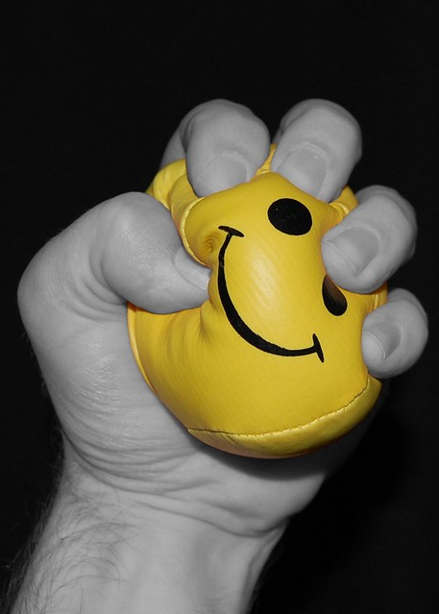
Stress
Some people do not realise that the brain interprets threat and stress and in the same way. This means that when you are stressed your brain prepares a ‘flight or flight’ response.
Stress also makes your brain freeze at the worst time, such as during a job interview!
Chronic, Long-term Stress can reduce levels of serotonin and dopamine. These are the ‘happy chemicals’ (or neurotransmitters) in your brain and can over time lead to depression.

Slide 11
Stress and Resilience – here’s what happens in your brain when you feel anxious:
https://www.youtube.com/watch?v=rpolpKTWrp4

Slide 12
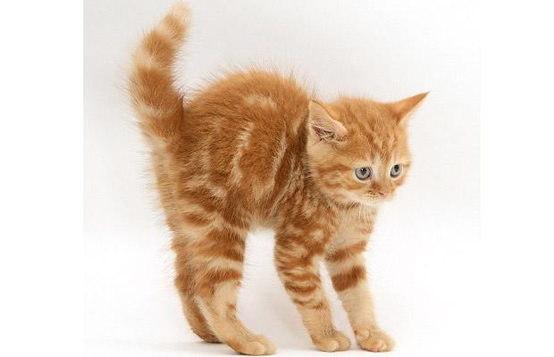
Red Head
In the Police they call this Red Mist; in the Air Force they call it Tunnel Vision
Red Head is the result of stress hormones surging through the body that affect your ability to think straight
Red Head makes you feel: Heated
Overwhelmed and
Tense
‘Red Head’ happens when the pressure takes over and your brain goes into survival mode
Notes:
Use the example from the All Blacks Rugby Team

Slide 13
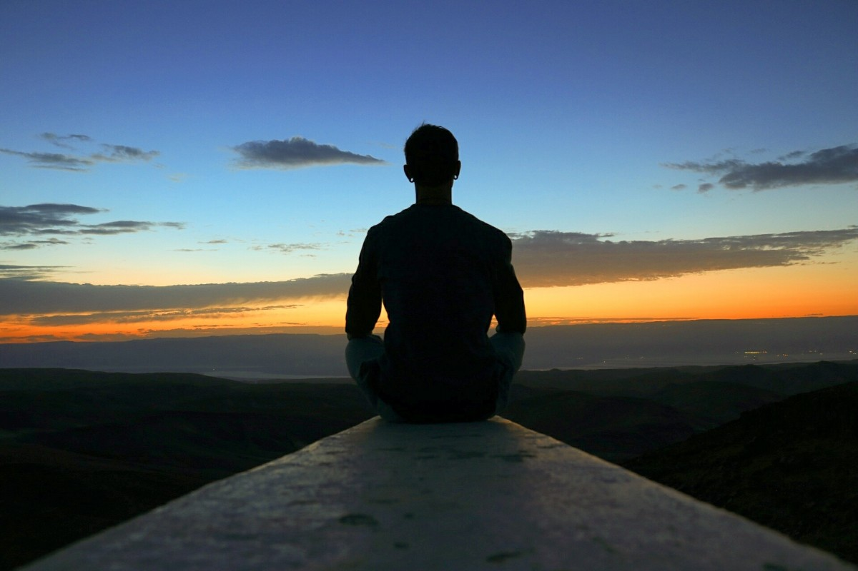
Blue Head (Clear Thinking)
To enter and stay in Blue Head you need to do three things:
Seek to stay in Blue Head as your default setting
Know how to recognise when you are about to enter Red-Head
Slow down your breathing
Use a physical or mental trigger to help get yourself back into Blue Head
Notes:
Blue Head is the opposite to this. It’s that cool, controlled, pattern-seeing state, when you keep your awareness and your ability to make decisions. You’re in the moment, focused, on-task, loose and expressive whilst remaining calm and clear. It’s that ability to stay flexible and deliver top performance when the pressure comes on
The key here is realising that you’re in the wrong emotional zone and find ways to cool yourself off and get back into a high-performing head space

Slide 14
Headspace 1 minute meditation:
GET THE APP
https://www.headspace.com/meditation/breathing-exercises
Notes:
Have a go at concentrating on your breathing for just one minute. How did you find this exercise?

Slide 15
Summary:
Stress has short-term and long-term affects on both your physical and mental wellbeing
You CAN build your personal resilience and ability to bounce back
You cannot change certain factors such as someone being rude or unkind … but you CAN choose how to respond
A good night’s sleep will help you prepare for stress and difficulties you encounter during your day
Good relationships (in work and at home) are one the most important factor for your personal wellbeing
Look for personal triggers when you are entering red head mode; these will differ from person to person
Aim to maintain a blue head at all times
Notes:
Tutor to recap on learning
Resources are also available on the VLE

Slide 16
Review of Learning Outcomes – have we?
Identified some of the factors linked to resilience and wellbeing?
Seen how this may impact your personal performance and happiness?
Identified how your body reacts to stress?

Slide 17
wellbeing
Notes:
Using these tiles, create as many words as possible related to wellbeing
Maths number, reading and writing task – learners to calculate own or swap papers to calculate scores
Consider providing a prize to the person with the highest score

