Slide 1
Starter: what are the following statements defining…
Believing someone is inferior or superior without even knowing them (pre-judging someone)
Treating people unfairly because of their race, age, gender, class, etc.
Notes:
Have this up on the board as they start arriving and let them know this is something to think about whilst everyone gets sorted in the class.
Ask the pupils if they have any ideas and see if they come up with anything close to prejudice and discrimination
Move onto the next title page within a few minutes, is just an exercise to get them started

Slide 2
Prejudice & Discrimination
Notes:
- Just explain that these words are the words that were defined and what we will be focusing on today

Slide 3
Aims:
To define prejudice and discrimination
To understand the different forms of prejudice/discrimination
To explore different examples of prejudice and discrimination
Notes:
Talk through these aims and how they will be achieved in this sessions (more in-depth definitions of both, looking through and trying to understand the different forms of prejudice/discrimination and then using examples to test the knowledge we’ve learnt)

Slide 4
Prejudice
Believing someone is inferior or superior without even knowing them
Prejudice means literally to pre-judge someone
Prejudice usually involves making a judgement (often negative) about a person based on one characteristic
→ What other forms of prejudice might exist?
Notes:
As we’ve already seen, this is the definition of prejudice, what it means is that someone pre-judges another person and that this is usually based on one characteristic in a negative sense
Provide examples such as age, race, sex/gender

Slide 5
Discrimination
Treating people unfairly because of their race, age, gender, class, etc.
For example, age discrimination might involve treating an older person less favourably simply because of their age
→ What other forms of discrimination might exist?
Notes:
Also, here is the full definition of discrimination (this is just to fully encode these ideas into the children's minds and ensure the understand the concept), it relates to actions whereas prejudice is more attitudes, beliefs and opinions, as the example displays on the board.
- At the end of this slide, BEFORE moving on, I would ask the class and have a quick discussion about what other forms of prejudice/discrimination people might this exist? E.g. age, sexuality, religion, race, gender/sex…, then move on and explain that these are the main forms of prejudice/discrimination…

Slide 6
Forms of prejudice and discrimination
Racism – prejudice/discrimination directed against someone of a different race
Sexism – prejudice/discrimination against someone based on their sex/gender
Islamophobia – prejudice/discrimination against someone who identifies as Muslim
Homophobia – prejudice/discrimination against homosexuality and people who are homosexual
Notes:
Talk through these being clear that they are forms of both prejudice/discrimination but it does not always occur as a pair
They will come on the slide individually as you click

Slide 7
Hierarchy of discrimination
Allport, a psychologist, argues there is a hierarchy of discrimination ascending in seriousness:
→ Antilocution (name calling, jokes)
Avoidance
Less favourable treatment (e.g. denying employment/promotion)
Bullying, harassment and physical attacks
Genocide
Notes:
An interesting addition to the forms of prejudice and discrimination is that typically discrimination occurs in a hierarchy of seriousness
The hierarchy will come on with each click so before you reveal the actual hierarchy you could ask for suggestions of acts that could be classed as discrimination
It gets increasingly more serious forms of action (as discrimination is based on acts towards a certain individual/group)

Slide 8
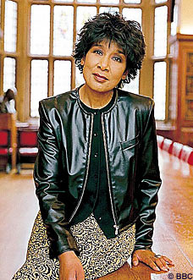
An example…
Moira Stewart (born 1949) was the first African-Caribbean newsreader on BBC television and winner in 2004 of a Global Diversity Award for being such an effective role model. Her long career was brought to a halt when the BBC decided ‘her skills as a newsreader were redundant in the modern age’. The BBC denied ‘sexism, racism or ageism’ in making its decision.
Do you think Moira Stewart was a victim of prejudice/discrimination? If so, which one?
Notes:
- A nice example to create discussions, read through the example and potentially ask students to write their answer on a whiteboard, move to a different side of the room based on what they think and this may inspire a bit of debating and/or putting their thoughts together to link the concept to examples and then explain the link

Slide 9
Prejudice or discrimination?
Discuss the following scenarios and decide whether you think it is a case of prejudice or discrimination…
Notes:
This is the title page for an ‘example game’ where a scenario is shown and the students have to answer whether they think it is prejudice or discrimination
Could use whiteboards, shout out, hands up, move to a different side of the room, depends how active you want it to be
Some can be argued both ways so encourage discussion and debate surrounding this

Slide 10
Is this prejudice or discrimination?
Mindy feels nervous when she sits on the tube next to a Muslim woman wearing a veil

Slide 11
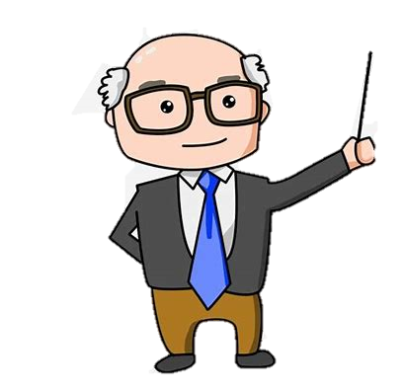
Is this prejudice or discrimination?
Mr Jones, the headteacher, fires Gavin from his job as a teacher a few days after his 50th birthday. He has always been a popular member of staff and his students have achieved good marks in RS, but Mr Jones has suggested that he would prefer to have a ‘younger’ member of staff.

Slide 12
Is this prejudice or discrimination?
Heather gets turned down for an apprenticeship as a mechanic. The employer suggests that she should aim for a more feminine career that requires less heavy lifting.

Slide 13
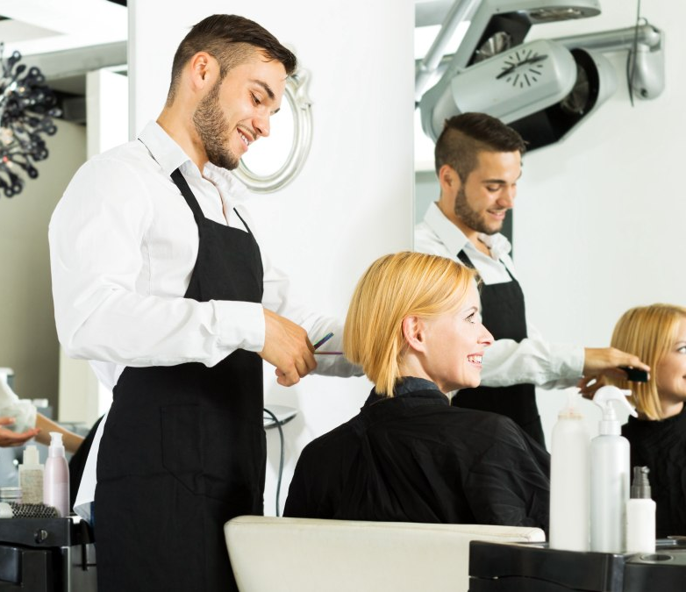
Is this prejudice or discrimination?
Karen is having her hair cut by Phil. She assumes Phil is a homosexual because he is a hairdresser.

Slide 14
Does the media pre-judge or discriminate against people?
Have a look at the following media coverage and decide whether you think it is prejudice/discriminatory or not…
Notes:
A similar activity to the previous one but with actual media examples
Could ask whether the students think the media is/was/has been prejudice or discriminatory?
Go through the examples without discussing them in detail.. Perhaps get a few suggestions on what form of prejudice/discrimination they think it is and talk about how overtime the media has improved and become less prejudice/discrimination, pose the question of why might that be? To encourage the children to think about this

Slide 15
Notes:
Example of racism in the news, mention the fact that this was in 2005

Slide 16
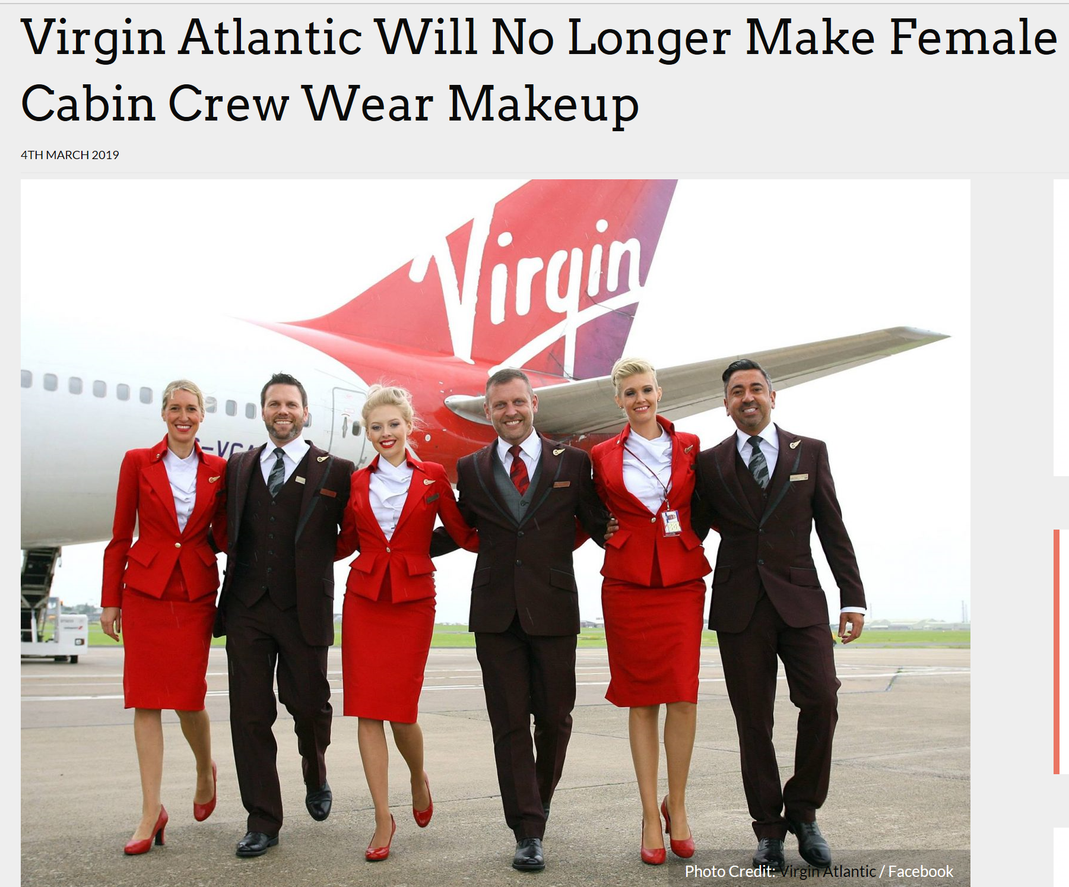
2011 Advert:
2019:
Notes:
Virgin and how it has changed across 8 years, pose the question what does this show about the change? How has society impacted this?

Slide 17
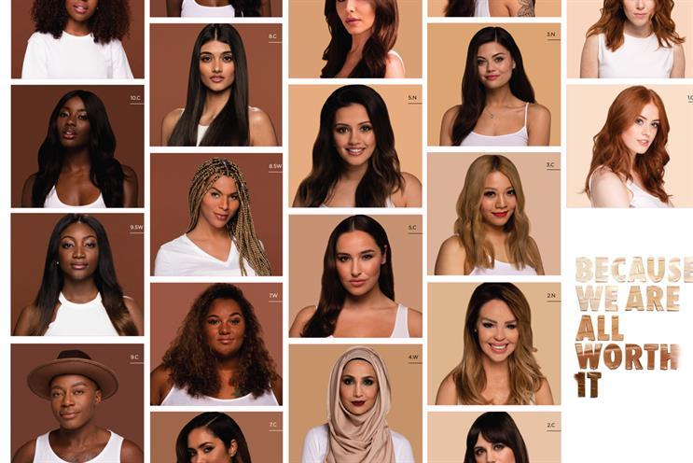
Loreal ‘yours truly’ campaign 2016:
Notes:
Recent media coverage demonstrating equality and diversity

Slide 18
Use these examples to write a Point Evidence Explain paragraph about prejudice/discrimination in the media
Is it present? How has it changed? Example?
Notes:
After going through the examples, have the students write down their thoughts in a PEE paragraph for 5-10 minutes and if the class enjoy feedback, I’d encourage class feedback with a few people reading theirs out, if not, I would circulate the class yourself and have small discussions with the pupils about what they think and have written

Slide 19
What have you learnt?
What is prejudice?
What is discrimination?
State one form of prejudice/discrimination.
Give one example of prejudice and discrimination.
Notes:
If you have time, provide them with this little quiz as they are packing up towards the end of the lesson to help consolidate their knowledge
Make it fun and not like a test

Slide 20
Summary
Prejudice refers to believing someone is inferior or superior without even knowing them
Discrimination refers to treating people unfairly because of their race, age, gender, class, etc.
There are different forms of prejudice/discrimination, e.g. racism, homophobia, sexism, etc.
Discrimination has been described to occur in a hierarchy of seriousness, e.g. from antilocution to genocide
Notes:
A little display to demonstrate the key points of the lesson
Can quickly show at the end, don’t need to fully talk through it, it is just a friendly reminder

