Slide 1
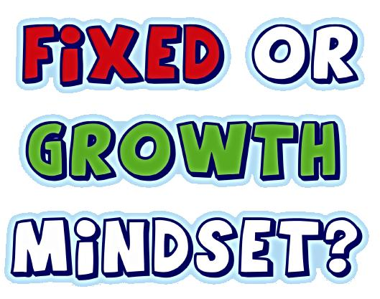
Mindsets

Slide 2
What are we hoping to cover today?
Identify the difference between a ‘fixed’ and a ‘growth’ mindset
Discover how mindset is linked to achievement in education, work and everyday life
Identify where the phrase ‘mindset’ comes from
Find out at least 10 practical tools to help develop a ‘growth mindset
Notes:
Is this what you are hoping to learn today?

Slide 3
Warm-up exercise 4 minute debate
Clever
Above average IQ
Super-intelligent
Hopeless at maths
Struggles with reading and writing
Can’t read and write
Creative & artistic
Brilliant at sport
Gifted and talented
Slow at learning
Notes:
Use a timer
Introduce the 4 minute quick debate on the nature vs nurture statement ‘a person’s intelligence is fixed at birth’.
Do learners agree or disagree?
Encourage learners to use active listening skill and respect other people’s opinion as they may not agree with other’s opinions but remind them that it still important to respect that person’s point of view. The aim of this ice-breaker is to engage in a speaking, listening and communication exercise and HEALTHY debate.

Slide 4
Mindsets - Nature vs Nurture
Notes:
Today’s session will look at two different types of mindsets (the work of Carol Dweck) and how it is possible to change your mindset from a fixed mindset (I can’t change as I was born clever/stupid) to a growth mindset (where I am in control of my learning, destiny and future – but this depends upon the effort I put in)

Slide 5
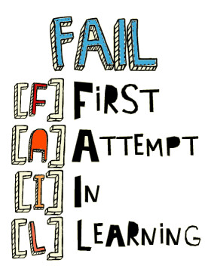
What is a mindset?
This video will introduce you to the terms fixed and growth mindsets and how it applies to your learning potential:
https://www.youtube.com/watch?v=KUWn_TJTrnU
Please discuss your thoughts after the video

Slide 6
Notes:
Summary of video to reinforce understanding

Slide 7
How can you develop a growth mindset?
In the video you saw how a growth mindset involves personal belief, effort and resilience.
In groups or pairs, please draw a brain (it doesn’t have to be perfect or in detail … just something that kind of looks like a brain!)
Now around the outside of your brain picture, please list as many things you can think of that might help you develop a growth mindset. I have mentioned a few ideas above
Notes:
You may want to demonstrate before this exercise the actual size of a human brain is usually the same as holding up two fists (and remind them that size doesn’t matter), like the two fists, it is also split into two parts and the electrical signals cleverly swap over sides.
This means that if you have damage on one side of your brain, it is the opposite that is affected!
It is also the consistency of blancmange that squishes inside a hard skull - so it can get damaged easily if it’s shaken up
Facilitate discussion and offer prompts if the groups/pairs are struggling to think of anything to put. An example may be - how about the way you respond to feedback? If you had a fixed mindset you may negative feedback as a failure. How would someone with a growth mindset view the same feedback?
Ask learners to feedback their ideas, before moving onto the 10 top tips for developing a growth mindset. Then relate their ideas to the following section

Slide 8
Top Tips for developing a growth mindset:
1 Acknowledge and embrace imperfections
Hiding from your weaknesses means you’ll never overcome them
Notes:
Please note that ‘imperfections isn’t about having your eyebrows “totes on fleek”!
Imperfections are what makes us human and adds to the rich variety in our society.
It’s not always wise to compare yourself to others, but it is important to realise that humans share the same weaknesses.

Slide 9
2. View challenges as opportunities
Having a growth mindset means relishing opportunities for self-improvement
It’s about learning how to fail well!
What do you think ‘failing well’ looks like?
Notes:
Learn more about how to fail well to support this slide and discussion here. Later in the slides we look at famous failures.

Slide 10
3. Try different learning tactics
There’s no ‘one-size-fits-all’ model for learning
What works for one person may not work for you
Notes:
Learn about learning strategies here

Slide 11
4. Replace the word “failing” with the word “learning”
When you make a mistake or fall short of a goal, you haven’t failed; you’ve learned!
5. Stop seeking approval
When you prioritise approval over learning, you sacrifice your own potential for growth
Notes:
Dweck says “not yet” has become one of her favourite phrases.
Whenever you are struggling with a task, just remind yourself that you haven’t mastered it yet.
Take risks in the company of others. Stop trying to save face all the time and just let yourself goof up now and then. It will make it easier to take risks in the future.
Cultivate grit.
Students with that extra bit of determination will be more likely to seek approval from themselves rather than others.

Slide 12
6. Value the process over the end result
Intelligent people enjoy the learning process, and don’t mind when it continues beyond an expected time frame
7. Cultivate a sense of purpose
Dweck’s research also showed that students with a growth mindset had a greater sense of purpose
Keep the big picture in mind!

Slide 13
8. Celebrate growth with others
If you truly appreciate personal growth, you’ll want to share your progress with others.
Remember to give others praise when they’ve worked hard
9. Emphasise growth over speed
Learning fast isn’t the same as learning well.
Learning well sometimes requires allowing time for mistakes
Notes:
9. Think realistically about time and effort. It takes time to learn. Don’t expect to master every topic under the sun in one sitting.

Slide 14
10. Take ownership over your attitude
Once you develop a growth mindset, own it!
Acknowledge yourself as someone who possesses a growth mentality and be proud to let it guide you throughout your career
11. Make a new goal for every goal accomplished
You’ll never be done learning
Just because your history exam is over doesn’t mean you should stop being interested in a subject
Growth-minded people know how to constantly create new goals to keep their minds stimulated

Slide 15
12. Change your language and change your attitude
Check you are avoiding ‘negative self-talk’
This involves changing any of your ‘can’t do’ statements into ‘can do’ statements
Activity
Please turn the following into a growth mindset sentence:
“This is too hard; I give up!”
Notes:
Learners are aiming for something like this: I can’t do it yet, but I will with time and effort.
Share next slide with growth mindset statements. You could prepare the sentences in advance as laminated individual statements. You can then use this as a a sorting exercise and/or ask learners to read the sentences out loud (embedded reading)

Slide 16
Can you see how changing your negative inner voice can help you change how you think about and approach a task?
So…
It is ok to take baby steps
It is ok to make mistakes
It is ok to change tactics
It is ok to ask for help

Slide 17
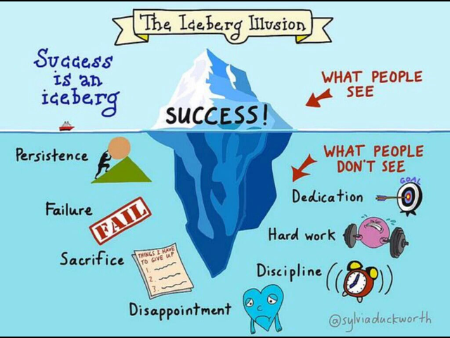
Summary:
Notes:
Successful people are not born that way – there is always an element of dedication, hard work, discipline, sacrifice. One things they all share is setting a goal or goals … and never giving up despite experiencing failure.
The next slide will show you some examples of famous failures:

Slide 18
Notes:
Famous Failures
Albert Einstein – didn’t speak until he was 4 years old and his teachers said “he would never amount to much”
Walt Disney – fired from his job at a newspaper for his lack of imagination and having no original ideas
Remind the learners that one of them may be the next Steve Jobs, Bill Gates, J.K Rowling or Albert Einstein

Slide 19
Review of Learning Outcomes – have we?
Identified the difference between a ‘fixed’ and a ‘growth’ mindset?
Discovered how mindset is linked to achievement in education, work and everyday life?
Identified where the phrase ‘mindset’ comes from?
Found out at least 10 tools to help develop our own ‘growth mindset?
We also found out about some ‘famous failures’ on our learning journey
Notes:
Any questions?

