Slide 2
Mental Health and Wellbeing

Slide 3
Aim (what I am going to do)
To discuss the importance of mental health and understand the different strategies I can use to improve my wellbeing.

Slide 4
Mental Health
Name as many different kinds of mental health problems as can you can think of.
What physical signs might you see in someone who is experiencing mental health problems?
Discussion Points
Would you know where to look or where to go if you wanted to seek help or support?
What influence/effect does social media have on your mental health?

Slide 5
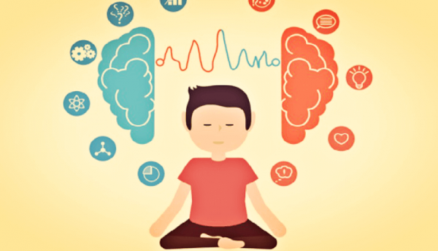
Mental Health – Mindfulness
Spend a few minutes researching what mindfulness is. Be prepared to feedback to the group with examples.

Slide 6
Mental Health – Mindfulness
"It's easy to stop noticing the world around us. It's also easy to lose touch with the way our bodies are feeling and to end up living 'in our heads' – caught up in our thoughts without stopping to notice how those thoughts are driving our emotions and behaviour,"
"An important part of mindfulness is reconnecting with our bodies and the sensations they experience. This means waking up to the sights, sounds, smells and tastes of the present moment. That might be something as simple as the feel of a banister as we walk upstairs.”
"It's about allowing ourselves to see the present moment clearly. When we do that, it can positively change the way we see ourselves and our lives."
“Reminding yourself to take notice of your thoughts, feelings, body sensations and the world around you is the first step to mindfulness.”

Slide 7
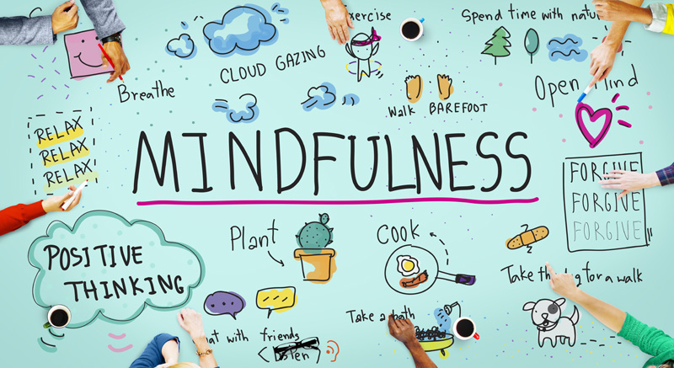
Mental Health – Mindfulness
Let’s try it. This is a simple mindfulness exercise. It can feel a bit strange and awkward at first, but relax and give it a go!
They key is to concentrate on your breathing
Click me for breathing activity:
https://www.youtube.com/watch?v=inpok4MKVLM

Slide 8
Mental Health – Mindfulness
If you are interested in mindfulness and want further resources. These links can get you started.
https://www.nhs.uk/conditions/stress-anxiety-depression/mindfulness/
https://www.youtube.com/watch?v=ny0d20TBc7s
https://www.youtube.com/watch?v=qzR62JJCMBQ
https://www.mindful.org/the-best-books-in-mindfulness-this-year/

Slide 9
Other strategies
There are lots of other strategies to help with your mental health and stress levels. There is not one approach that works for everyone, so it is about finding what is right for you. Lets take time to share strategies that we all use in our live.

Slide 10
Coronavirus and your wellbeing
This recently updated page has lots of advice on how to look after your wellbeing during the coronavirus. Spend time looking through it and jot down three key things that you find useful or that other might want to use.
https://www.mind.org.uk/information-support/coronavirus/coronavirus-and-your-wellbeing/#PracticalAdviceForStayingAtHome

Slide 11
Where can we go for help?
This is a simple mood assessment tool. It will give you tips at the end for how to improve you well being!
https://www.nhs.uk/conditions/stress-anxiety-depression/mood-self-assessment/
This website is packed full of advice and support.
https://www.mind.org.uk/
Don’t forget about the employee wellbeing page!

