Slide 2
Healthy lifestyles

Slide 3
Aim (what I am going to do)
To understand the importance of a healthy lifestyle on your wellbeing.

Slide 4
Healthy lifestyle
What barriers do people face that will effect whether they have a healthy lifestyle?
What does a healthy lifestyle mean?
Discussion Points
Have there been any trends in recent years to do with healthy lifestyles? Discuss whether these trends good.
Do you know anyone who you would consider to have a healthy lifestyle?
Notes:
New years resolutions

Slide 5
Healthy lifestyle
Draw a person and jot down two different things:
Healthy lifestyle ideas
Unhealthy lifestyle trends/habits
Remember this is about whole lifestyle choices.

Slide 6
Healthy lifestyle
Discussion time:
Share the things you have written down with the group. What sort of things have been included for both the healthy and unhealthy lifestyle.
Think about how these different lifestyles compare and how they might make people feel.

Slide 7
Smoking:
By now the majority of people know that smoking is not a healthy lifestyle choice. However, it is one of the biggest causes of death and illness in the UK. Here are some facts (NHS.uk):
Around 78,000 people die from smoking every year
Smoking increases your risk of developing more than 50 serious health conditions
Smoking causes around 7 out of every 10 cases of lung cancer
For more facts and advice on how to quit visit:
https://www.nhs.uk/live-well/quit-smoking/10-self-help-tips-to-stop-smoking/
Do you have any tips for people who would want to quit smoking?

Slide 8
Alcohol
Love it or hate it alcohol features in cultures across the globe, so it is important that we understand it. Have a go at matching the drink to the correct units.
1 Units
2.6 Units
Click me
1.6 Units
2.3 Units

Slide 9
Alcohol
Love it or hate it alcohol features in cultures across the globe, so it is important that we understand it. Have a go at matching the drink to the correct units.
1 Units
2.6 Units
Click me
1.6 Units
2.3 Units

Slide 10
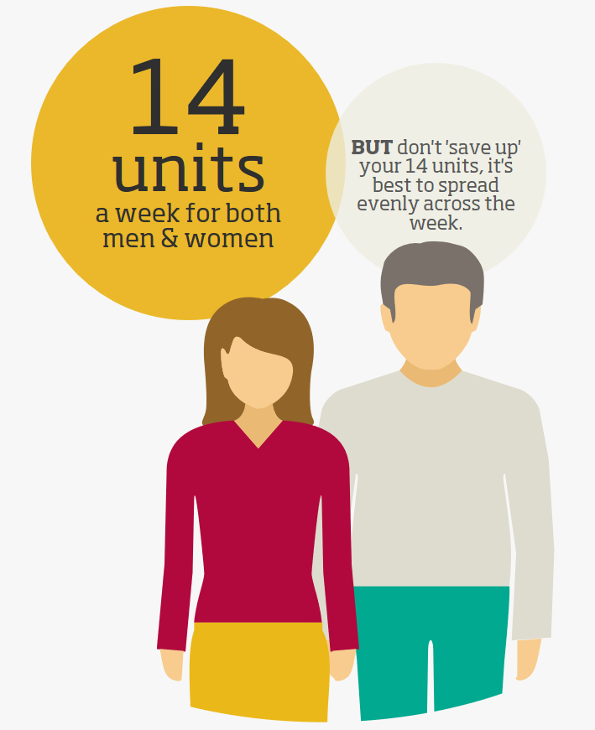
Alcohol
Work out what 14 units a week would look like. For example, would one glass of wine = 14 units in a week? You may need to do some research.
Finished?
Calculate how many units of alcohol you consumed last week. You don’t have to share your log; it is just for your person record.
Click me

Slide 11
Discussion
Let’s share any other factors that might make up a healthy lifestyle. As well as, any tips you can share with each other that might help.
Healthy weight
Eat well
Exercise
Click me
Quit smoking
Sleep and tiredness
Alcohol
Mental wellbeing

Slide 12
Further resources and learning
There are other components that make up a healthy lifestyle. You can find good information on this NHS site.
https://www.nhs.uk/live-well/
For more information on alcohol consumption or helping someone else here is a good link.
https://www.drinkaware.co.uk/
If you need help with quitting smoking or know some who neds support then look here for advice.
https://www.nhs.uk/live-well/quit-smoking/nhs-stop-smoking-services-help-you-quit/

