Slide 2
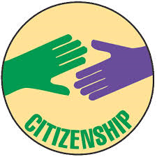
Citizenship

Slide 3
Citizenship – Session Aims
Understand what citizenship is
Have a brief overview the history of citizenship
Look at how you get citizenship
What are the key areas of citizenship?
Notes:
Remind people that today’s space is: confidential, a safe space to speak and comfortable

Slide 4
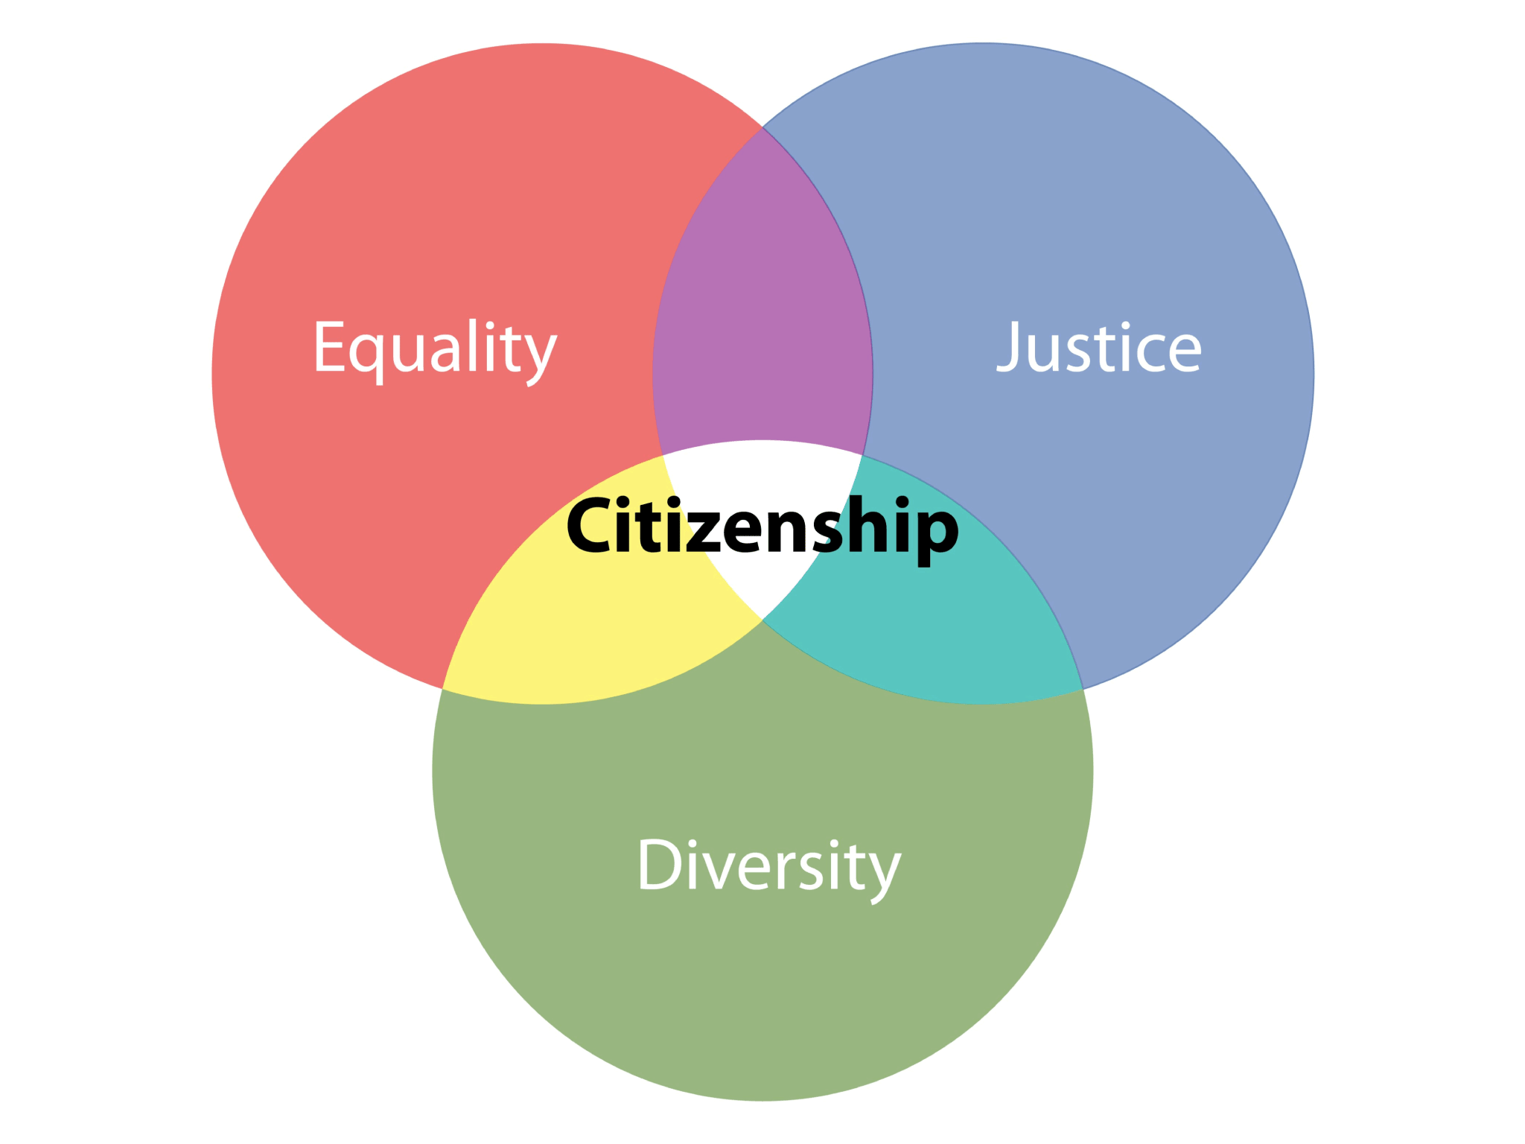
Citizenship - Definition
citizenship (noun)
the position or status of being a citizen of a particular country.
"the refugees could be granted dual citizenship“
Source: Oxford Dictionary and www.vocabulary.com › dictionary › citizenship
Notes:
Ask class

Slide 5
What is Citizenship?
Citizenship is the status of being a citizen.
If you have citizenship in a country, you have the right to live there, work, vote, and pay taxes!
Source:: www.vocabulary.com › dictionary › citizenship
Notes:
An example of citizenship is someone being born in the United States and having access to all the same freedoms and rights as those already living in the US.
Citizenship comes from the Latin word for city, because in the earlier days of human governments, people identified themselves as belonging to cities more than countries.

Slide 7
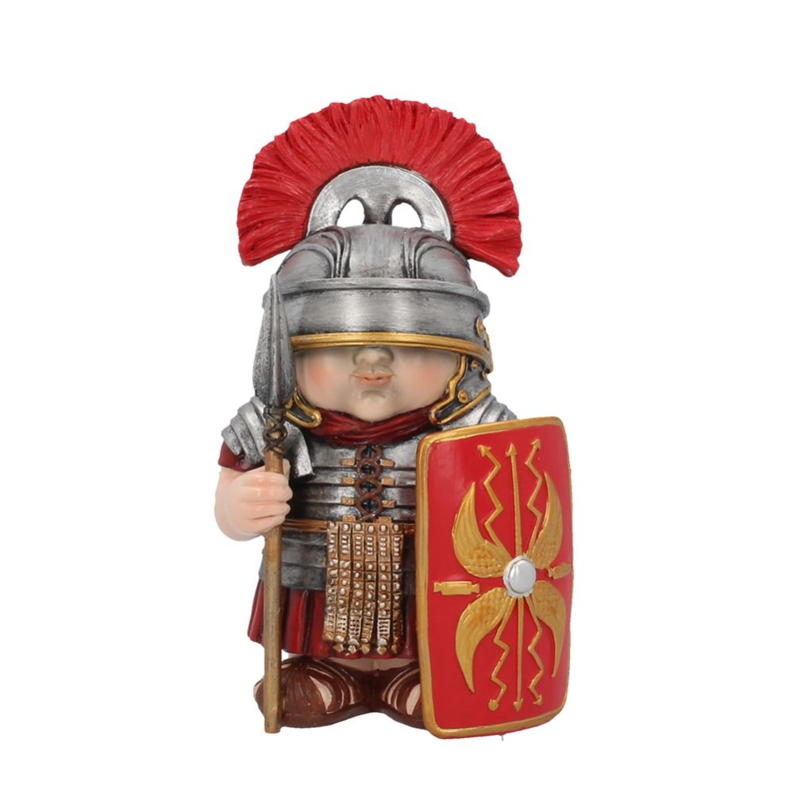
Where did citizenship come from?
The history of citizenship starts in Ancient Greece – but back then, generally only applied to property owners.
Citizens of Ancient Greece could vote, and could be taxed or drawn to military service.
The Romans then used citizenship to separate residents of the City of Rome from people in territories they had conquered.
.
Source: https://www.britannica.com/topic/citizenship
Notes:
The concept of citizenship first arose in towns and city-states of ancient Greece, where it generally applied to property owners but not to women, slaves, or the poorer members of the community.
A citizen in a Greek city-state was entitled to vote and was liable to taxation and military service.
The Romans first used citizenship as a device to distinguish the residents of the cityof Rome from those peoples whose territories Rome had conquered and incorporated. As their empire continued to grow, the Romans granted citizenship to their allies throughout Italy proper and then to peoples in other Roman provinces, until in ad 212 citizenship was extended to all free inhabitants of the empire. Roman citizenship conferred important legal privileges within the empire.
As the Roman empire grew, they then granted citizenship to their allies in Italy fully and in 212 AD citizenship was given to everyone in their empire

Slide 8
Where did citizenship come from?
However, in the Middle Ages, the idea of citizenship virtually disappeared in Europe – replaced by a state of feudal rights, where the King controlled everything.
Source: https://www.britannica.com/topic/citizenship
Notes:
The concept of national citizenship virtually disappeared in Europe during the Middle Ages, replaced as it was by a system of feudal rights and obligations.
In the late Middle Ages and the Renaissance, the holding of citizenship in various cities and towns of Italy and Germany became a guarantee of immunity for merchants and other privileged persons from the claims and prerogatives of feudal overlords.
Modern concepts of citizenship crystallized in the 18th century during the American and French Revolutions, when the term citizen came to suggest the possession of certain liberties in the face of the coercive powers of absolutist monarchs.
In the late Middle Ages and the Renaissance, citizenship in some cities and towns of Italy and Germany was restored.
Modern concepts of citizenship came about in the 18th Century during the American and French Revolutions.

Slide 9
How do you get citizenship?
There are multiple ways to have citizenship for a certain country or territory, :
Question: Which of these is the basic principle used by the UK?
Source: https://www.britannica.com/topic/citizenship
Notes:
The principal grounds for acquiring citizenship are birth within a certain territory, descent from a citizen parent, marriage to a citizen, and naturalisation.
Question – answered on next slide
Multiple ways
Being born there, regardless of if your parent is a citizen
Having a parent who is a citizen there at the time of birth, if it is a different territory to where you were born
Marrying a citizen
Naturalisation – the legal process of changing citizenship from one territory to another, generally through the Government

Slide 10
How do you get citizenship?
In the UK the basic principle is your citizenship is based on your birth here.
The UK will recognise your citizenship as that of your parents instead – but with strict limitations.
In some other countries basic principle is parental citizenship.
Sometimes, the laws of the birth country’s and parents country’s laws overlap – this can result in dual nationality.
Source: https://www.britannica.com/topic/citizenship
Notes:
The basic principle in the UK is citizenship based on being born here – but will recognize acquisition of nationality based on parental citizenship, subject to strict limitations.
Other countries the basic principle is parental heritage. The provisions of nationality laws that overlap often result in dual nationality; a person may be a citizen of two countries.
There are a few territories without these laws, where you will become stateless, without citizenship – but this is rare in the modern world

Slide 11
Key areas of citizenship
There are a lot of key political and social areas involved in citizenship.
It is important to think about democracy, and the rights and freedoms in diverse societies.
How these are governed by the role of laws, and how these laws balance different rights.
But also important to remember the role of individuals and groups within that community, to bring about change when necessary.
Source: https://www.teachingcitizenship.org.uk
Notes:
Key areas include: democracy, equality, liberty – freedom of speech, religious freedoms – and hate and violence, and how the inclusion and toleration of each area as necessary
The nature of democracy (e.g. through exploring rights and freedoms and the nature of toleration in diverse societies), the role of laws (e.g. in balancing different rights and ensuring the rule of law in a democracy), and the role of individuals and groups in bringing about change in society (e.g. campaigns for minority rights).
We will take a closer look at some of these as examples on the following slides

Slide 12
CITIZENSHIP QUIZ
Notes:
QUIZ IN FOLDER

Slide 13
Key areas of citizenship - Democracy
We will now look at one area of citizenship specifically as an example: democracy
Question:
What is democracy?
What things come to mind when you hear democracy?
Notes:
Ask the group to think about the questions and ask for feedback to the group
democracy (noun)
a system of government by the whole population or all the eligible members of a state, typically through elected representatives.
"a system of parliamentary democracy"

Slide 14
Key areas of citizenship - Democracy
One of the main things many think of when we hear the word democracy is voting.
But this is only one element of democracy to consider in the broader political system.
Looking at the history and different views, there is no obvious agreement, but on the following slide we will aim to look at some of the main characteristics that make up a democratic political system.
Source: https://www.teachingcitizenship.org.uk
Notes:
How many yps mentioned voting when asked what democracy is?
When we talk about democracy we often emphasise the centrality of voting, but there is much greater breadth and variety of the concept in the broader political system. Given what we have already said, there is no obvious agreement, but the following list aims to capture some of the main characteristics that constitute a democratic political system

Slide 15
Video – Citizenship - Democracy
https://youtu.be/gu_jCl6vliI
Notes:
Give the students paper to write down what they see in the video then ask – next slide

Slide 16
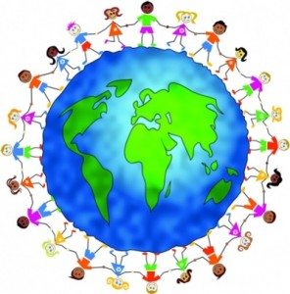
Key areas of citizenship - Democracy
What are the key areas ?
Source: https://www.teachingcitizenship.org.uk
Notes:
Main characteristics of democratic political system – get learners to work in small groups and write the seven, could use IT to research if available.
Regular elections to elect representatives to govern, which also provides the public with regular opportunities to remove people from power.
• Freedom to stand as a candidate in elections, to ensure that there is no permanent political class.
• Free and secret ballot, to ensure that people feel free to cast their vote as they wish, whilst minimising the chances of coercion or bribery.
• Political parties to help organise representatives around core policy ideas. This is perhaps a more debatable point, but it does provide a mechanism for political representatives to form governments and it also makes it easier for citizens to identify candidates to support.
• Free media to ensure information and a range of opinions are widely spread. This means that citizens are free to develop their own informed views and that politicians can be held to account for their actions, which are widely reported and analysed.
• Minority rights are essential in a democracy to ensure that the principle of liberty is maintained for all and to avoid what is often called the ‘tyranny of the majority’.
• Equal citizenship rights for women, a separate point because women are generally not a minority, but have nevertheless been excluded from ‘democratic’ institutions and processes.

Slide 17
Key areas of citizenship - Democracy
Volunteering and doing things for yourself:
One end of the spectrum is voluntary work with few obvious political implications.
Many charities do have political dimensions, these could be things like Clean Up Campaigns, which can be viewed in a few ways, or they could be charities openly trying to implement of influence policies
At the extreme end of the spectrum can be vigilantism – where communities take direct responsibility for aspects of security they feel have been failed in; e.g. groups in London to prevent riots and looting.
Source: https://www.teachingcitizenship.org.uk
Notes:
Ask the group to look at and feed back, on how they feel each of these areas may be judged
Volunteering and doing things yourself:
this can involve essentially charitable voluntary work at one end of the spectrum, with few obvious political implications. However, many charities also have a political dimension to their work:
Clean up campaigns – two views: directly tackle the problem rather than expecting a government agency to do it, but can be seen as campaigning methods in themselves to bring problems to public awareness
implementing or influencing policy or sometimes spending public funds.
The extreme end of this type of action we might consider vigilantism,15 where communities or individuals take direct responsibility for aspects of security where they perceive the police have failed. There is a huge range of vigilante action in the UK including: anti-paedophile groups, Jewish Shomrim groups protecting their communities, or spontaneous groups which arose in London to prevent riots and looting.

Slide 18
Key areas of citizenship - Democracy
Acts of omission or withdrawal:
We often think of citizenship action as positive action to change things, there is also tradition of just stopping doing something – such as striking in the workplace. Equally, people refuse to comply with unjust laws by sometimes ignoring them.
Civil disobedience:
Some acts of omission also count as civil disobedience – where the objective is to disrupt the law. Some examples of such non-violent acts include sit-ins and other forms of occupation, data leaks and whistleblowing in the age of social media.
Source: https://www.teachingcitizenship.org.uk
Notes:
Ask the group to look at and feed back, on how they feel each of these areas may be judged
Acts of omission or withdrawal: whilst we tend to think of citizenship action as a positive action to try to change things, there is also a powerful tradition of simply stopping doing something - practices as working to rule or striking have proved powerful. Others simply refuse to comply with unjust laws by bending the rules, or ignoring them. These acts are frequently seen as acts of ‘everyday resistance’ but Lily Tsai has recently described some as ‘constructive noncompliance’, where people believe this is a legitimate form of feedback to the government on badly framed laws
Civil disobedience: some of the acts of omission also constitute civil disobedience, where the object is to disrupt the law. Widely used non-violent acts include: sit-ins and others forms of occupation, such as the Greenpeace Women’s Camp or the Occupy movement; kiss-in protests have formed part of the campaign for gay equality; data leaks, whistleblowing and hacktivism have been widely publicised in the age of social media; and more traditional forms of sabotage and disruption have been used. The point here is to disrupt the law by stopping other legal activities from proceeding (such as arms sales or GM crop experiments) or forcing the legal system to confront injustices.

Slide 19
Key areas of citizenship - Democracy
Although rare exceptions – such as examples in the past – can make political violence for the greater cause seem worth it; generally it would do more harm than good and cause anarchy.
The laws were passed through our democratic government, and maintaining our freedom and order within society relies on following them.
As such, we can see how democracy is such an important element within citizenship and helps us maintain our equality with and contribution to our societies.
Source: https://www.teachingcitizenship.org.uk
Notes:
It is generally agreed that in order to live a life of relative freedom and order, we have to submit to the rule of law, or else it would be anarchy – these laws were passed through democracy and maintaining our society relies on following them.

Slide 20
CITIZENSHIP QUIZ
Notes:
QUIZ IN FOLDER

Slide 21
Citizenship – Conclusion
Citizenship is being a part of a country and entitles you to the rights within the law and society of that specific territory.
In modern day, with a few exceptions, where you are born will determine your citizenship – depending on the laws of the country through your birth location or your parents
Citizenship covers many political and social areas, such as democracy which we have looked at today

