Slide 1
Equality & Diversity

Slide 2
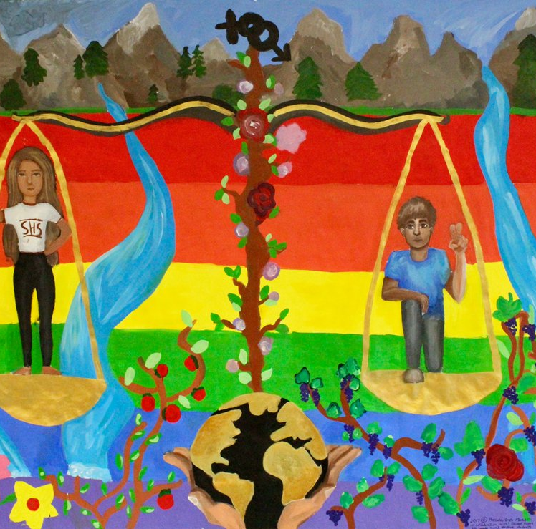
What are we hoping to cover in this tutorial?
Find out the definition of equality and diversity
Identify the factors that connect us all as human beings
Recognise the term ‘protected characteristics’ and identify the legal framework that protects peoples’ rights to be treated with fairness and respect
Look at some examples and discuss how we can support equality, diversity and inclusion
Notes:
Is this what you are hoping to learn today?

Slide 3
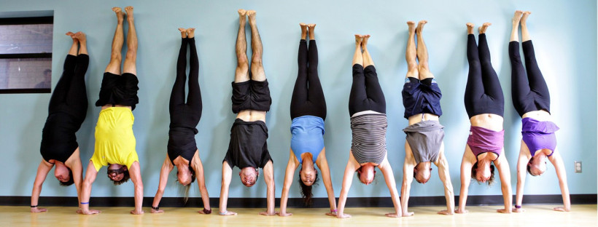
Warm-up exercise
Notes:
Ask learners to all stand up then read out the following:
I am going to ask you to sit down when I read out something that describes you:
I’m wearing socks that don’t match
I love gherkins
I’m a vegan or vegetarian
I need to wear glasses
I have an older brother or sister
I have blue eyes
My favourite pastime is reading
I can speak another language
I was born in another country other than the UK
I have a reptile, or reptiles as a pet
I have been bullied at some point in my life
My best subjects at school is (or are) sports, dance or art
After each time a person sits down, give them a card or post-it note in a different colour. At the end, see how many categories each person fits into. Who has the most cards? What do the learners think this exercise is trying to tell them?

Slide 4
Little Boxes “All That we Share”
https://www.youtube.com/watch?v=5jjqTav4-88

Slide 5
What is Equality? What is Diversity? Why does it matter?

Slide 6
Equality Law
Activity
Review the equality laws on worksheet 28
Complete the timeline below, by writing the equality laws in the boxes in the correct order
Identify what type of discrimination the law is aiming to tackle e.g. discrimination on grounds of race, sex or disability
Notes:
Prepare for this activity by printing & laminating the equality laws on worksheet 28.
Hand out worksheet 29 and ask learners to identify the

Slide 7
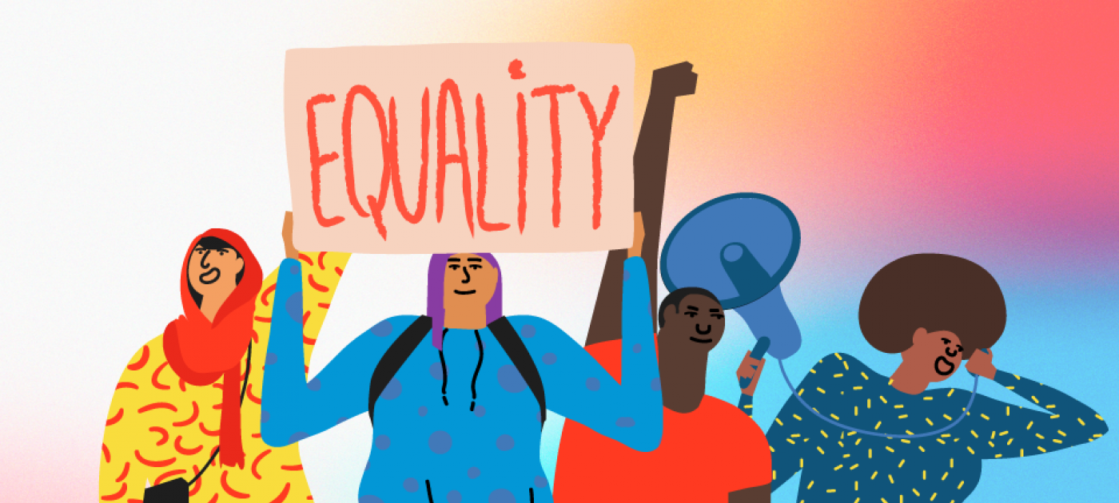
When would you rather live?
Activity
Imagine you have to travel back in time to live in a different era
Review the timeline on worksheet 27
Now circle a point in time, when you would most rather live and discuss this in your group
Why have you selected this time?

Slide 8
What is Equality and Inclusion?
https://www.youtube.com/watch?v=C-uyB5I6WnQ
Notes:
Play video about The Equality Act 2010 before moving onto the next activity looking at case studies

Slide 9
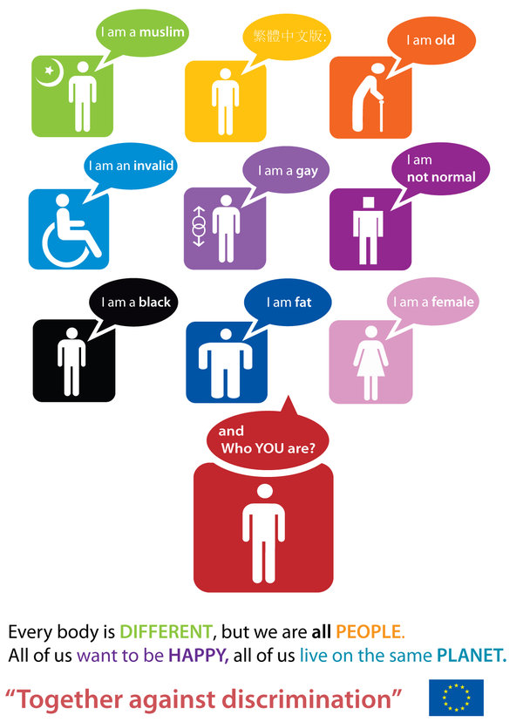
The Equality Act 2010
The Equality Act 2010 makes it law that every private, public and voluntary organisation must not discriminate against employees and people that use their services because of particular characteristics.
The Act brings together all previous equality laws, making them simpler, more effective and easier to understand.
Activity
Take a look at your case study (there are 6 in total) and answer the three questions on your card
It is suggested that you make notes so you’re prepared to share your ideas with the rest of the group
This Photo by Unknown Author is licensed under CC BY

Slide 10
Case Study 1
“I use a wheelchair to get around and I’m finding it very hard to get a place at my local college. I want to study science and the labs are on the first floor. The college hasn’t got a lift and they say they can’t afford to have one put in just for me so I must go somewhere else. Travelling any distance is really difficult and expensive so I don’t want to go to another college.”
What protected characteristic is potentially being discriminated against?
Could this be unlawful discrimination under the Equality Act 2010?
What action could the person take?
Notes:
The Trainer will need to print off these case studies in preparation for the session. You may wish to laminate them so they can be reused.
Allocate one case study per group, or per person (depending on numbers) and give the learners approx. 3-5 minutes to discuss their case study and write their answers.
Display each slide and invite the group with that side to feedback their answers to the group. Be prepared to respond to any questions

Slide 11
Case Study 2
“I was refused an apprenticeship at a local hairdresser’s because I wear the hijab and they say that all staff must wear their hair in trendy styles to impress the customers. I’m not prepared to do this as it is against my beliefs.”
What protected characteristic is potentially being discriminated against?
Could this be unlawful discrimination under the Equality Act 2010?
What action could the person take?

Slide 12
Case Study 3
“One of my friends, who is a girl, has said I can’t be a social care worker because it is a ‘girl’s job’. She said all men that work as social workers are probably gay.”
What protected characteristic is potentially being discriminated against?
Could this be unlawful discrimination under the Equality Act 2010?
What action could the person take?

Slide 13
Case Study 4
“I am an Irish Traveller. We live on a permanent site now and so we don’t move around anymore, which is great because I get to stay at the same school. But the other day I was in school and I heard a teacher making horrible comments about gypsies and travellers. They were saying our site should be shut down and we are all trouble.”
What protected characteristic is potentially being discriminated against?
Could this be unlawful discrimination under the Equality Act 2010?
What action could the person take?

Slide 14
Case Study 5
“I am at college and I’m pregnant. I am required to attend parenting classes at the same time as my science class. Both classes are really important and it seems unfair that I can’t attend them both.”
What protected characteristic is potentially being discriminated against?
Could this be unlawful discrimination under the Equality Act 2010?
What action could the person take?

Slide 15
Case Study 6
“At the moment I am undergoing gender reassignment. The college have been informed that I’m undergoing reassignment but does not seem to be willing to accept this, so won’t change my registration details and keeps referring to me by my birth name rather than my new name.”
What protected characteristic is potentially being discriminated against?
Could this be unlawful discrimination under the Equality Act 2010?
What action could the person take?

Slide 16
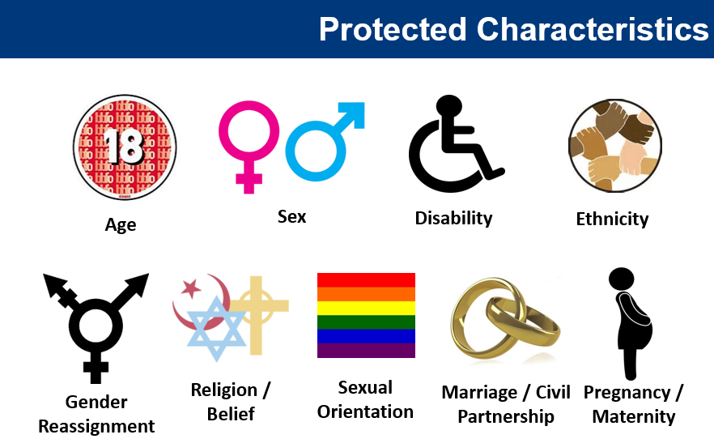
Quick Reminder:
The Equality Act 2010 makes it law that every private, public and voluntary organisation must not discriminate against employees and people that use their services because of the nine protected characteristics shown below.
The Public Sector Equality Duty (PSED)
The Equality Act 2010 also includes the Public Sector Equality Duty
This means public bodies, like the police, schools and hospitals, not only have to take steps to stop discrimination, but also have to….
Promote Equality
Question: Do you feel public sector bodies such as schools or the police promote equality effectively?
Notes:
Discussion – you may choose a specific area to focus upon depending upon the group you are working with (make it specific so it is more relevant and interesting)
For this slide you may wish to review the Public Sector Equality Duty via discussion and use an example or examples of people who have not been treated equally by schools, hospitals and/or the police. You may wish to use a photo of a person who has died in police custody with learning needs or a person of colour.
You may wish to consider using the ‘black lives matters’ demonstrations as a discussion point about institutionalised discrimination.
For older groups of learners you may want to look at changes by using examples such as the programme ‘Life on Mars’ where women police officers were treated very differently to their male counterparts

Slide 17
Review of Learning Outcomes. Have we…
Found out the definition of equality & diversity?
Identified the factors that connect us all as human beings?
Be able to recognise the term ‘protected characteristics’ and identify the legal framework that protects peoples’ rights to be treated with fairness and respect?
Looked at some examples and discussed how we can support equality, diversity and inclusion?
Notes:
Thank learners for their contribution and ask if there are any further questions.

