Slide 2
Aim
I can explain who John Muir was and why he was a significant individual.
Learning Outcome
Having selected a significant individual from the past, I can contribute to a discussion on the influence of their actions, then and since.

Slide 3
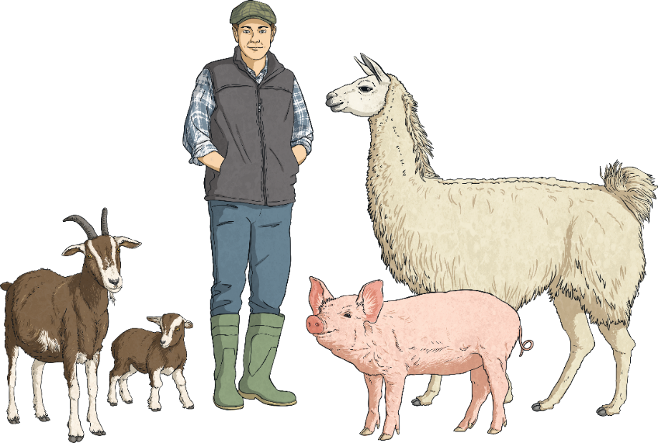
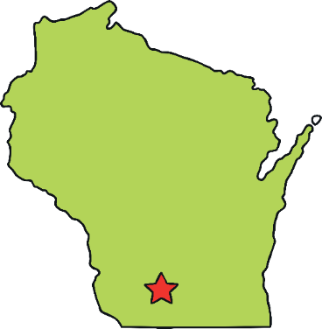
John Muir
John Muir was born in 1838, in Dunbar near Edinburgh. As a boy, John loved exploring wild places. In 1849, when John was 11 years old, he emigrated with his family to the United States. John lived and worked on the family’s farm in Wisconsin for 10 years. He still enjoyed studying, exploring and inventing things.

Slide 4
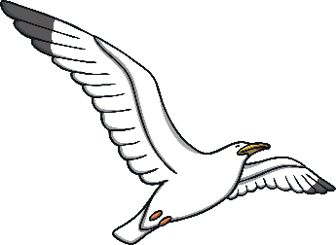
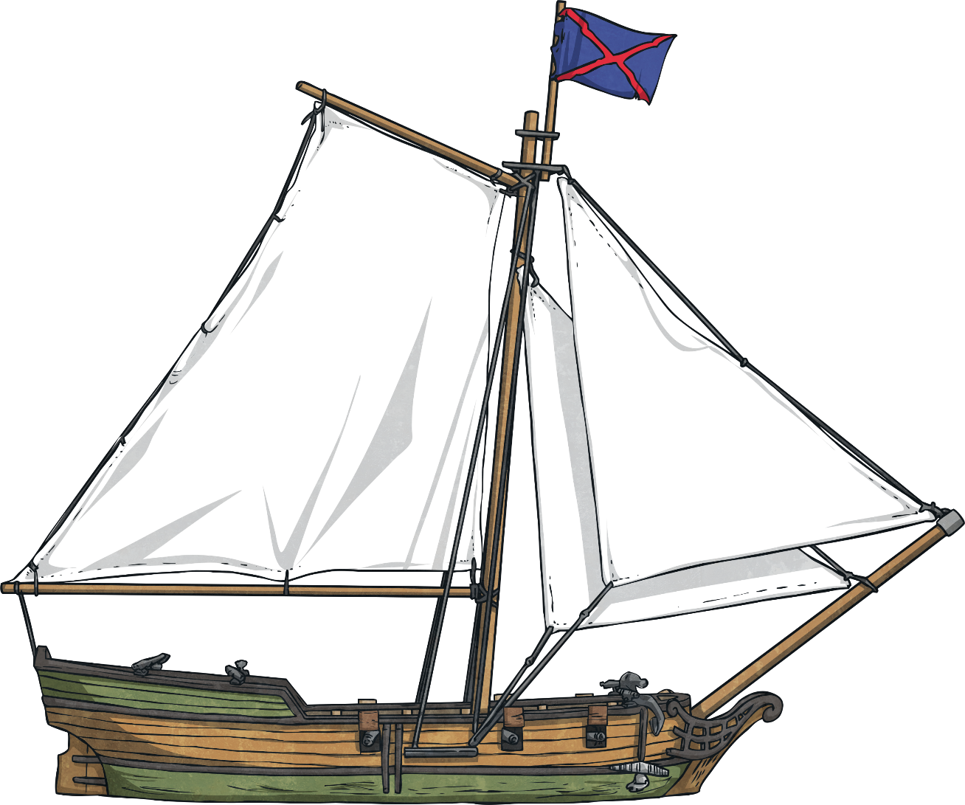
1867
In 1867, John went to work in a factory. When a tool he was using struck his eye, John was blinded. After several weeks his sight came back and when it did, he knew that he wanted to explore the outdoors more than anything. John went on a 1000 mile walk from Wisconsin to Florida and then sailed to Cuba.

Slide 5
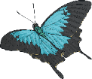
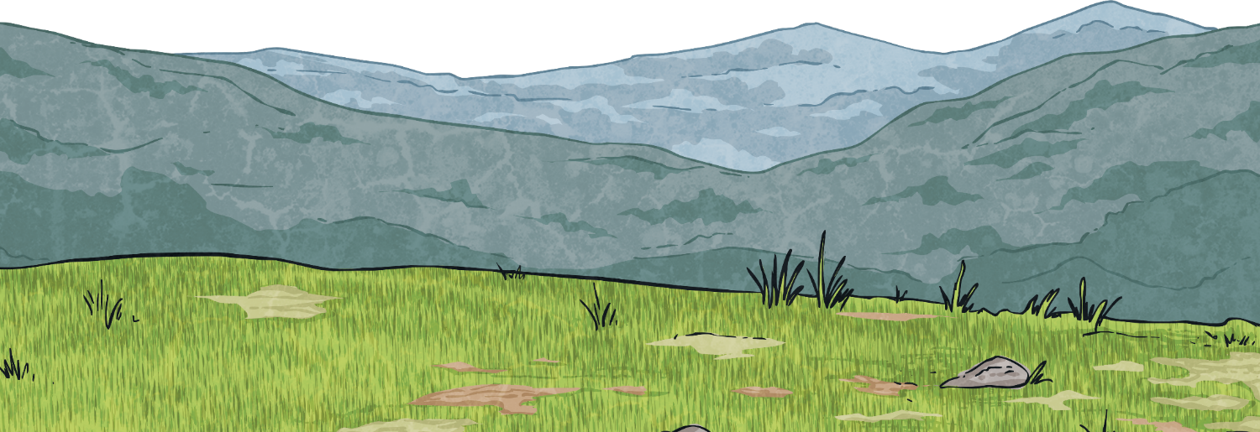
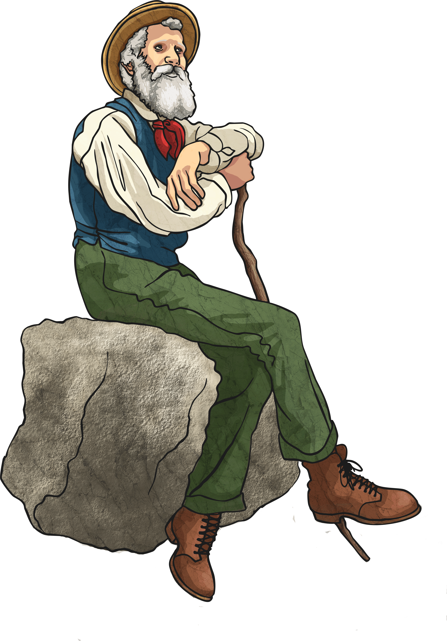
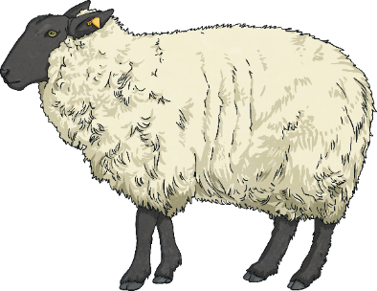
1868
In 1868 John settled in the Sierra Nevada mountains in California. He worked as a shepherd and that gave him time to study the natural wilderness, climb and explore glaciers. John led many visitors who wanted to explore this beautiful and rugged area. Muir loved everything about nature; the insects, the wild animals, the plants, trees, rivers and mountains. He understood that all of these things were connected to each other.

Slide 6
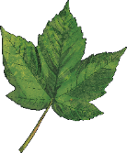
1872
In 1872 John became a writer. He went on to write and publish many articles and books about looking after nature. John’s love of nature led him to want to protect it all. John was one of the first ever conservationists. A conservationist is someone who wants to conserve or protect natural places or living things from being destroyed. John Muir believed that people should do something to help protect nature.

Slide 7
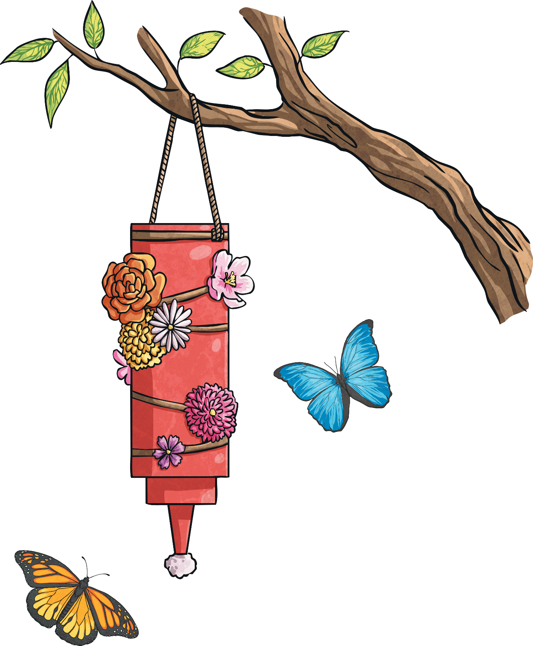
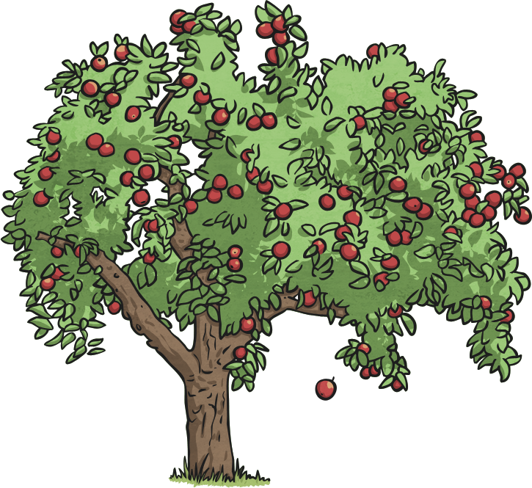
1880
In 1880 John married Louisa Strenzel and he worked as a fruit farmer and rancher. John and his wife had two daughters, Wanda and Helen. John began to give talks about what he believed in. These talks, along with his writing, helped people to understand the importance of the wild.

Slide 8
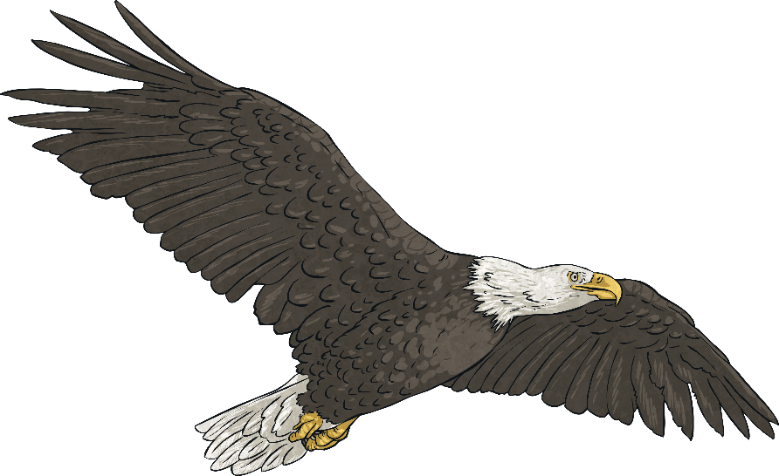
1872
In 1890 he helped in making the Yosemite Valley in California one of the first National Parks in the USA. With others, John formed the Sierra Club in 1892. The Sierra Club is an American organisation that still works today to protect the environment.

Slide 9
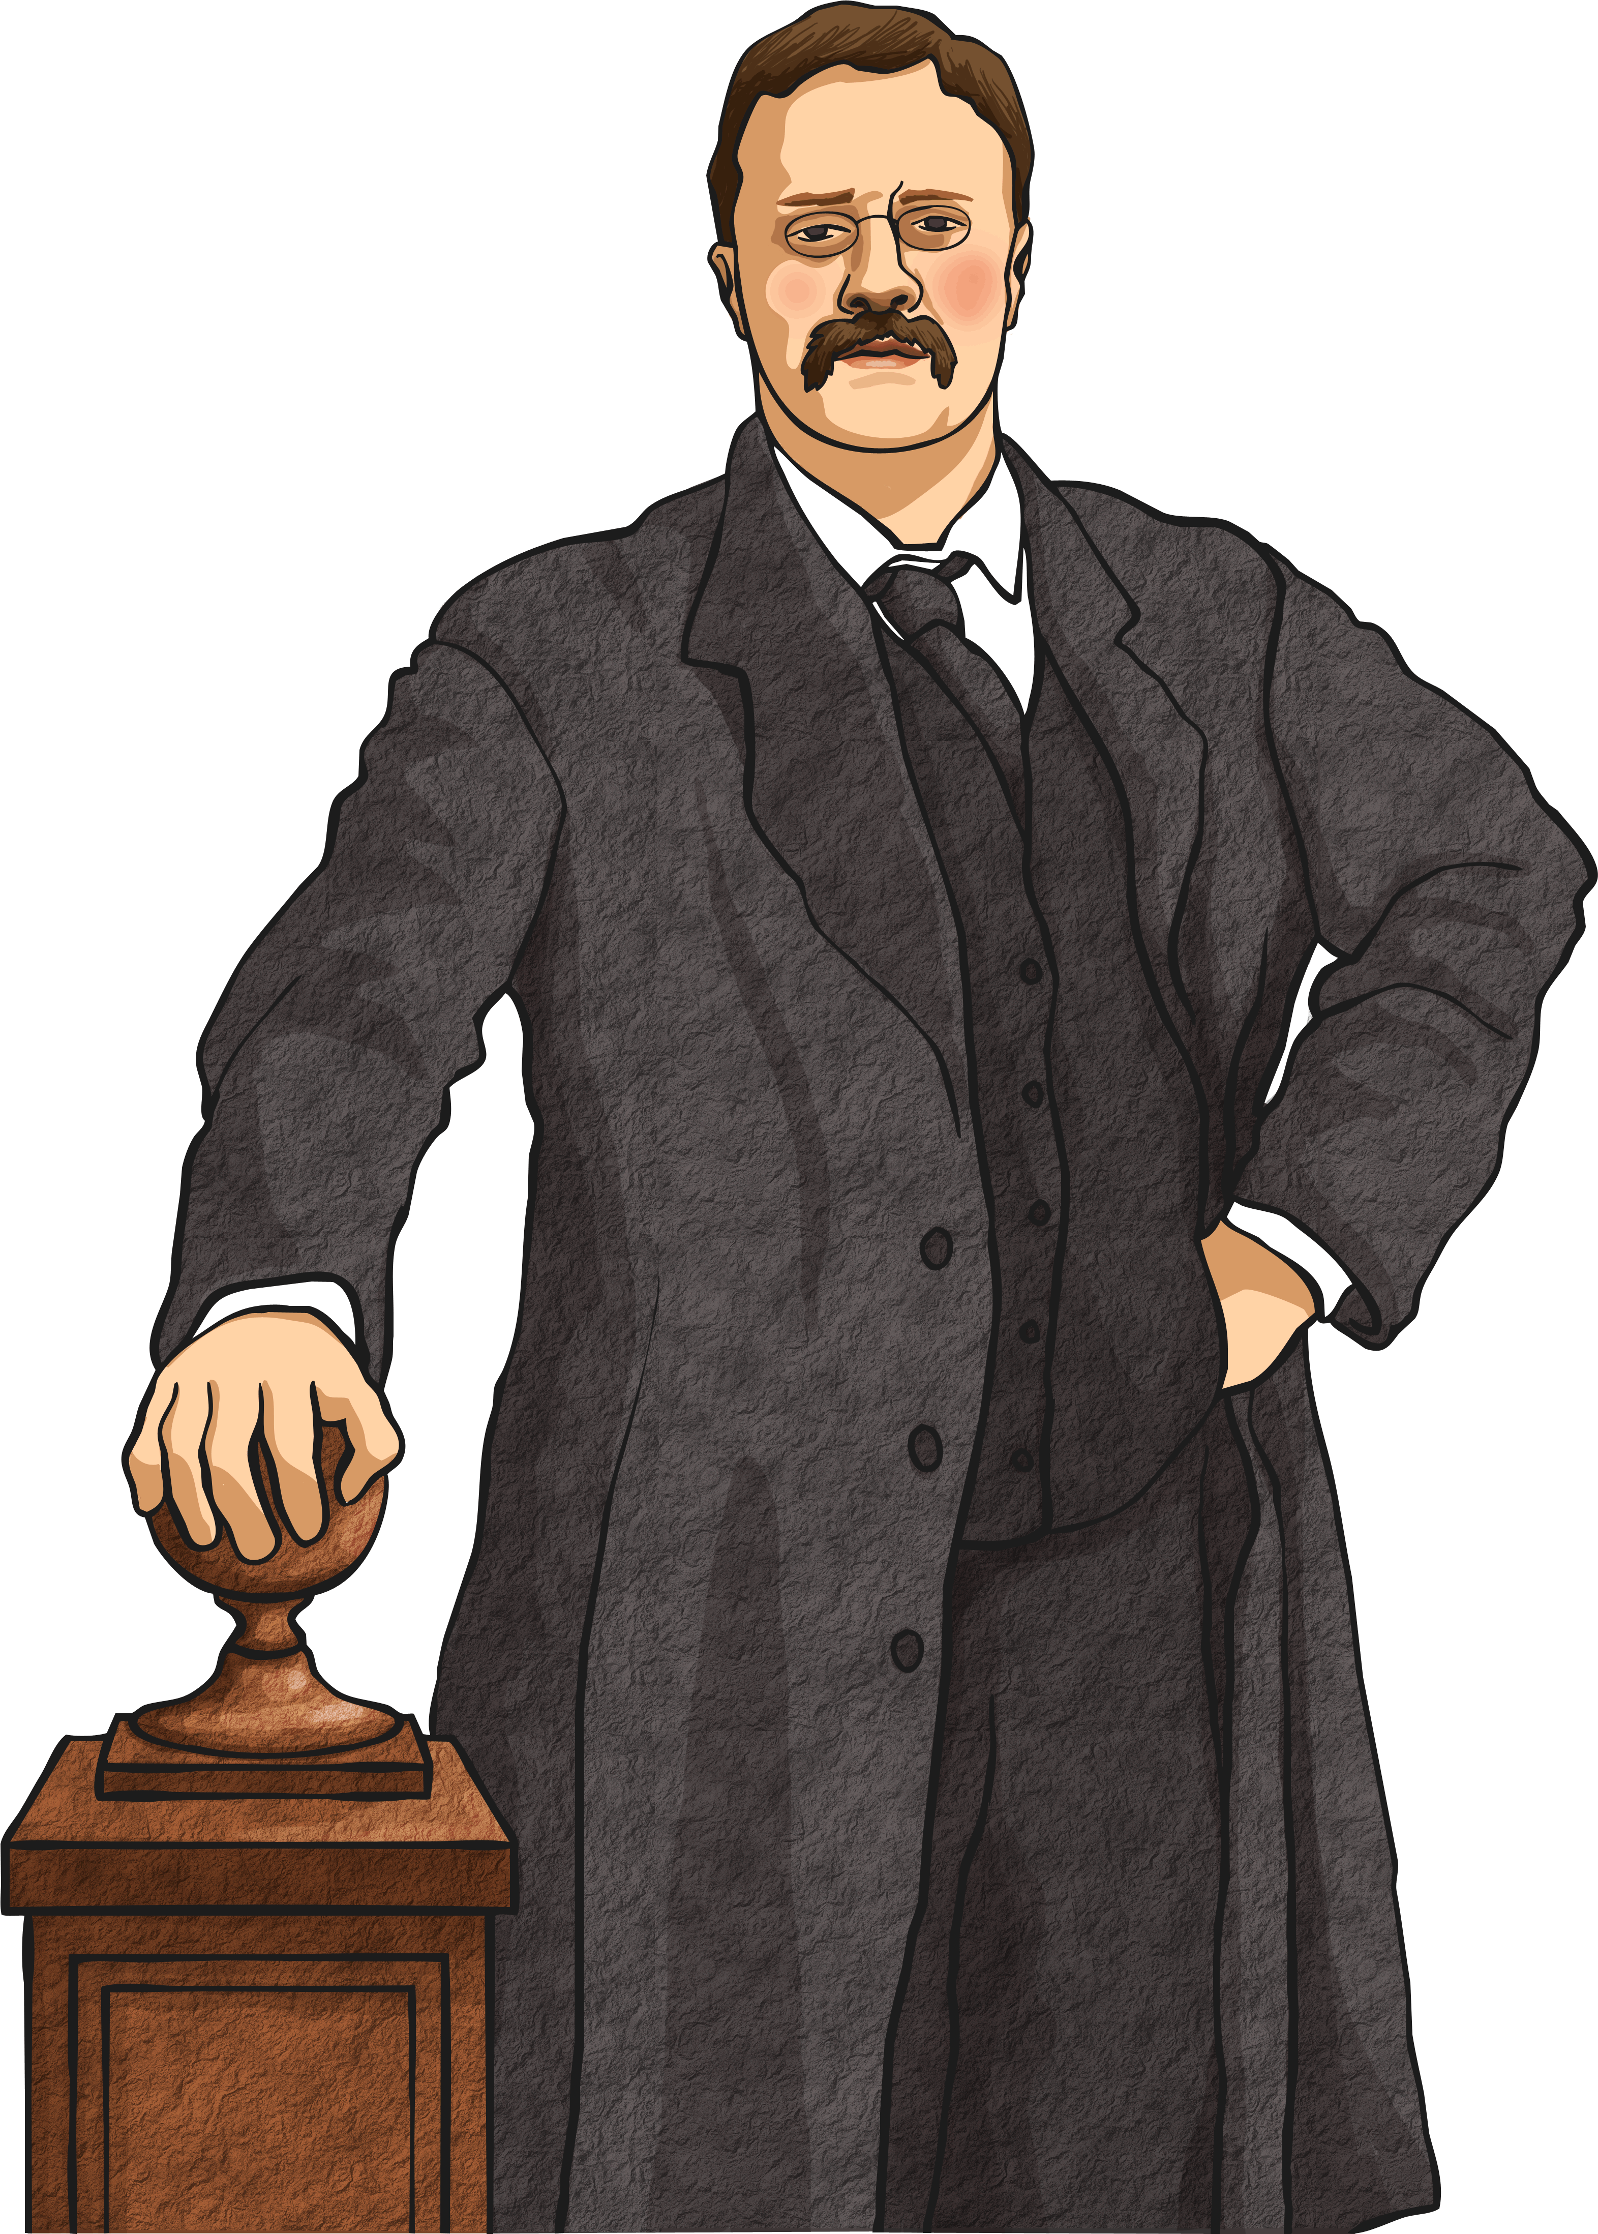
1868
John’s books and talks made him famous. In 1900 President Roosevelt asked to spend time with him and they went camping in Yosemite. They camped in the wild country and when they woke up the next morning, they were covered in a light dusting of snow!

Slide 10
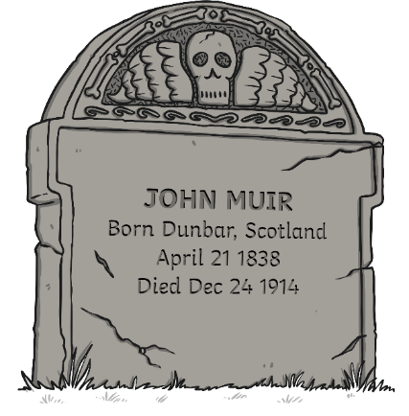
1914
In 1914 John Muir died of pneumonia, aged 76. John Muir’s message that we all need to enjoy and care for nature is just as important today as it was when he was alive. The John Muir Trust is a charity that was started in the UK in 1983 to preserve and protect wild places. They own, care for and protect areas of wilderness in Scotland, including Ben Nevis and an area on Skye. People’s belief in John Muir’s work also helped lead to the establishment of Scotland’s National Parks in 2002 and 2003; the Cairngorms, Loch Lomond and The Trossachs.

Slide 11
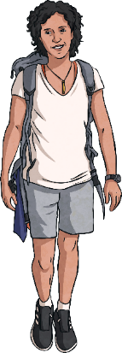
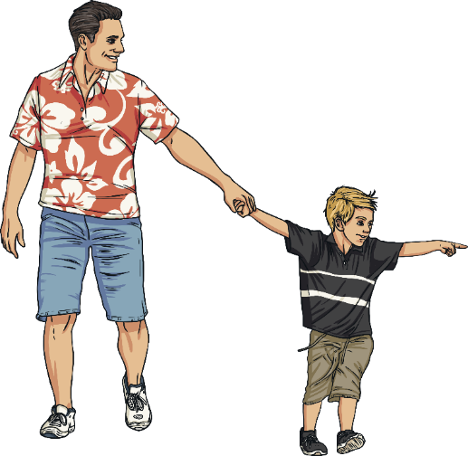
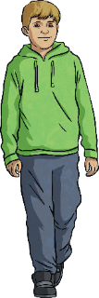
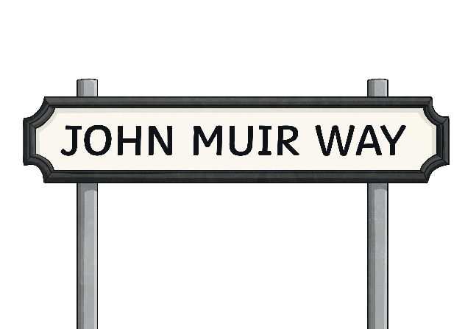
Today
The 21st of April is John Muir Day in Scotland; events and activities are held to celebrate Muir’s love of the outdoors. In 2014 John Muir Way was opened. It is a Long Distance Path that stretches for 134 miles (215 km) across Scotland. It runs between Helensburgh in the West through to Muir’s birthplace, Dunbar, on the East Coast. John Muir’s passion for encouraging people to enjoy the outdoors lives on across the world today.

