Slide 1

Hampshire Careers and Employability Service
CV Workshop
Oak Lodge School June 2018

Slide 2




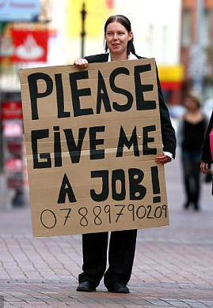

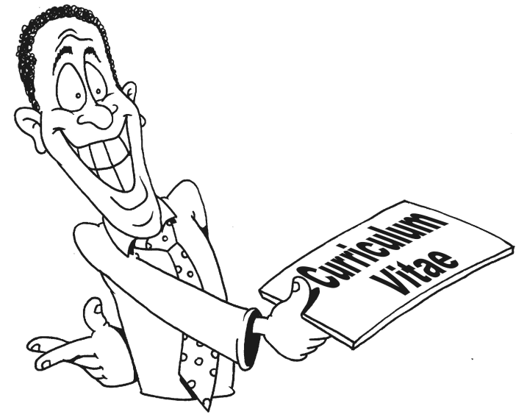
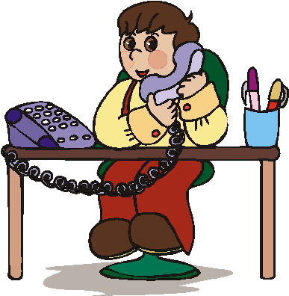


Slide 3



How do you get a job?

Slide 4




Slide 5




Slide 6


How do you apply for a job?
CV
You give information
Application form
Asks you for information

Slide 7

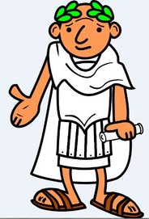
What is a CV?
CV stands for
the course of one's life or career”
In Latin this means…

Slide 8




What goes in a CV?
But who do you choose?

Slide 9



How do you choose?
What do you need to know?
What information do you want?

Slide 10









What to put in a CV?
Contact Details
What you are like
Your job interests
Your skills
Schools and colleges attended
Who to contact to check what you are like
Work Experience
Hobbies and Interests
Your qualifications
Achievements

Slide 11





Contact Details
Name
Address
Telephone Number
Mobile Number
Email Address

Slide 12

Lee Smith
1 Sunshine Road
Hythe,
Southampton
SO45 1AA
Tel: 02380 123456
Mob: 07123 456789
Lee.Smith@yahoo.co.uk

Slide 13






Personal Profile
You need to write about:
What are you like?
What are your strengths?

Slide 14

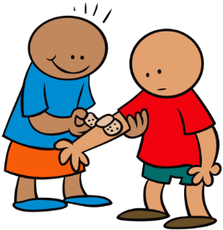




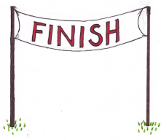
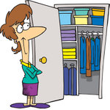

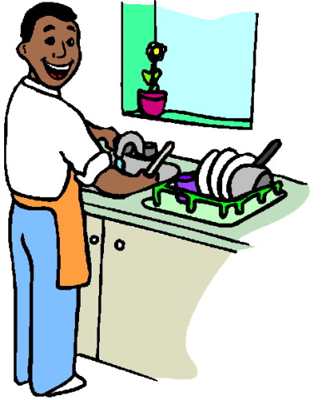

Personal Profile
Friendly
Never gives up
Honest
Kind
Helpful
Organised
Hardworking
Good sense of humour

Slide 15


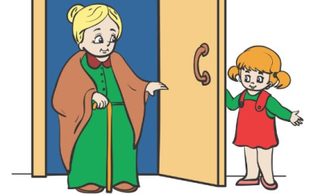


Personal Profile
Pick the words that describe your strengths and what you are like.
Friendly
Helpful
Polite
Hardworking
Put them in a sentence:
I am a friendly, polite and helpful person who enjoys working hard.

Slide 16
Personal Profile
You need to write about:
What are you like?
What are your strengths?

Slide 17






Personal Profile
Artistic
Caring

Slide 18



Personal Profile
Polite and helpful
Hardworking and good with hands on tasks

Slide 19
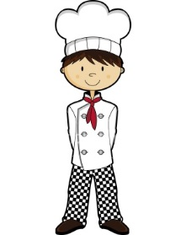

Personal Profile
You need to write about:
What kind of work are you looking for?
Why would you be good at it?

Slide 20

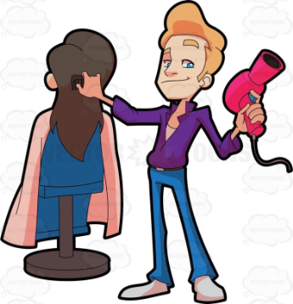

Personal Profile
If you know what kind of work you are looking for…
Why are you interested?
    Like fashion Enjoy working with people
What skills do you need for this type of work?
Artistic Good with hands Creative
Hairdressing
I am looking for work or training in a hairdressers as I like fashion and enjoy working with people. I think I would be good a this type of work because I am artistic, creative and good with my hands.

Slide 21

Personal Profile:
I am a friendly and polite person who enjoys working hard. I am honest and always try my best. I am looking for work or training in a hairdressers as I like fashion and enjoy helping people. I think I would be good at this type of work because I am artistic, creative and good with my hands.
Personal Profile

Slide 22






Key Skills
You need to write about:
What knowledge do you have?
Why would you be a good employee?
What do you have experience of?
What things are you good at?

Slide 23




Key Skills
Able to speak to people in a polite and friendly manner
Good attendance and timekeeping
Can work in a team
Able to follow instructions

Slide 24




Key Skills
Computer and keyboard
skills
Aware of
Food Hygiene
Good attention to detail
Experience of giving good customer service

Slide 25







Key Skills
Using bullet points can break up your CV
Key Skills
Key Skills
Key Skills
Key Skills
Don’t repeat anything from your Personal Profile.
Write about skills that link to the job you want.

Slide 26
Key Skills
Key Skills:
Able to speak to people in a polite and friendly manner
Excellent timekeeping and attendance records
Good computer and keyboard skills
Able to work well in a team
Good at practical and hands on tasks
Experience of using hand tools for gardening work

Slide 27


Education
List where you have attended education and training
Put the most recent at the top
For school, only list the school you attend in Year 11.
Southampton City College Sept 2017 - Present
Oak Lodge School, Hythe Sept 2013 - July 2017

Slide 28
Education
Education
Oak Lodge School, Hythe Sept 2015 - Present

Slide 29


Qualifications
Subject:
English
Art and Design
Food Technology
Grade or Predicted Grade:
1, 2, 3, 4, 5
A, B, C, D, E,
Pass, Merit, Bronze, Silver
Date of qualification: July 2017
Name of qualification:
GCSE, Arts Award, Asdan, BTEC

Slide 30
Qualifications
Qualifications:
English GCSE Grade 3 July 2017
Art and Design GCSE Grade 4 July 2017
Mathematics GCSE Grade 5 Predicted
Arts Award Bronze Pass July 2017

Slide 31




Employment History
When listing your Employment History, put the most recent at the top
Make sure you include:
Your job title
Shop
Assistant
Name of employer
Start and Finish Date
Shop
Assistant
Whether it was work experience, paid work or voluntary work

Slide 32

Employment History
Employment History:
Tesco’s, Dibden
Work Experience 8th – 19th January 2018
In my role as a Shop Assistant…

Slide 33

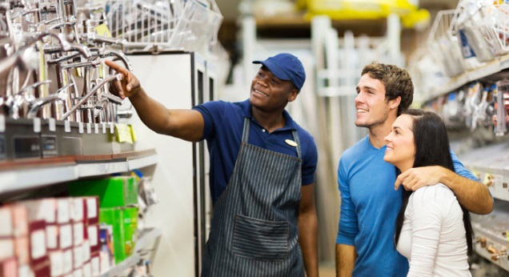
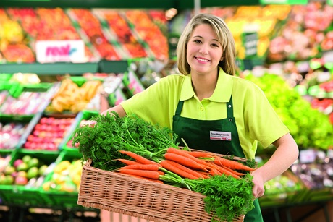
Employment History
Retail Sales Assistant
Provided good customer service
Gave advice to customers about products
Used a computerised till
Took payments (cash, debit card, credit card)
Stacked shelves
Arranged products to look good
Packed and wrapped products
Kept shop clean and tidy
Working as part of a team

Slide 34
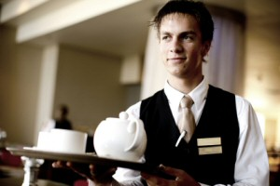
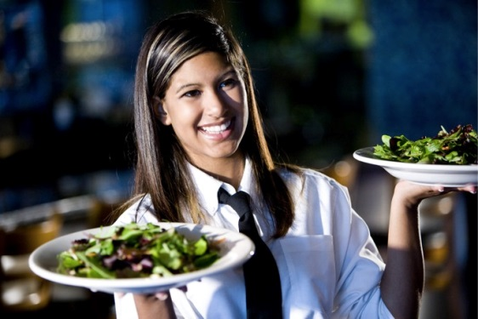
Employment History
Waiter/Waitress
Provided a quality customer service
Welcomed customers
Showed them to tables
Handed out menus
Took orders
Served food and drinks to customers
Ensured standards of hygiene
Cleaned, wiped and laid tables
Worked as part of a team

Slide 35

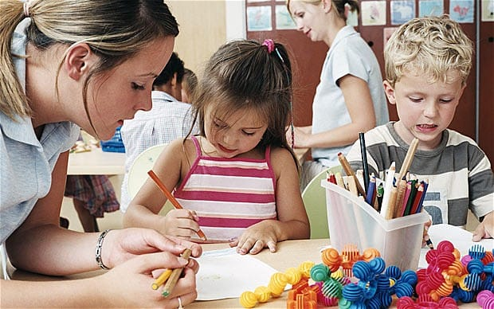
Employment History
Child Care Assistant
Looked after Children and made sure they were safe
Helped with activities such as painting
Supervised the use of toys
Read stories
Played games with children
Encouraged children to succeed
Helped serve food and drinks
Kept play areas clean and tidy
Followed instructions

Slide 36
Employment History
Employment History:
Tesco’s, Dibden
Work Experience 8th – 19th January 2018
In my role as a Shop Assistant, I helped customers find products, unpacked goods and stacked shelves. I cleaned up spillages and made sure the shop floor was kept clean and tidy. In this role I worked as part of a team, but also had individual tasks to complete.

Slide 37



Achievements
Helps to pad out shorter CV’s and helps you stand out from the crowd!
Section is optional
Member of local sports team.
Being in sports demonstrates skills such as commitment and team work. You could also write about any special responsibilities you had in this team, trophies gained or awards given
Fund raising.
Demonstrates willingness to put yourself out for others, that you care about others, that you are organised, that you see things through.

Slide 38



Achievements
Prizes for :
Special or extra work
Having a talent
Certificates
For hard work or full attendance.
Or any certificate not included in any other sections of your CV.

Slide 39


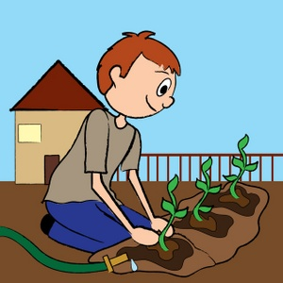
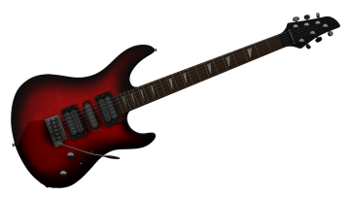

Achievements
Have you ever completed a gardening project for yourself or a neighbour?
Have you ever raised money for charity?
Have you been in a school play?
Have you ever been a mentor or prefect?
Do you play an instrument
Have you been in a band
Have you any musical certificates?

Slide 40
Achievements
Achievements:
I enjoying keeping fit and I have lots of swimming certificates. Last August I helped to raise money for Comic Relief by swimming laps in my local pool and making cakes for a bake sale.

Slide 41










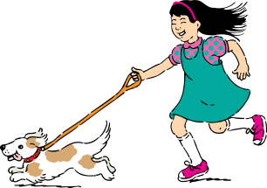





Interests
Baby- sitting
DIY
Interested in environment
(animals or plants)
Playing for a local team
Listening to music
Cycling
Arts and Crafts
Volunteering
Gardening
Martial Arts
Reading
Dog walking
Make-up and Beauty
Sewing / knitting
Dancing

Slide 42




Interests
Include hobbies and interests that link to the kind of job or training you are applying for.
Hospitality & Catering:
Like to cook
Create new recipes
Experiment with new ingredients in the kitchen
Meet new people

Slide 43



Interests
Hair & Beauty
Enjoy drawing and painting
Like to read about fashion
Complete make-overs on friends or family
Enjoy socialising and meeting new people

Slide 44



Interests
Construction
Like to complete DIY type tasks
Making things using tools
Gardening
Like being physically active.

Slide 45
Interests
Interests:
I enjoy lots of sport such as swimming, football and cycling. I like meeting new people and looking after our two cats. My real passion is cooking and trying out new recipes for friends and family. I like trying new ingredients and people really seem to like my cakes and biscuits.

Slide 46

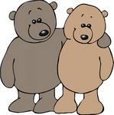





References
Under the heading of references, you can write:
‘References available on request’
You should have at least 2 references.
Employers Friends
Education providers Family

Slide 47

References
Mr Oliver Twist Ms Sandra Smith
Head of Year 11 Line Manager
Crookhorn College Tesco
Stakes Hill Road Hythe
Waterlooville Southampton
PO7 5UD SO45 5AA
Tel: 02392 251120 Tel: 01730 222222
E-mail: Oliver.twist@crookhorn.com E-mail: S.Smith@tesco.com

Slide 48


