Slide 2
House keeping

Slide 3
Progress to date
Notes:
88% of tutors will have been observed by end of July – not quite at our 90% plus target
(last year 90.4%)

Slide 4
PROVIDER | Meets Exp | Not observed | Planned | Re-obs Rqd | Total
CFW | 6 | 1 | 1 | 0 | 8
EMS | 7 | 0 | 0 | 0 | 7
FUT | 6 | 2 | 1 | 0 | 9
HCT | 9 | 2 | 2 | 0 | 13
HFR | 1 | 1 | 0 | 0 | 2
ITCH | 8 | 2 | 0 | 1 | 11
LIB | 42 | 5 | 2 | 1 | 50
RCS | 10 | 1 | 0 | 1 | 12
Total | 86 | 13 | 6 | 3 | 108

Slide 5
Tutors requiring support
3 currently waiting for re-observation
15 in total
Notes:
Safeguarding x

Slide 6
Key Strengths - summer

Slide 7
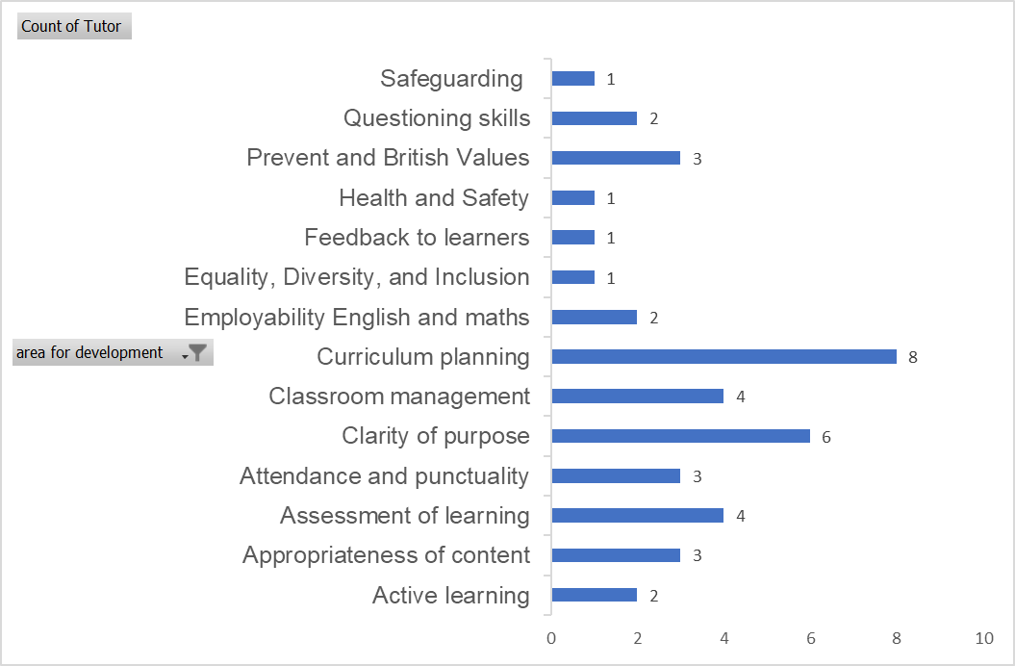
Key areas for development -summer
Notes:
Clarity of purpose: SMART objectives, objective focused sessions
Curriculum planning: session evaluations, consistency of LO, weekly focus,

Slide 8
Emerging themes from mini-inspection
Notes:
Mikaela Collins
Initial Assessment a weakness
Strengths – relationships with learners – supportive environments, all able to make progress.

Slide 9
Feedback on HL/QD25
Categories
Sections
Notes:
No additions or changes requested by observers

Slide 10
Changes to quality documentation
HL05 – curriculum plan – minor changes
HL22a – tutor course evaluation – being withdrawn
HL16b – learning goals no longer need to be written on form
ILG only need to be on HL16c

Slide 11
Standardisation activity
For the following reports please consider the following questions
Does the report contain judgemental language with supporting evidence?
Is the report written in a supportive manner?
Does the narrative support the identified strengths and action areas?
What outcome would you give based on the information in the report?

Slide 12
Questions

Slide 13
Teaching and Learning Conference
Thursday 19th October
Theme: personalisation and inclusivity
Keynote Speaker: Geoff Petty

Slide 14
Annual Update meeting
Date: Thursday 7th September
Time:1-4 PM
Venue: Gainsborough Room Elizabeth II Court
Please let me know if you have not received a calendar invite for this

