Slide 1
How to be a great teacher (without the burnout)
Gillian Forrester
HOLEX workshop
25 Feb 25

Slide 2
Agenda
Background
Newcastle City Learning – Wellbeing approach
Why do we need such a focus on staff wellbeing?
Why a change in mind set is needed
Steps to consider around a change in mind set
* Step 1. Consider what makes a great teacher
* Step 2 – Consider strategies to combat negative emotions like stress, anxiety and overwhelm.
* Step 3 – Consider how to get a better night's sleep.
* Step 4 - Understand how your emotions impact on your performance at work.
* Step 5 – Understand the habits of high performers
* Step 6 – Increase our productivity.
* Step 7 – Consider how to sustain good habits and get back the love for the job
How to be a Great Teacher without the burnout – a practical online course (discount for HOLEX members)
Questions?

Slide 3
Background

Slide 4
Who is Gillian
Head of Newcastle City Learning – have worked in the post-16 sector for over 30 years.
I was also an HMI for a very short period. Part-time inspector for over 20 years.
Ran my own consultancy and coaching business for a number of years.
Offer personal coaching to empower others to thrive.

Slide 5
This work around teacher burnout evolved from three sources:
My own role as a Head of Newcastle City Learning and the requirement to write a Staff Wellbeing strategy.
My work as an educator in teacher development, a coach and mentor within the sector.
My training and work as an Emotional Freedom Technique (EFT also known as Tapping) practitioner

Slide 6
Newcastle City Learning – Wellbeing approach

Slide 7
NCL
Wellbeing
Strategy
2024 – 2025

Slide 8
Foreword
However, reaching this is a challenge, and certainly this policy alone will not allow us to achieve this.
So, this is a growing project which will develop over time.
We also often hear the saying, if you love your work then it does not feel like work at all.
Perhaps everyone loving their work all of the time is an over-ambitious aim, but we can at least strive to make work a place where we can feel safe and hopefully thrive.
The challenges in the education sector make this difficult. We are working in a public sector which has been underfunded for decades, and where people need to rise to challenges and change on a regular basis.
We also know that the culture of an organisation and good management contribute greatly to establishing an environment which is conducive to good employer wellbeing and, as a result, high performance and productivity.
Our Wellbeing Strategy
Welcome to Newcastle City Learning’s workforce Wellbeing Strategy 2024 – 2025.
The link between good mental health and wellbeing and good performance at work is well documented.
“For many of us, work is a major part of our lives. It is where we spend much of our time, where we get our income and where we make our friends. Having a fulfilling job can be good for your mental health and general wellbeing.”
Mental Health Foundation

Slide 9
Engage, motivate and retain employees
Create a healthier, more inclusive culture
Lower sickness absence
Improve performance and development
Improve productivity

Slide 10
Wellbeing at Newcastle City Learning
Improving the wellbeing of our people will support Newcastle City Learning (NCL) to achieve more and to reach our ambition of becoming an outstanding provider of relevant education and development opportunities for the residents of Newcastle upon Tyne.
It is a fact that a happier workforce is a more productive workforce.
“Addressing wellbeing at work increases productivity by as much as 12%.”
Mental Health Foundation

Slide 11
Wellbeing at Newcastle City Learning
Introduced:
Staff Yoga classes
Deep breathwork classes
Walking Challenges
End of year wellbeing day – included hand massages, breathwork classes, Emotional Freedom Technique (EFT) workshops, visualisation meditation workshop, rounders on the field, picnic lunch catch ups.

Slide 12
Why do we need such a focus on staff wellbeing?

Slide 13
Why do we need such a focus on staff wellbeing?
Staff wellbeing is seen as a leadership priority.
The highest percentage of sickness recorded in many businesses now is stress.
We see this appear within the new proposed Scorecards for the new Ofsted framework.

Slide 14
Why do we need such a focus on staff wellbeing?
There is an epidemic of stress and anxiety affecting our population.
Humans were not created to deal with our current lifestyles.
When our bodies get flooded with Cortisol we respond in a very negative way.

Slide 15
Why do we need such a focus on staff wellbeing?
When in high stress mode:
We are less creative
We struggle to learn
We struggle to make sound decisions
Our brains can misfunction
We can have negative thoughts
We make mistakes
Our monkey minds can go into overdrive
We become less confident
We can begin to lose our self-confidence and self-esteem.
We worry
When our bodies get flooded with Cortisol, we can feel physical symptoms.

Slide 16
Why do we need such a focus on staff wellbeing?
If allowed to spiral this can lead to the early signs of burnout.
Trouble sleeping
Low mood
Loss of interest in things we used to love doing
Frustration or even anger at our situation
An inability to control our emotions and behaviours

Slide 17
Why a change in mind set is needed

Slide 18
Change takes a mind shift change
Don’t use up energy worrying or focussing on what you can’t control or influence.
This is just wasted energy and time.
Out of your control
Within your
Control

Slide 19
Pause
Any questions?

Slide 20
Steps to consider around a change in mindset

Slide 21
Step 1. Consider what makes a great teacher

Slide 22
What is it that those teachers who make it all look easy do and know? Will I know when I see an outstanding lesson in practice?

Slide 23
Do we still care about outstanding teaching?
A question I am often asked is
What makes an outstanding lesson?
What does outstanding practice look like?
How can I get there without working ridiculous hours and killing myself in the process?

Slide 24
Stress and anxiety can be the enemy of the very person you need to be, to be a great teacher.
Think of a great teacher you know or have been taught by in the past.
Close your eyes and bring them to mind now.
How does thinking about this person make you feel?

Slide 25
Great teachers – what characteristics do they demonstrate?
They care
They valued me
They were very knowledgeable about their subject and often they had a passion for their subject
They were firm but fair
They were kind and they made me feel safe.

Slide 26
We all know teachers who exude an air of authority and who command attention the minute they walk into a room. Their presence communicates itself to students, often without a word having been spoken. When they speak and interact, they come across as engaging, effective communicators. Their classes are calm and focused, students and teacher work well together and behaviour is rarely a problem. How do they do it?

Slide 27
Great teachers are calm and confident
Great teachers have presence
Great teachers have good cognitive skills and are they make sound decisions in the classroom
They create a climate which is conducive to learning and makes learners feel safe in their learning and feel valued.

Slide 28
Pause
Any questions?

Slide 29
Step 2 – Consider strategies to combat negative emotions like stress, anxiety and overwhelm.

Slide 30
Noticing is the first step.
Acknowledging what is happening is the next.
Most people get to this point and just wish for things to change.

Slide 31
Those people who realise that the only way to make a difference, realise that it is them who need to change.
You have to work on your mind.
You have to protect your brain.
You have to take action to change habits.

Slide 32
EFT demonstration 1
The Tapping Solution (EFT): Who Would You Be Without the Stress?

Slide 33
Pause
Any questions?

Slide 34
Step 3 – Consider how to get a better night's sleep

Slide 35
Research has shown that a good night’s sleep is so important for good performance at work.
Learn how to combat poor sleep will reduce constant tiredness and improve performance.

Slide 36
Step 4 - Understand how your emotions impact on your performance at work

Slide 37
The link between our emotions and our performance at work is much better understood now.
Learning how to manage your emotions and behaviours in the classroom will help maximise learning and your rapport with your learners.

Slide 38
You are energy.
Your energy is governed by your emotions.
When you feel low (In low vibration) – this message is picked up by your learners.
When you feel good and happy (In high vibration) – you give off a completely different signal to your learners.

Slide 39
Step 5 – Understand the habits of high performers

Slide 40
Understanding the habits adopted by high performers can be incredibly helpful; what can we learn from these achievers to improve our performance in the classroom and increase our productivity at work?
The work of Brendon Bruchard and his research on the six habits adopted by high performers is incredibly informative.

Slide 41
Step 6 – Increase our productivity.

Slide 42
Do more of what matters. How can we be more productive rather than busy?
Do less but make more of a difference.
Mel Robbins - Stop Wasting Energy on Negativity

Slide 43
Being constantly busy is not the same as being productive!
Being busy can drain your energy and make you feel more frustrated.
Being productive makes you feel good.
Do more of what matters.
Mel Robbins - Stop Wasting Energy on Negativity

Slide 44
Step 7 – Consider how to sustain good habits and get back the love for the job

Slide 45
Sustaining good habits. The role of the teacher gets more demanding each year.
We need to be able to set boundaries in terms of our own work balance.
How can I sustain a better way of working and managing a better work-life balance?
How can I get back my love of this job?
How can I make being a great teacher look easy?

Slide 46
A Little Guide for Teachers: Teacher Wellbeing and Self-care (A Little Guide for Teachers): Amazon.co.uk: Bethune, Adrian, Kell, Emma: 9781529730579: Books
HAPPY teachers make great teachers. Overwhelmed ones don’t!

Slide 47
How to be a Great Teacher without the burnout – a practical online course (discount available for HOLEX members)
Gillian Forrester
Find out more at Gillian Forrester Coaching

Slide 48
This course will show you:
How to become an outstanding practitioner.
How to reduce stress, anxiety and feelings of overwhelm
Take back control of your emotions and your free time
Learn strategies which help to reduce cortisol in the body.
Over the course of the progamme you will explore how you can work towards a better work life balance. You will learn simple strategies to help reduce stress, improve your well-being and productivity at work and start doing more of what matters to you and makes a real difference to your learners.
With over 30 years of experience, I know that ours is one of the most challenging careers there is, but I also know how much of a difference we get to make to our students’ lives.
I also know that with the right support, it’s a career that can be enjoyable and rewarding.

Slide 49
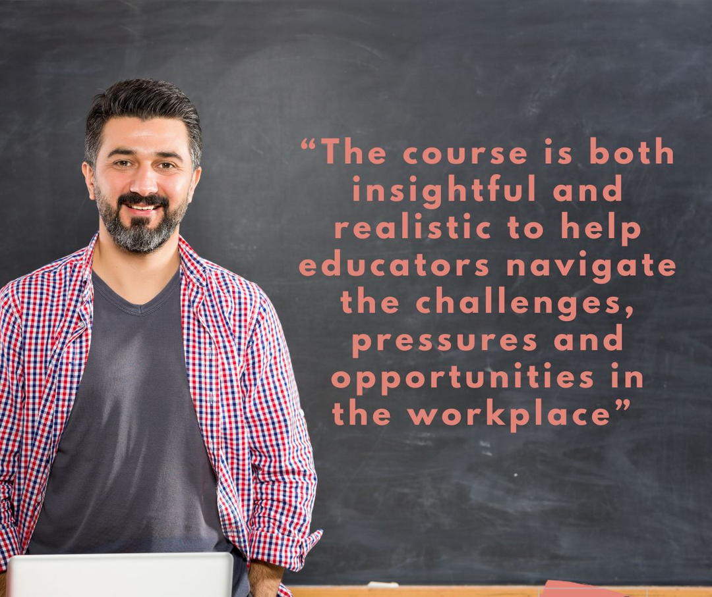

Slide 50
Questions?

Slide 51
thank you
Enrol here How to be a great teacher without the burnout | Gillian Forrester Coaching
For a £100 discount use the code HOLEX

