Slide 1
OTLA standardisation
17th July 2024
Wendy Scott

Slide 2
Observations in Numbers
Guess how many observations have been completed this year?
Numbers on a post-it note
130 Number of tutors
15 Number of tutors not observed
49 provider own SLW
32 provider own OTLA
21 sample SLW
63 sample OTLA
A grand total of 165 observations

Slide 3
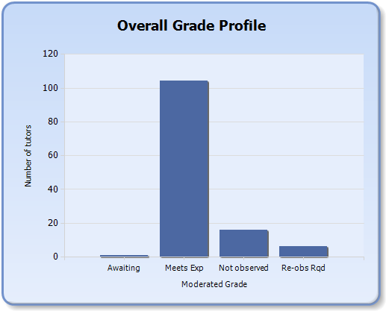
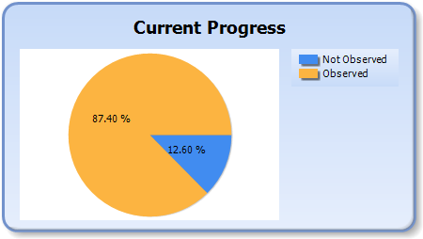
Tutor Statistics

Slide 4
Congratulations for those achieving 100%
GCS
CFW
HFRS
Itchen

Slide 5
What we are doing well with
Most reports clearly identify key strengths, with supported evidence
Safeguarding/Prevent/British values is being reported well on
Pedagogical elements are being noted (question/cognitive load/assessment)

Slide 6
Where we could improve
Not all tutors are receiving suggestions on ways to be even better (developing best practice)
Some reports are overly narrative, and judgement is not always clear
Some reports come in with elements missing, or not proof-read
Not all reports are submitted in a timely manner

Slide 7
Standardisation Activity
Guess the strength:
Review the report and agree in pairs what you think the strengths are
We’ll then see if they match the original observers

Slide 8
The reveal:1
Area of strength | Example of strength
Questioning skills | Questioning was used very effectively to check learning and to develop and extend the learners’ thinking.
Active learning | The learners were highly engaged in creating their artwork and peer support was good.

Slide 9
The reveal:2
Area of good practice | Observed strength
Clarity of purpose | Good introduction with SMART learning goals shared.
Active Learning | Learners were highly engaged and supported throughout the session participating to the best of their ability, following action and instruction attentively.
Feedback to learners | Feedback to learners was excellent to allow them to achieve and progress and work with emphasis on safe practice with correct alignment and technique.
Use of Resources | Excellent use of resources to engage learners including tennis balls, weights, and inspiring music.

Slide 10
The reveal:3
Area of strength | Example of strength
Feedback to learners | Feedback was clear and supportive, whilst still encouraging learner decision making.
Classroom management | The classroom was managed well, with good access to resources and information, as well as safe movement around the room.
Sequence of learning | The session was well thought out, with learners developing skills in the morning, which they were then able to apply in the afternoon.

Slide 11
The reveal:4
Area of good practice | Observed strength
Clarity of purpose | Individual learning objectives were clear and visually shared with each learner. Objectives clearly built on learners’ prior knowledge and achievement.
Active learning | Learners were encouraged to be independent in their learning through high expectations, open questioning and collaboration with other learners.

Slide 12
Standardisation Activity
Guess the weakness:
Review the report narrative and agree in pairs what you think the development areas should be
We’ll then see if they match the original observers

Slide 13
The reveal:1
Development Area: Assessment of Learning
Development Action: Clearly indicate on the curriculum plan how each learning objective will be assessed.

Slide 14
The reveal:2
Development Area: Assessment for Learning
Development action
Plan some open questions to measure achievement effectively and create accurate assessment records, where the goals match across the CIL, CP, HL16b and e.
Development Area: Employability- English and Maths
Development Action
Add embedding codes to the curriculum plan.

Slide 15
The reveal:3
Development Area: Clarity of purpose
Development Action:
Learning objectives need to be reviewed to ensure that they are SMART.

Slide 16
The reveal:4
None were given

Slide 17
What advice would you give to a new observer?

Slide 18
Annual Update training
4th September 1-3:30
Winchester Drop in Room

