Slide 1
Annual OTLA Update
4th September 2024
Wendy Scott
Notes:
Resource:
Report guide
VLE pages

Slide 2
What advice would you give to a new observer?
Notes:
https://forms.office.com/Pages/ResponsePage.aspx?id=tdiBPwfuF0yGnB20OQGNmyVF8czsMLNOnsDI6Cc4i-FUNUhVNlVMSE1CTjIxQ0tYUFhYSjdBUzZUWSQlQCNjPTEu
If you have not sent through any advice for new observers then please do by end of the month.

Slide 3
Agenda
Changes to report writing
Giving feedback
Standardisation meetings for 2024-25

Slide 4
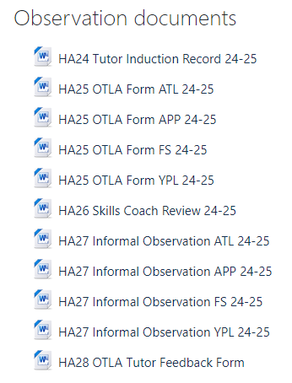
Templates
Make sure you are using the correct one!
ATL= Adult Tailored Learning
APP = Apprenticeship
YPL = Young People’s Learning
FS = Functional Skills
The tutor file checklists are different according to programme type

Slide 5
Changes to criteria
Removed: subject expertise
Re-named: active learning - learner engagement

Slide 6
Course information leaflets
HA03
The tutor file should have information about the course, this might be on HA03 (CIL) or it might be a publicity flyer.

Slide 7
Email address
HAQuality@hants.gov.uk

Slide 8
Giving feedback
The easy ones…
The not so easy ones…
Notes:
Round table discussion

Slide 9
The Easy Ones
Good experienced
Where it’s easy to identify positives and negatives
Tutor can recognise their strengths and improvement areas
Learners are engaged and eager to learn
Use of good questioning
Tutor is tuned into the learners
Learners provide good feedback
Tutor is keen to receive feedback and improve
Tutor is good at problem solving, and responding to unplanned events

Slide 10
The Not so easy ones
Finding an EBI/development point, when the tutor has strong skills
Tutor is set in their way
Tutor is hostile to feedback
Session is overwhelmingly bad
Not the observers way of doing something (action or different?)
Zero learner engagement
Tutor is short of time
Tutor is in a vulnerable state (not make it worse)

Slide 11
The challenges
Tutor ‘doesn’t have time’
No strengths come to mind?
Confrontational tutor
Where do you begin?!
Notes:
Tutor ‘doesn’t have time’
No strengths come to mind? Flip it – ask them what they thought went well
Confrontational tutor – suggest rather than tell- have you thought about? You could consider…
Where do you begin?! – flip it – what would you change next time? what are you pleased with? What have the group learnt from the session?

Slide 12
Bad day at the office
It’s ok for the tutor to be having a bad day…
They recognise this themselves
They have personal circumstances impacting on them
Things went wrong from start – beyond tutors' control
What might these be?

Slide 13
Probe the situation
Is this standard learner behaviours? Hawthorne effect?
Are you feeling ok today?
How were you feeling about being observed?
Notes:
The Hawthorne Effect is a situation where an individual or group of people know they are being observed and so change their behaviour accordingly.

Slide 14
Steps to manage the challenges
Feedback more than 10 mins? Consider feeding back at an alternative time
Gives you and the tutor time to reflect on the session
Seek advise
Check outcome criteria
Choose your battles

Slide 15
What not to feedback
Negative terminology: dreadful, boring…any others?
Critique beyond tutors control
Venue
Funding stream
Funding criteria
Enrolments
Even if the session was not good feedback needs to be developmental

Slide 16
Action or advice?
You might choose to focus on the main aspects for improvement
No sneaking in elements that are not present within the main text of the report
No surprises for the tutor – unless they are nice ones!

Slide 17
Standardisation meetings
Decide on dates:
Friday 17th January 1:30-3:30 – via Teams
Wednesday 30th April 1:30-3:30 – Winchester
Thursday 17th July 1:30-3:30 Winchester

