Slide 2
Focus of today:
Identify how to prevent cognitive overload from presentations
Identify best practice for use of text and visuals on presentation slides
Notes:
Cognitive load: principles of not the detailed theory
Myers multimedia principles

Slide 3
Types of electronic presentations
MS PowerPoint
Google Slides
Prezi
Mentimeter

Slide 4
Practicalities
First impressions
Eye contact
Body Language
Volume
Pace
Voice
Breathe
Language

Slide 5
Dealing with nerves
Breathe
Drink Water
Smile
Visualisation techniques

Slide 6
Elements of a successful presentation
Understandable
Memorable
Emotional
Notes:
Understandable: words, language…What is the key message – too many ideas, too much information,
Memorable: brain holds 3-7 facts in short term memory, how are you reinforcing concepts/ideas to make them more memorable?
Emotional : relate to, make connections to, story telling is a great way for people to make connections

Slide 7
Key Rules for presentations
Notes:
Tips for using computer presentation programmes
Don’t write everything you want to say onto a slide – the slide is there as a prompt for you and to give the ‘headlines’ to the audience
Don’t read out the slide – if you write in full sentences you will find yourself simply reading to an audience who are perfectly capable of reading for themselves!
‘Whizzy’ effects are fine, but not if they start to detract from the messages you are trying to give or if it just becomes a way to show off your technological skills

Slide 8
The good, the bad and the ugly of presentations
Think back to a presentation you experienced that you did not like.
Why did you not like it?
Notes:
Gather group feedback on what not to do!
Now think of a successful presentation – what was the difference?

Slide 9
What is cognitive load?
Notes:
The Cognitive Load Theory (CLT) was developed by John Sewell in the 80s and it focused on the learner’s cognitive process when learning new topics or problem solving (Chandler & Sweller, 1991).
Cognitive load theory builds on the premise that working memory (or short-term) has a limited capacity and that overloading it reduces the effectiveness of teaching.
Given that the goal of learning is to move new information from the working memory into the long term memory,
Cognitive load theory suggests that instructional materials and environments should be designed by practitioners to reduce this load, thus removing distractions enables a more efficient passage of the desired learning from working memory to the long term memory.
This is because as we learn the working memory can be overloaded reducing the capacity to store information in our long term memory.

Slide 10
Cognitive Load & Working Memory
Notes:
Cognitive load refers to the amount of information the working memory can hold at any one given time.
Intrinsic – the actual difficulty of the subject matter itself. Instructional design has less influence on this than the other load types.
Extraneous – unnecessary distraction and increase in cognitive load without benefiting the learning such as decorative graphics that don’t serve a learning purpose.
Germaine – highly beneficial and can help the learners move information from working to long-term memory via models and mental connections.
Most people can handle a cognitive load of between 3 to 7 separate pieces of information.
Intrinsic cognitive load
Sometimes a task is just hard. Consider calculus vs. arithmetic. Perhaps you’re great with math and this wouldn’t be a heavy lift for you. For others, this task would require a great deal of mental concentration.
Germane cognitive load
This refers to the actual processing of information. How will we organize it in our brains? Does this information connect with anything we’ve previously learned? Making connections is part of learning, and strengthens knowledge moving forward.
Extraneous cognitive load
This is the part that teachers have the most control over. It is generated by the way the information is presented and has nothing to do with the task. Are you learning calculus in a rock concert or a library? Have you used a PowerPoint slide theme that is distracting or clean?
Learner emotional level will also impact here (stress, worry, anxiety, mood)

Slide 11
Applying the theory to practice
The coherence principle
Signalling principles
Redundance principle
Spatial contiguity
Split attention effect
Notes:
5 principles to consider

Slide 12
The Coherence Principle
Notes:
This involves reducing the amount of information on each slide/page/worksheet to only that that is necessary.
Images, sounds and words that are not essential, add to cognitive load.
Giving the learners’s working memory fewer stimuli to focus on enables more processing power to be used by the germane load (remember this is our goal).

Slide 13
The Signalling Principle
Notes:
highlighting the important details.
We can do this via arrows or rings around the information. This reduces cognitive load by taking the work of scanning this visual away from the working memory.
This results in more juice for the germane load!

Slide 14
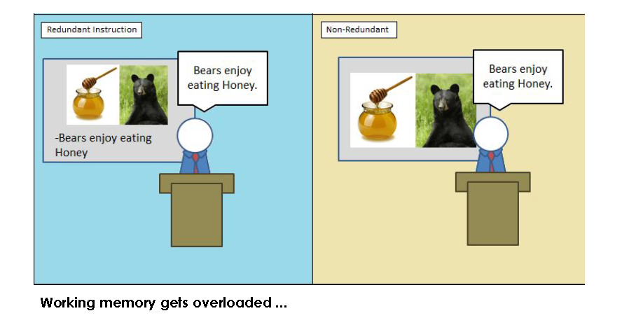
Redundancy Effect
Notes:
The Redundancy Effect often hinders learning due to inefficient use of working memory resources. For educators, this means reducing the unnecessary cognitive load of redundant information for learners and focusing primarily on what matters most.
When a learners’ working memory becomes clogged up by unnecessary information, they may remember the irrelevant information and forget what they actually need to know

Slide 15
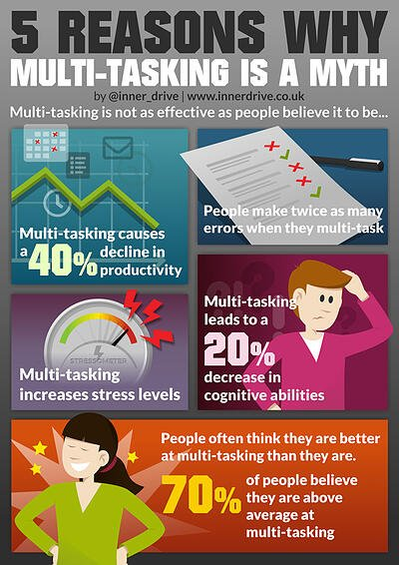
Split Attention Effect
Notes:
The Split Attention Effect occurs when learners have to refer to two different sources of information simultaneously when learning something.
Infographics are not your friend in presentations
This creates an extra load on their brain as switching between tasks takes time, effort and energy.
How could this have been presented?

Slide 16
Spatial Contiguity
Notes:
Placing labels next to the thing they are describing, so students don’t have to waste cognitive load juice working anything out.

Slide 17
Strategies to reduce cognitive load
Discourage multi-tasking (reading/listening/writing)
Provide cognitive helpers
Manage the emotional atmosphere
Teach thinking routines
Notes:
Memory has 2 points of entry – audio and visual – use both to establish strong learning path

Slide 18
What can you do to help maximise learning?
Intrinsic
Extraneous
Germane
Notes:
Intrinsic - simplicity
Break tasks down into smaller sequenced chunks
Give examples of new concepts
Simplify content
Reduce redundant information
scaffolding
Extraneous - distractions
Keep related text and images in close proximity
Reduce visual and audio competition
Remove decorative graphics
Germane – managing memory
Activate prior learning or experiences
Provide opportunities to practice exchange of information between the memory types

Slide 19
12 Principles of Multimedia Learning
12
Notes:
If you are designing a PowerPoint presentation, developing an online course or preparing to flip your classroom, you may need to reconsider how you will get students to engage with the material without the traditional face-to-face interaction. In the book Multimedia Learning (Cambridge Press, 2001), Richard E. Mayer discusses twelve principles that shape the design and organization of multimedia presentations
We’re going to cover the basics of his 12 Principles of Multimedia Learning that are specific to presentations (not video)

Slide 20
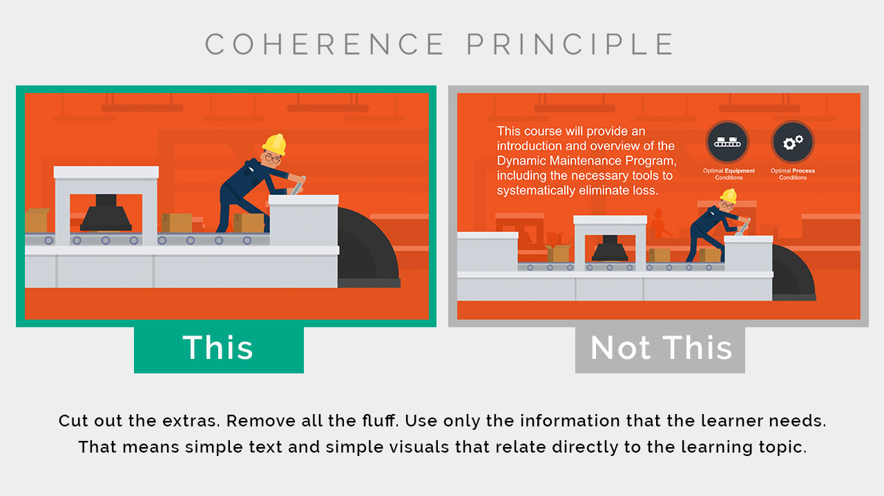
The Coherence Principle - Less is More
Notes:
The Coherence Principle states that humans learn best when extraneous, distracting material is not included.
How to use the Coherence Principle:
You can use the Coherence Principle as you’re planning your visual elements. Ask yourself, “Is this image 100% necessary to help with comprehension? Or could you find a better one? Does this message use simple enough language so the audience will understand? Maybe I could trim down a few words.”
The Coherence Principle is also quite helpful when you’re editing your training video or eLearning course. As you re-watch the experience, make sure to watch with a critical “Coherence Principle” eye. Determine how you can reduce, simplify, and clarify.
See HERE for examples of pages not using the Coherence Principle

Slide 21
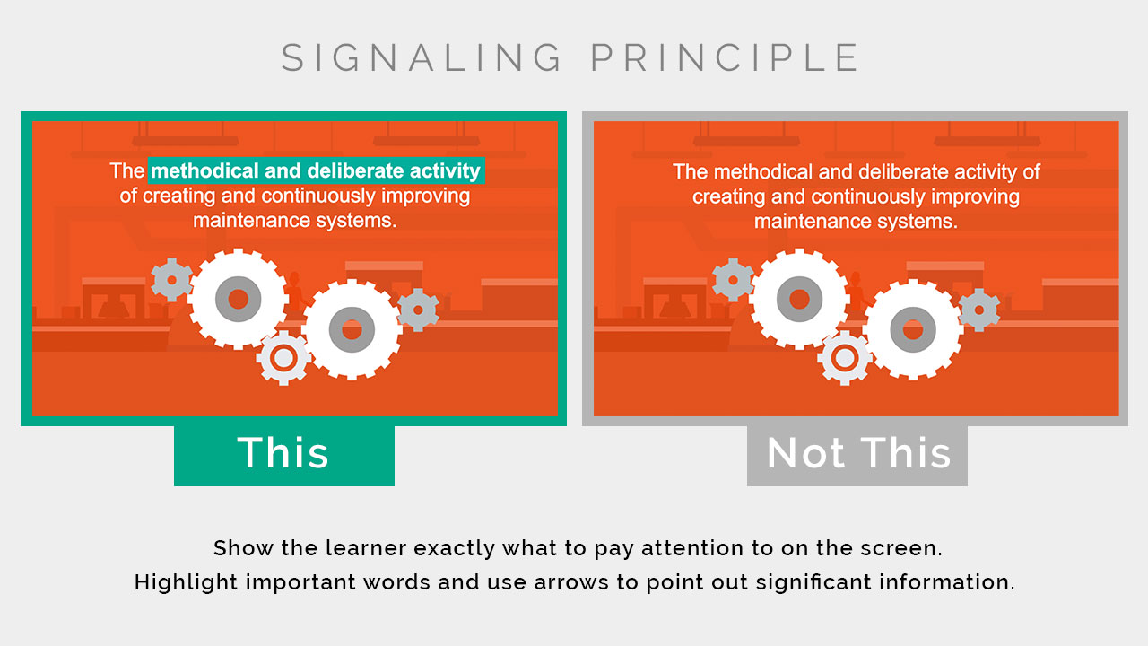
The Signaling Principle - What is Important
Notes:
The Signaling Principle essentially means that humans learn best when they are shown exactly what to pay attention to on the screen. If there is a ton of information on the screen, how is the learner supposed to know what is the most important part?
How to use the Signaling Principle:
This is where you can utilize the signaling principle by thoughtfully using features such as highlighting important words and using animated arrows to point out significant information. Another way you can use the signaling principle is by having slides or scenes that separate learning sections. This is a quick and easy way to signal to the learner that we’re moving on to the next topic.

Slide 22
The Redundancy Principle – Speech or Text, Not Both
Notes:
The Redundancy Principle. This principle suggests that humans learn best with narration and graphics, as opposed to narration, graphics, and text. The theory here is that if you already have narration and graphics, then the text on top is just redundant information. And this can be overwhelming for a learner.
How to use the Redundancy Principle:
You can use this principle for videos or eLearning courses that have narrated audio. Try to only include graphics or text, but not both together. Or if they are together, make the text minimal.
See HERE for examples

Slide 23
The Spatial Contiguity Principle - Group Related Information
Notes:
The Spatial Contiguity Principle is about the actual space in between your text and visuals on the screen, stating that humans learn best when relevant text and visuals are physically close together. People learn better when corresponding words and pictures are presented near to each other rather than far from each other on the page or screen. Presenting graphics followed by explanatory text further down the screen forces the user to scroll up to see the graphic & scroll down to see the text. This physically separates the text and graphic. Related text and graphics should be presented together.

Slide 24
Notes:
How to use the Spatial Contiguity Principle:
This one makes sense intuitively. You should keep all related text and graphics physically close together in your frame. This makes it much easier for learners to process the information, using less energy to decipher meaning. This principle is pretty straight forward. Make it easy for your audience to know where to look for information.
Consider the first example:
In the first example , the bones of the skull are labelled using a legend, with descriptions off to the side of the image. Numbers are used to link the areas identified with the names. This divides learners’ attention and should be avoided.
In the second example, labels are provided on top of the graphic, which makes it easier to focus on the content.
See HERE for further examples

Slide 25
The Temporal Contiguity Principle - Present Information Together
Notes:
The Temporal Contiguity Principle states that humans learn best when corresponding words and visuals are presented together, instead of in consecutive order.
Similar to the Spatial Contiguity Principal, presenting an animation that is followed by audio narration separates the two in time, resulting in less learning than if the animation and narration were synchronised in time. Related media should be integrated and presented synchronised in time.
How to use the Temporal Contiguity Principle:
If you’re introducing a new process, the animation (or visual) should be occurring at the same time as the voiceover audio. This is preferred to having the voiceover audio play first, and then watching a visual after. You can use this by making sure your voiceover audio is always timed well with your visuals or animations.

Slide 26
The Segmenting Principle - Learner Control
Notes:
The Segmenting Principle states that humans learn best when information is presented in segments, rather than one long continuous stream. Mayer found that when learners can control the pace of their learning, they performed better on recall tests.
How to use the Segmenting Principle:
You can use this principle by providing learners with more control over their learning. This is done by adding next buttons or allowing the speed which a video plays.
This principle also suggests that learning is broken up into smaller, bite-sized chunks. Make sure that no one lesson, slide, or video has too much information packed in it.
Find more information HERE

Slide 27
The Pre-Training Principle - Start with the Basics
Notes:
The Pre-training Principle states that humans learn more efficiently if they already know some of the basics. This often means understanding basic definitions, terms, or concepts before beginning the learning experience.
And this makes intuitive sense. If a learner starts an eLearning course knowing about the topic, they can easily become overwhelmed once complex visuals and definitions start being thrown their way. A bit of pre-training before starting the course really would have helped.
How to use the Pre-Training Principle:
You can use this principle by creating an introductory “guide” or “cheat sheet” for learners to use throughout the course. Or you can create an entire lesson up front dedicated to understanding the basics, before the learner moves into the actual course.
Further examples can be found HERE

Slide 28
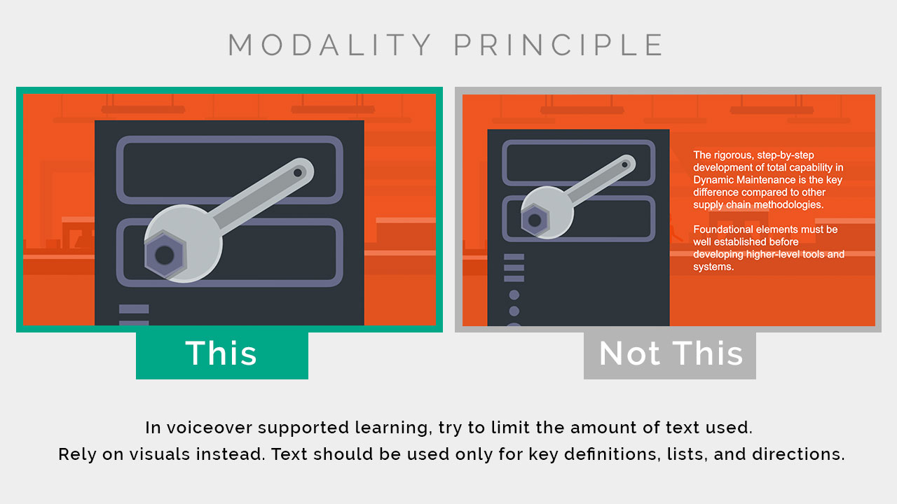
The Modality Principle - Limit Text
Notes:
The Modality Principle states that humans learn best from visuals and spoken words than from visuals and printed words. This doesn’t mean that you should never use text on screen, it simply means that if there are visuals and too much text, learners will be overwhelmed.
How to use the Modality Principle:
Try to limit the amount of text you use on screen overall. Rely more on visuals, unless you need to define key terms, list steps, or provide directions.
More information can be found HERE

Slide 29
The Multimedia Principle – Words and Pictures
Notes:
The Multimedia Principle states that humans learn best from words and pictures than just words alone. This principle is sort of the foundation of all Mayer’s principles, that images and words are more effective than words alone.
In any kind of training, it is customary to use words, either printed or spoken, as the main method of sharing information. Words are quick and cheap – you don't need specialist software or expertise to produce them.
Research results suggest that words and graphics are more effective when combined than just words alone, with some provisos:
graphics should not be an afterthought: they should be planned alongside the text to maximise understanding
decorative graphics do not improve learning
Multimedia presentations that represent material in both words and pictures encourage learners to make connections between the pictorial and verbal representations of the information, making the experience more meaningful and more likely to be committed to long-term memory. By contrast, providing words alone may encourage learners – especially those with less expertise – to engage in shallow learning by not making connections with other knowledge.
There is more to instruction than simply presenting information, and page after page of text is rarely sufficient.
How to use the Multimedia Principle:
You can use this principle by being very thoughtful about the images you select. Remember that these images need to enhance or clarify the information.
Further information can be found HERE

Slide 30
The Personalisation Principle – Conversational not Formal
Notes:
The Personalisation Principle says that humans learn best from a more informal, conversational voice than an overly formal voice. Having a more casual voice actually improves the learning experience.
How to use the Personalisation Principle:
You can use this by keeping your language simple and casual. Try to avoid overly professional sounding text, or long, complex words. It also helps to use the first person (you, I, we, our). This is where it helps to consider your audience demographics and try to match the tone of your voiceover to enhance personalisation.
More details can be found HERE

Slide 31
The Voice Principle - Human
Notes:
The Voice Principle states that humans learn best from a human voice than a computer voice. While Siri and Alexa are getting pretty close, there is no substitution for a human voice. It’s important to note that the studies are still rather preliminary for the Voice Principle. But even so, it makes sense to use a human for your voiceover.
How to use the Voice Principle:
You can use this principle by recording your own professional narration or hiring a professional to create an audio voiceover. Make sure your audio is high quality by using a professional microphone and mastering in audio editing software.

Slide 32
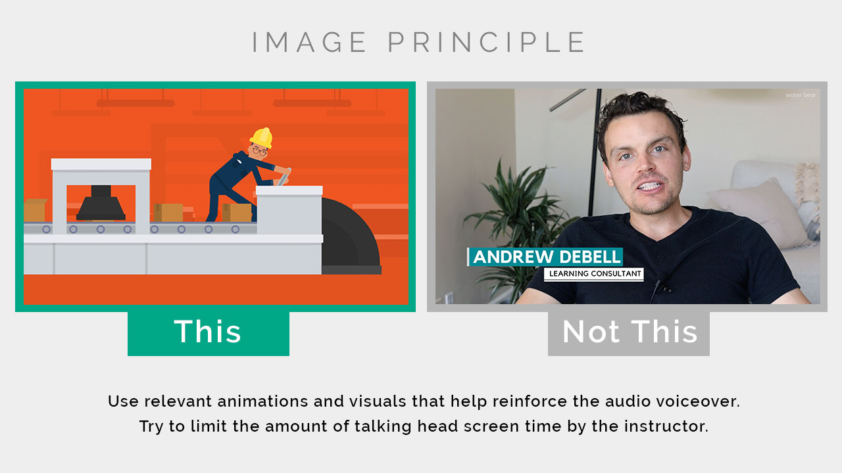
The Image Principle - Facecam
Notes:
The Image Principle states that humans do not necessarily learn better from a talking head video. Talking head videos are incredibly common in eLearning courses and MOOCs. The research on this one is also still in its early phases, so take this principle with a grain of salt.
The thinking here is that if there is important information to be learned, relevant visuals on the screen will be more effective than showing a talking head of an instructor.
How to use the Image Principle:
Instead of having a talking head of the instructor, use relevant animations and visuals that help reinforce the audio voiceover. Note that talking heads can provide some value for the instructor by building credibility and trust. This is especially useful to establish at the beginning of your learning experience. Just try to limit your use of talking heads as your video or course dives deeper into the learning content.

Slide 33
Principle Overview
1. Coherence Principle – People learn better when extraneous words, pictures and sounds are excluded rather than included.
2. Signaling Principle – People learn better when cues that highlight the organization of the essential material are added.
3. Redundancy Principle – People learn better from graphics and narration than from graphics, narration and on-screen text.
4. Spatial Contiguity Principle – People learn better when corresponding words and pictures are presented near rather than far from each other on the page or screen.
5. Temporal Contiguity Principle – People learn better when corresponding words and pictures are presented simultaneously rather than successively.
6. Segmenting Principle – People learn better from a multimedia lesson is presented in user-paced segments rather than as a continuous unit.
7. Pre-training Principle – People learn better from a multimedia lesson when they know the names and characteristics of the main concepts.
8. Modality Principle – People learn better from graphics and narrations than from animation and on-screen text.
9. Multimedia Principle – People learn better from words and pictures than from words alone.
10. Personalization Principle – People learn better from multimedia lessons when words are in conversational style rather than formal style.
11. Voice Principle – People learn better when the narration in multimedia lessons is spoken in a friendly human voice rather than a machine voice.
12. Image Principle – People do not necessarily learn better from a multimedia lesson when the speaker’s image is added to the screen.

Slide 34
Cognitive load - Further reading
Cognitive Load Theory - Learning Skills From MindTools.com
The importance of cognitive load theory | Society for Education and Training (et-foundation.co.uk)
Using Cognitive Load Theory To Reduce Learning Barriers For Students – Thinkific
Cognitive Load Theory 1 - An introduction - YouTube

Slide 35
Blog #1 What is Cognitive Load Theory (CLT)? How does it affect learning? (tech-eds.com)
Cognitive Load Theory - gerardfriel.com

Slide 36
Multi-media References
Mayer, R. (2001). Multimedia Learning. Cambridge: Cambridge University Press
How to use Mayer’s 12 Principles of Multimedia - https://waterbearlearning.com/mayers-principles-multimedia-learning/
Mayer’s 12 Principles of Multimedia Learning are a Powerful Design Resource - https://www.emergingedtech.com/2017/06/mayers-12-principles-of-multimedia-learning-are-a-powerful-design-resource/
Mayer’s Principles for Multimedia Learning - http://instructionaldesign.io/toolkit/mayer/
12 Principles of Multimedia Learning - https://www.hartford.edu/faculty-staff/faculty/fcld/_files/12%20Principles%20of%20Multimedia%20Learning.pdf
Cognitive Theory of Multimedia Learning - https://sites.google.com/site/cognitivetheorymmlearning/
The Cambridge Handbook of Multimedia Learning - https://books.google.co.uk/books?hl=en&lr=&id=Cvw6BAAAQBAJ&oi=fnd&pg=PA279&dq=mayer%27s+12+principles+of+multimedia+learning&ots=HvZcUdyV_Y&sig=PAICI-LcXumW8phwNYmkzZaznaw#v=onepage&q=mayer's%2012%20principles%20of%20multimedia%20learning&f=false

Slide 37
Further information
How to avoid death By PowerPoint | David JP Phillips | TEDxStockholmSalon - YouTube
The 110 techniques of communication and public speaking | David JP Phillips | TEDxZagreb - YouTube

