Slide 2
Aim of today
This workshop will explore the key principles of Rosenshine,
We will look at the 10 principles
Unpick the concepts and language used
Discuss how they apply to our practice

Slide 3
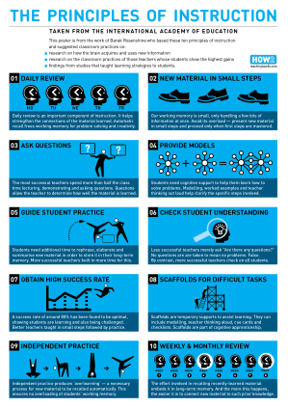

Slide 4
Barak Rosenshine
RosenShine was a professor in the Department of Educational Psychology at the University of Illinois. Along with Robert Stevens, he explored teacher instruction, and identified the approaches and strategies that were features of the most successful teachers' practice.
Principles of Instruction: each principle is based on research and classroom practice

Slide 5
Rosenshine’s Principles of Instruction
Rosenshine’s principles resonate for teachers of all subjects and contexts – because it focuses on aspects of teaching that are pretty much universal:
questioning,
practice,
building knowledge.

Slide 6
“THERE’S NO HARD FAST DOGMA HERE. IT IS QUITE POSSIBLE TO MAKE A REASONABLE LIST OF 4 OR 6 OR 8 FUNCTIONS; HOWEVER,THESE FUNCTIONS ARE MEANT TO SERVE AS A GUIDE FOR DISCUSSING THE GENERAL NATURE OF EFFECTIVE INSTRUCTION”.
Rosenshine, B. (1982) Teaching Functions in Instructional Programmes. National Institute of Education. Washington DC
Notes:
Barak Rosenshine, professor at University of Illinois. His work focussed on the features of effective teaching. What he saw the most effective teachers doing.

Slide 7
Rosenshine’s Principles of Instruction
Originally there were 6 Principles:
Review, checking previous day’s work (and reteaching if necessary).
Presenting new content/skills.
Initial student practice (and check­ing for understanding).
Feedback and correctives (and re-teaching if necessary).
Student independent practice.
Weekly and monthly reviews.

Slide 8
Rosenshine’s Principles of Instruction
Expanded 10 in 2012:
Begin the lesson with a review of previous learning.
Present new material in small steps.
Ask a large number of questions (and to all students).
Provide models and worked examples.
Practise using the new material.
Check for understanding frequently and correct errors.
Obtain a high success rate.
Provide scaffolds for difficult tasks.
Independent practice.
Monthly and weekly reviews.
Notes:
Some of these are amplification of the original 6 but the biggest development was the introduction of questioning and scaffolding

Slide 9
Principle 1: Begin the session with a review of previous learning
Why?
to uncover and challenge misconceptions,
peer or self-marking work and correcting mistakes.
strengthen understanding and the connections between ideas
Ideas?
1
Notes:
What do we currently do?
What works well?
What have we seen other people do?

Slide 10
Principle 2:Present new material in small steps
Why?
This increases the progress made by the students.
Learners (everyone) can only process so much at one time
A reduction in cognitive load allows metacognition to take place (it allows them to think about how they are thinking about the task)
What does this mean for our curriculum planning?
2
Notes:
What are the implications for how we teach?
Length of sessions
Number of sessions
What do we have to cover?
What can learners do for themselves?

Slide 11
Principle 3:Ask lots of questions (to all students).
Why?
they can highlight misconceptions,
challenge students to think deeper into a subject.
The greatest value of questioning though is that they force learners to practice retrieval, (over-learning, Ebbinghaus)
Questions are a teacher’s most powerful tool
3
Notes:
What can you do?
Plan the questions in your session plan?
Think about the type of questions:
What if
How does this apply when..
Use assertive questioning techniques

Slide 12
Principle 4:Provide models and worked examples
Why?
allows learners to gain an understanding quicker,
it also gives them deeper retention.
especially true of more conceptual ideas.
How?
4
Notes:
link it to something they are familiar with (e.g. process)
Example:
In Science, we may explain the flow of electrons in a circuit by using the model of the water in a “lazy river”. The water being the flow of electrons, the pumps providing the voltage (power) and the people in the water providing resistance

Slide 13
Principle 5:Practise using the new material
Why?
Practice makes perfect
Retrieval practice = long term memory
Rosenshine suggests that successful tutors allow more time for guidance, questioning and repetition of processes.
Have you allowed for this in your planning?
5

Slide 14
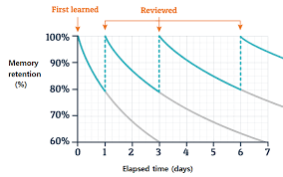
Ebbinghaus Forgetting Curve
Source: www.researchgate.net
The Forgetting Curve: 5 Ways to Challenge it | LearnUpon

Slide 15
Principle 6:Check for understanding frequently and correct errors
Why?
Regular asking of direct questions (rather than “does anyone have any questions?”)
allows teachers to check understanding and catching misconceptions,
informs on any aspects which need reteaching
How?
6
Notes:
What can you do?
Have a follow up activity which checks understanding?
Quizzes
Test application

Slide 16
Principle 7:Obtain a high success rate.
Teaching for mastery ensures all learners in a class are ready to move on to the next stage in the topic, thus preventing learners from taking misunderstanding into their future learning.
From his research, Rosenshine found that for a class that the optimal success rate is an 80% understanding. This shows that not only have the students learnt the material but also were challenged in doing so. Any higher and the work may not have been challenging enough and vice versa.
This is about understanding and about stretch
7

Slide 17
Principle 8:Provide scaffolds for difficult tasks.
What do we understand by scaffolding?
Employ Vygotskian scaffolding. Providing learners with a framework that more easily allows them to make progress.
The scaffolds can then be gradually removed as their competency grows
Anticipate commonly made errors and build tools into the scaffold tasks that reduce the chances of learners making the same mistakes.
8
Notes:
checklists,
cue cards
writing frames

Slide 18
Principle 9: Independent practice
Why?
Following scaffolded tasks, students should be competent in the task and therefore can practice the task independently. This repetition of the task will promote a deeper fluency, Rosenshine called this “overlearning”.
What/How?
9

Slide 19
Principle 10: Monthly and weekly reviews
An extension of the first principle:
monthly and weekly reviews of previous learning aids
recall of information and processes.
In practice how might this be seen within short courses?
10
Notes:
Short course – sequencing to allow review of materials – more than once

Slide 20
Final thoughts
Don’t turn the principles into a checklist.
It’s a guide for professional learning
Take time to explore the implications at a subject-specific level.
The ideas of practice, modelling, questioning… each have meaning only in the context of your curriculum content.

Slide 21
Did we achieve?
We will look at the 10 principles
Unpick the concepts and language used
Discuss how they apply to our practice

Slide 22
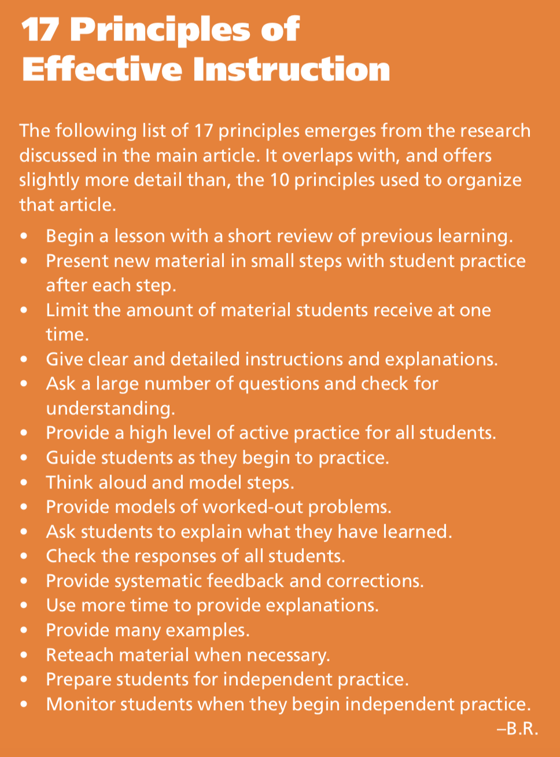

Slide 23
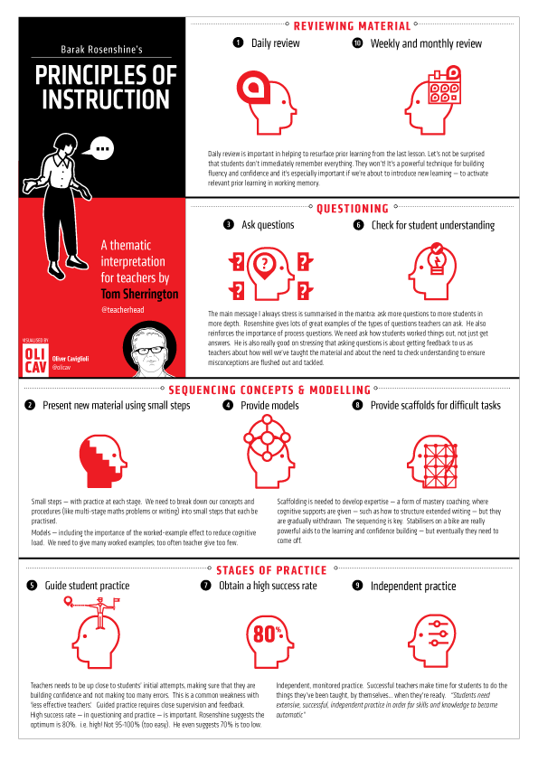
Useful resources and sources:
Principles of Instruction: Research-Based Strategies That All Teachers Should Know, by Barak Rosenshine; American Educator Vol. 36, No. 1, Spring 2012, AFT
Tom Sherrington - Barak Rosenshines Principles Of Instruction Paper - researchED 2019 – YouTube
Understanding_Scaffolding_and_the_ZPD_in_Education.pdf
Zone of Proximal Development and Scaffolding | Simply Psychology
Rosenshine Principles red (squarespace.com)

