Slide 1
OTLA Standardisation
16th April 2024
Wendy Scott

Slide 2
Reminders
Notes:
Length of observation: start and end times, if longer than that please let WS know reason (such as first session and waited to see delivery start)
Submission of reports – to correct email not direct to WS participation.lifelong.learning@hants.gov.uk
Supportive not wagging fingers

Slide 3
British Values
reminder
Notes:
Reference BV only when these are overtly referenced by the tutor
Do not reference BV where you decide that the tutor behaviours are modelling/promoting BV

Slide 4
Safeguarding review
Outcomes
Key points for observations
Curriculum planning
Learner question
Notes:
There should be explicit reference to safeguarding within learner induction – this should be documented within the curriculum plan
If you see any good examples of resources, please ask the tutor for a copy and send through to WS
If learners cannot recall information around BV/safeguarding/Prevent then it has not been effectively delivered and this will be an action for tutor, if the tutor cannot provide evidence that it was covered e.g. slides then a follow up observation will be required (tutor requires support)

Slide 5
Curriculum plan sample

Slide 6
Action Categories
Notes:
Discussion and agreement on any additional categories to apply to reports
Insert those to reflect upon
New categories:

Slide 7
Moving to outstanding
Most tutors use skilful questioning to ensure learners’ understanding is secure.
Most tutors use a variety of methods of assessment effectively to plan learning and check what learners and apprentices know and can do
Notes:
Questioning – if not a strength, then in developing good practice refer to resources that will improve their questioning skills

Slide 8
Progress to March
2024
2023
Notes:
Still slightly behind compared with 2023 with completed OTLAs, but significant numbers planned.
Few tutors not observed (4% less)

Slide 9
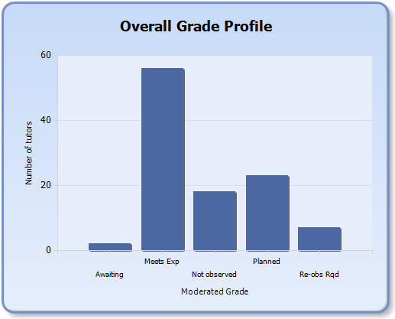
Notes:
Currently 7 tutors require support to meet expected standards

Slide 10
Comfort break

Slide 11
Standardisation activity: HL25
Does the report contain judgemental language with supporting evidence?
Is the report written in a supportive manner?
Does the narrative support the identified strengths and action areas?
Do you agree with the outcome awarded?

Slide 12
Next Standardisation Date:
Wednesday 17th July 10AM – 12:30 PM at Winchester

Slide 13
Seven tips to get the most from your time observing practice...
1. Establish clear goals: Before observing, it is essential to have a clear understanding of what both you and the person you are observing want to achieve. It is a CPD partnership. Great observers learn as much as the person being observed.
2. Create a safe environment: It is important to create a supportive environment where the person being observed feels comfortable with you being there and safe to receive feedback. Feedback that doesn’t land, is a waste of both of your time.
3. Use multiple sources of data: Observing a single event is only one source of data. To provide a complete picture, it is important to gather data from multiple sources, such as assessed work, reviews, and self-reflection.
4. Identifying and capturing strengths is important: Observers should focus on the positives in the lesson, highlighting strengths and areas of effective practice helps to build confidence and motivation to continue to improve. Mesma captures key strengths and weaknesses for each observation. This clear summary of feedback also helps leaders and managers to identify insights against key themes.
5. Provide specific, actionable feedback: Feedback should be specific and actionable, discussing problems to solve and working through practical strategies to address them. Feedback should also be timely and given soon after the observation to ensure its relevance.
6. Use a collaborative approach to observing practice: Observers should adopt a collaborative approach, working with the observee to identify areas for improvement and strategies to address them. This approach helps to build a shared understanding of effective practice and encourages the observee to take ownership of their professional development.
7. Use evidence-based practices: Finally, observers should use evidence-based practices when providing feedback. This means using research-based strategies and techniques that have been shown to be effective in improving practices.

Slide 14
Five reflective questions on observations for your organisation...
How well do we use the outcome from observations to inform CPD for staff?
What impact does the resulting CPD have on quality?
What evidence can we draw on that shows observations helpfully change a person’s approach to delivery?
How well do we evaluate the overall quality of delivery based on findings from observations?
How well do we use the outcomes from observations to learn from good practice?

