Slide 2
House keeping

Slide 3
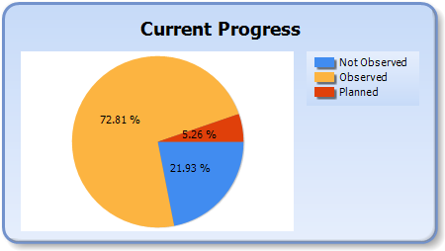
Progress

Slide 4
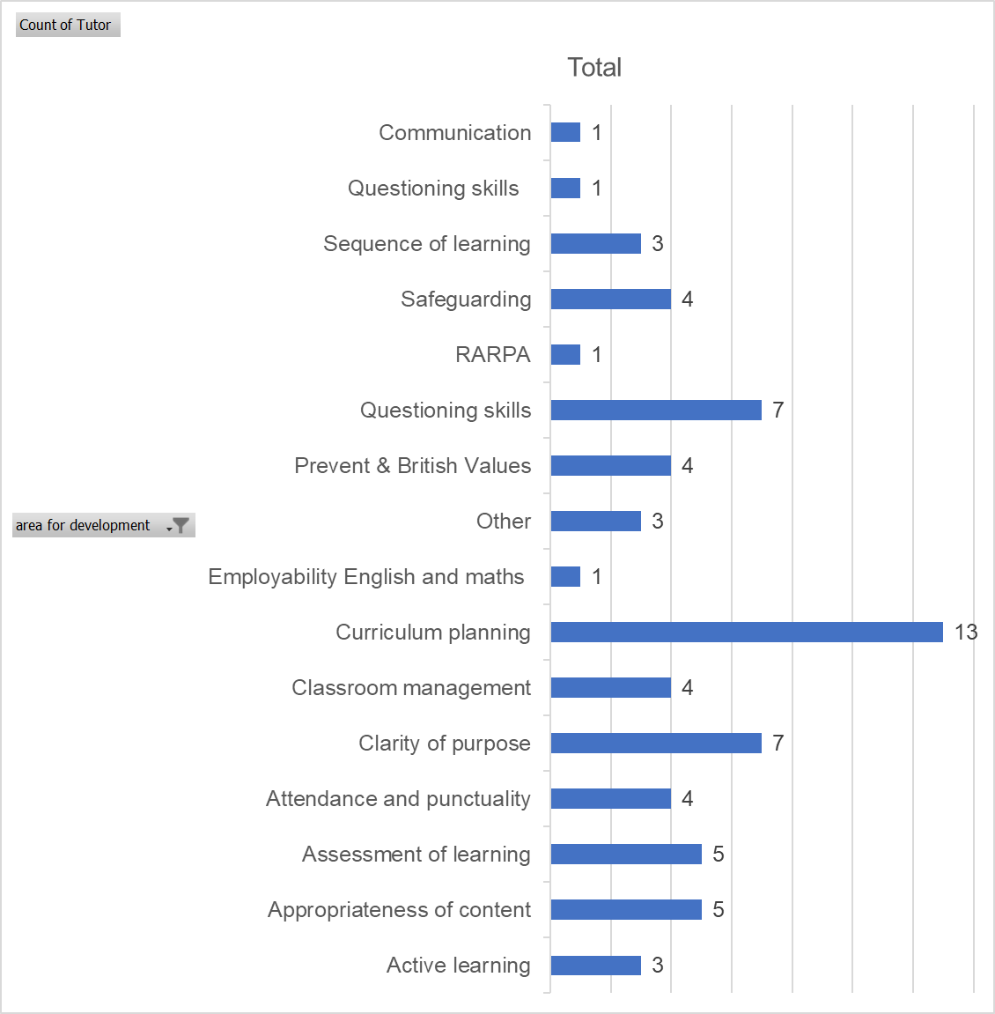

Slide 5
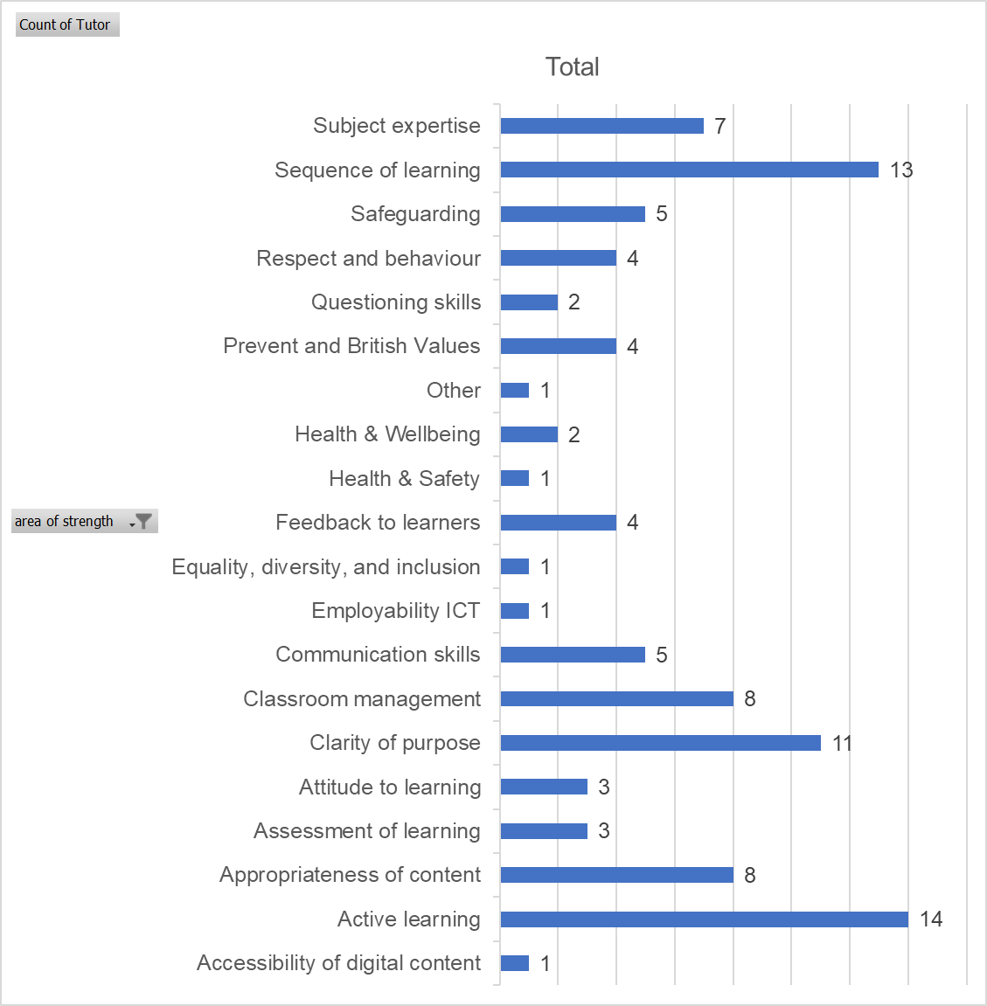

Slide 6
Standardisation activity
Please consider the following questions when reviewing the observation reports
Does the report contain judgemental language with supporting evidence?
Is the report written in a supportive manner?
Do the reports help the tutor to identify areas they can improve upon?
Have all areas for development been addressed?

Slide 7
Development of HL27 proforma
Check list
Use of action areas
Developing good practice

Slide 8
Standardisation activity
For the following reports please consider the following questions
Does the report contain judgemental language with supporting evidence?
Is the report written in a supportive manner?
Does the narrative support the identified strengths and action areas?
What outcome would you give based on the information in the report?

Slide 9
Examples: key questions to learners
Why are you here and why are you doing the course? What is your intention?
How will the course prepare you for your intention?
Tell me about your work and your interests?
What have you learnt since you've been here? What will you learn next in the course?
Are you on track to complete? How do you know this?
What feedback do you get?
How have your skills improved since starting the course?
Do you do work experience? How does this help your course work?
What are you doing after the course? What is your next step?
How well are you developing to be successful at your next step?

Slide 10
Examples: key questions to staff
How much freedom do you have to shape the curriculum?
Tell me about this lesson - why is it relevant?
How does this lesson link to other lessons? What will you do next week?
What are the overall aims of your learners?
How do you use this information to plan learning activities?
What skills/qualifications do you have that are appropriate to the course?
What professional updating have you done?
Do you still practice professionally?
What CPD have you had?
How to you keep in touch with Industry knowledge?

Slide 11
Questions

Slide 12
Next dates
Monday 17th July
10 AM-12 PM
Winchester, Drop-in room, podium
Annual Update
7th September 1-4PM Drop in Room, Winchester

