Slide 1
‘County Lines’ Child Criminal Exploitation & Police Information Sharing Processes
DCI Ross Toms Intelligence, Tasking and Development
PC Maria Carrick, Education & Youth Engagement Coordinator
PC Matthew Painter, Serious & Organised Crime Unit

Slide 2
What will be covered in this presentation
Overview of County Lines
Synopsis – Motivation - Commodity
Drugs – Crime – MO
Threat – Harm - Risk
Overview of Child Criminal Exploitation
What is CCE
Vulnerability – Victim Profile
Case Study
Overview of the Community Partnership Information Form
Completion and Quality of Information
Examples – Best Practice
Safe4me and Resources

Slide 3
TDCI Ross Toms: 19 year Journey
2002: Gosport drug squad (YD)
2007-2009: Aldershot and Farnborough priority crime unit (Insurgents)
2009-2013: Serious and organised crime unit (Transients)
2013-2017: Intelligence department (County lines)
2017-2019: Missing, exploited, trafficked team
2019: Intelligence department

Slide 4
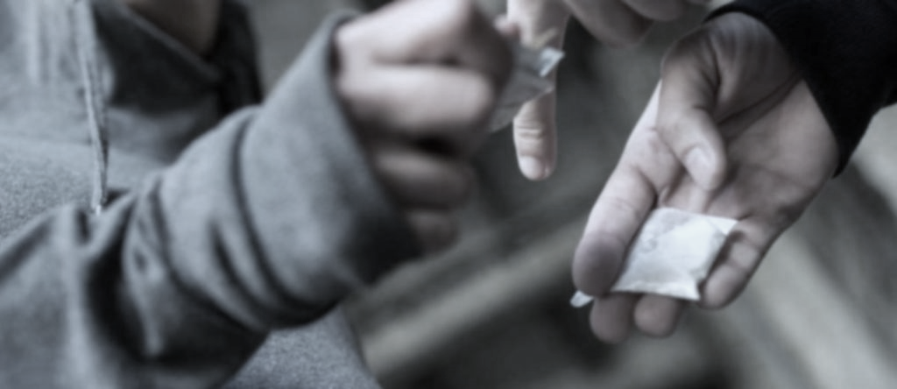
‘County Lines’

Slide 5
Introduction
Synopsis/ key points of county lines problem
The commodity (crack cocaine, heroin)
Motivation
Key factors (phones, travel, violence, vulnerable)
County lines in Hampshire
Vulnerability Factors

Slide 6
County Lines - Home Office term for drug networks deriving from “Urban Hubs” that supply drugs to
outer-city, suburban and coastal areas using dedicated mobile phone lines or “deal lines” - presenting significant risks to children, vulnerable adults and communities.

Slide 7
Street supply of Crack cocaine and heroin into another County
Synopsis
Deal Phones
Pay as you go mobile with brand name
Use hire cars & railways to travel into counties
From an ‘Urban Hub’
London
Liverpool Manchester
Aggravating factors:
Cuckoo nesting vulnerable adults
Child exploitation (CCE/CSE)
Violence & weapons

Slide 8
Lucrative business!
Criminal intent is not perversion or cruelty of the vulnerable
Motivation
The crack cocaine and heroin supply trade is possibly
the most lucrative criminal enterprise
The dealers are often ‘victims of society’ who have limited access to role models
This business is about money, bling/assets and peer/street status
A kilo of heroin costs £40,000
Using cutting agents to break it down into 10,000 street deals
@ £10 per deal = £200,000

Slide 9
Not generally Cannabis supply
Commodity
Not generally other crime types, albeit associated aggravating factors can present other crimes
Not generally MDMA or other party drugs
Murder
Assault
Sexual assault/exploitation
Money laundering
Modern day slavery
Not generally powder cocaine (recent reports suggest this on the rise)

Slide 10
Crack Cocaine
Crystalised powder cocaine washed up or ‘cooked’ with baking soda - often called white, rock.
Small rocks often yellowish tint - smaller than a 5p piece
Deals often buy 2 for 3 - each rock sold @ £10 - £20
Extreme high - lasting approx. 20 mins
Highly addictive
Smoked not snorted - reaches brain fast

Slide 11
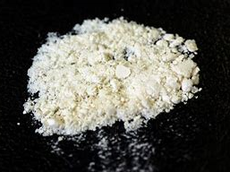
Powder Cocaine
Powder cocaine is mostly used as recreational drug.
Cocaine will comprise at least 80% of other substances
Sold in grams @ £30 - £40. One gram will produce 10-14 lines.
Euphoric, energetic, alert high - lasting up
to 60 mins
Highly addictive - usually snorted

Slide 12
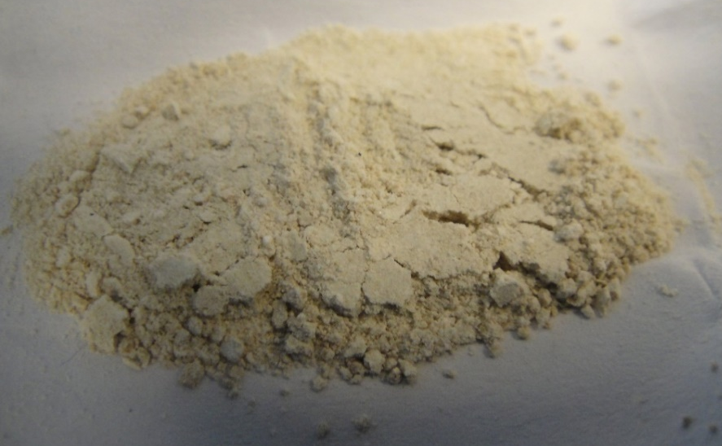
Heroin
From opium poppies in Afghanistan and Pakistan regions
Small bag amount is less than size of a 5 piece = av. cost £10
Effect is a “downer” lasting approx. 4 hours - gives a fuzzy sensation (Mothers womb/ wrapped up in a duvet)
Users often offset heroin against crack (take one of each)
Highly addictive, smoked or injected

Slide 13
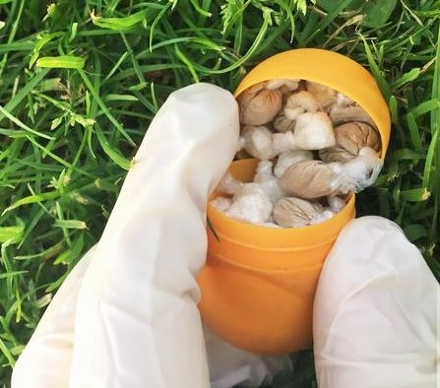
Kinder Egg Cases
Kinder egg cases commonly used to stash/conceal quantities of drugs

Slide 14
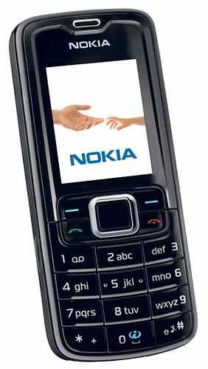
The Deal Phone
Named after the deal network
Often based in the hub - acts as a call centre between the user and the runner
Pay as you go
Group/ bulk texts in “slang”
Often recycled – old ‘Nokia’ style
One phone can facilitate daily business worth £3,000 a day

Slide 15
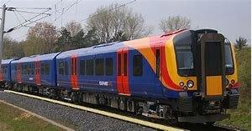
Trains and Hire Cars
Discreet hire cars from legitimate companies
Often rack up thousands of miles
Use ‘back street’ lease companies - smoke screen
Trains increasingly popular
Trafficking is easier due to the
anonymous nature of travel

Slide 16
Terminology of “County Lines
5-O– Police
Bait – You are obvious, or simple. As in, “You’re bait blud”
Bars – a rap song, part of a song, as in “spit some bars” (to sing something)
Buki – When something is strange or suspicious.
Crepes – shoes or trainers: “check out deez heavy crepes.” assume its as you ‘wrap your feet’ in them.
Up Country/Cunch – Going out of London, Country is commonly referred to as areas outside of London used for County Lines dealing.
Ends – Area, neighborhood
Feds – police
Notes:
These are a very brief selection of phrases and terminology used by County Lines “gangs”, these are ever evolving and as you will see cofusing, for example Shooting or Shots you would immediately thing there is a linked to guns, but no.

Slide 17
Terminology of “County Lines
Hooptie - a worn out or old car used to commit crime in.
Merk – This word originally meant to kill someone, but now it means to insult someone.
Peng/Peng Ting– Good looking, Good looking person
Shot/Shotting – to sell – mainly used to sell drugs such as Cannabis or Crack Cocaine and Heroin at street level.
Shots – known to be used to describe crack and heroin deals for example “100 shots”.
Taxed – Stealing
Trapping – To sell drugs.
Trap House - a house used to sell drugs from.
Trident – Armed police
Whipping – The method of “whipping” Cocaine into Crack Cocaine.

Slide 18
Terminology of County Lines
“The irony of trappin on a Boris bike”
Stormzy –The Crown, reached number 4 in the UK Charts and 5.6 million youtube views.
“Whipping, whipping in the kitchen”
“I was chilling in the trap I had to pivot, I head a knock at the door, it was suspicious”
Fredo – TrapSpot – 7 million youtube views.
“My young boy in a different country, but he aint even been on vacation” – Dave - Funky Friday – 10 Million Youtube views. Reached number 1 in the UK charts.
Notes:
Have you every found yourself humming along to the latest Chart number 1, I have! Its not until you start reading the lyrics when you realise the basis of these songs that are receiving millions of views and streams.

Slide 19
Examples of Text Messaging
“6L2D St Mary’s do for 70”
“1on1 London Road behind KFC”
“ON B.O.B 24/7”
“ANYTIME FAT DEALZ BEST IN TOWN”
“Good Morning Mate”
Notes:
These are all examples of current text messages sent out by Deal Lines, explain L and D, B.O.B and the latest addition as to how they are evolving to avoid detection.

Slide 20
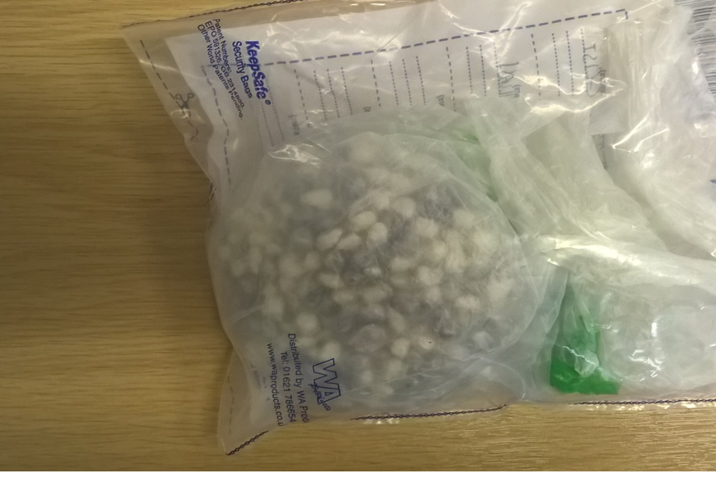
The reality of County Lines
Notes:
These drugs have a street value of over £13,000, the consist of 635 wraps of Crack Cocaine and Heroin.
These were located by the Drug related harm team in Portsmouth, 2 local Portsmouth drug users were seen dealing to others, they were arrested and during the search of their home address a 20 year old female from London was located with a handbag containing these drugs.
She received 22 months Imprisonment.

Slide 21
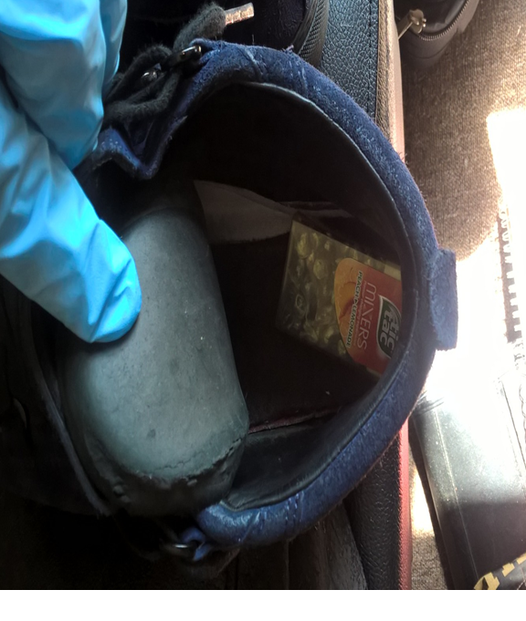
The reality of County Lines
Notes:
During a weekly visit to a vulnerable drug user in Portsmouth the Drugs Related Harm team located a 20 year old male from SW16 London sleeping on her sofa, he was searched and located within both of his shoes were £3,000 worth of Crack Cocaine and Heroin. Despite his denial of ownership of the shoes “including walking out of the address and around Custody with no shoes” he was found guilty of Possession with the Intent to supply and sentenced to 2 years imprisonment. The drug user has continued to engage with support services and is still visited by the team.

Slide 22
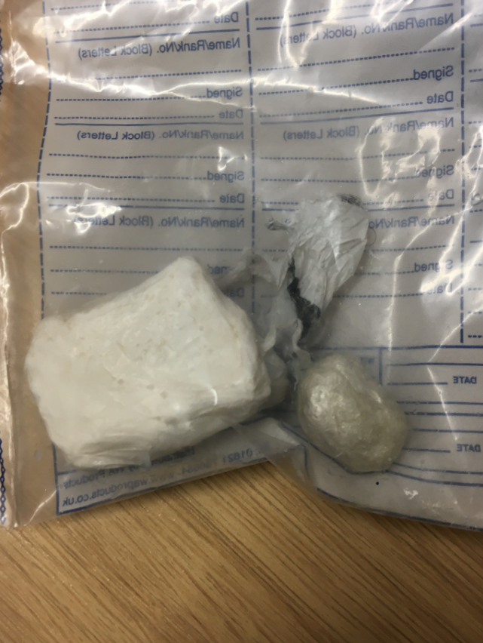
The reality of County Lines
Notes:
These “lumps” of Crack Cocaine and Heroin were located during a drugs search of a pregnant 21 year old female from London “SW16”, she was located driving a vehicle following an ANPR hit, during the search she admitted having these drugs “plugged” and subsequently received , 40 months imprisonment.

Slide 23
Violence and Vulnerability
Cuckooing
Flat/house of a vulnerable ‘user’
Used as a base for hours or days
Home invasion: addicts, dogs, violence, sexual activity
Balancing offender - victim (MD Act): allowing home to be used or a victim?
Violence and Weapons
Boiling water, acid, irons, stabbings, sometimes use or threat of firearms
Ready access to firearms
Turf wars rare in the counties

Slide 24
COUNTY LINES CASE STUDY: ‘THE REAL THREAT OF HARM’
Case Study: County Lines
A 16-year-old male reported as missing from London - considered at high risk due to his age and known link to gangs.
Recently failed to appear at court for alleged involvement in a stabbing
Arrested in Southampton in possession of a 6” kitchen knife and 30 wraps of drugs
In custody he was found to have significant burns to his body, consistent with having been burnt by boiling liquid.
He would not disclose further details, but it was highly likely injury was caused by those responsible for sending him to Southampton to deal/deliver class A drugs. (Safeguard concerns – Custody outcomes- St Giles trust)

Slide 25
County Lines in Hampshire
Mapped Drug Networks
Recognising the transient nature of networks, Hampshire Constabulary have produced an objective ratification process
Market locations
Basingstoke
Portsmouth
Southampton
Suburban/urban towns on A3/M27 corridors and rail connections
Hampshire currently have 73 known mapped networks: (Feb 2019)
29 = North of county
27 = East of county
17 = West of county

Slide 26
Partnership Approach: County Lines
The Response to tackle the issues involves Police, National Crime Agency, government departments, local authorities, voluntary and community sector organisations

Slide 27
Recognising Vulnerability Factors
Vulnerable Children
Living above means
Drill music
‘Gangster’ talk
Phones
Unexplained injuries
Vulnerable Adults
Drug User
Visitors to address
Alcoholism
Premise location: town/city, railways
Front line roles who may encounter those involved:
Housing
Education
Youth/Drug workers
Medical Prof/Staff
Social workers

Slide 29
Introduction
What is CCE
CCE link to CSE
Vulnerability – threat, risk, harm
Trafficking / Modern day slavery
Victim Profile
Risk Factors

Slide 30
Definition of CCE
Occurs where an individual or group takes advantage of an imbalance of power to coerce, control, manipulate or deceive a child or young person under 18 into any criminal activity
in exchange for something the victim needs or wants, and/or
(b) for the financial or other advantage of the perpetrator or facilitator and/or
(c) through violence or threat of violence.

Slide 31
Definition of CCE (continued)
The victim may have been criminally exploited even if the activity appears consensual.
Child Criminal Exploitation does not always involve physical contact, it can occur through the use of technology.

Slide 32
Main Forms of Child Exploitation
Child Criminal Exploitation (CCE)
Child Sexual Exploitation (CSE)
The Children Commissioner for England estimated 46,000 children were involved in criminal gangs in the UK in 2017
Child Sexual Exploitation
Deceiving, coercing, controlling or manipulating U18 for sexual activity
Child Criminal Exploitation
Deceiving, coercing, controlling or manipulating U18 for criminal gains
Child Criminal Exploitation
Bulk shoplifting
Handling stolen goods
Burglary
Drugs (inc. County Lines)
Family
Car washes & Takeaways
Children always to be treated as children first
Safeguard
Victim Care
Protect
Educate

Slide 33
Who is vulnerable to County Lines Exploitation?
Who is vulnerable to CCE? (including CSE & County Lines)
Children as young as 10yrs exploited by criminals gangs – varied forms of criminal activity, move and sell drugs within/out of their local area
Both males and females (increase in females)
15-16 years is the most common age range (getting lower)
Increase in white British children being exploited - gangs perceive them more likely to evade police attention (avoid stereotypical profile)
Increased use of social media to make initial contact/lure children ‘grooming’ by glorifying gang affiliation - use ‘drill’ (urban music)
Increase in peer on peer exploitation (Both CCE/CSE)

Slide 34
COUNTY LINES CASE STUDY: ‘THE REAL THREAT OF HARM’
Case Study: CSE/Trafficking/Modern Day Slavery
A young vulnerable female has been used by a gang from London to sexually ‘serve’ its members, and has been subjected to sexual violence. Claiming she owes ‘drug debts’ the gang had made attempts to kidnap her and it is believed they also trafficked her to London, forcing her to pay off her ‘debt’ through ‘prostitution’.

Slide 35
Child Criminal Exploitation Victim Profile
Change in attitudes
Young people gravitating towards involvement attracted to perception of ‘get rich quick’, ‘excitement’ & ‘family’
Victim risk profile often children from broken homes, facing deprivation and not in full-time education.
Highly common factors but not always the case.
Organised crime networks ‘grooming/targeting’ those outside of the stereotype = reduce risk of attention/detection.
Increased change to children’s ‘mindset’ & ‘aspirations’
Aware of exploitation but remain in the situation – personal gain outweighs the risks.
Knowingly take risks for gains, peer status and reputation etc.
Influenced by lifestyle and material assets
Children may not realise or accept they are being exploited - will say they’re okay!
Starts off friendly, then can turn into a debt bond
High Risk Safeguarding

Slide 36
COMMON RISK INDICATORS
Risk Indicators: CCE/CSE
Persistently going missing from school and/or home - found out-of-area
Not in education/part-time timetable
Significant decline in school attendance/performance
Unexplained acquisition of money, clothes, or mobile phones
Excessive receipt of texts / phone calls (more than one phone)
Relationships with controlling/older individuals or groups
Leaving home/care without explanation
Suspicion of physical assault/unexplained injuries
Carrying weapons
Gang association or isolation from peers or social networks
Self-harm or significant changes in emotional wellbeing

Slide 37
Sharing Information
Keeping Children and Vulnerable People Safe Disrupting Crime Networks

Slide 38
Introduction to Community Partnership Information Form
CPI forms help police build a clearer picture of threat, risk and harm to children, vulnerable people and the wider community
The CPI is a safe, direct and dynamic way for partner agencies to share non-urgent information
Alternative ways to share information will be covered in this presentation

Slide 39
Why use the CPI to share information?
Offers protection to the person providing the information (the source).
Information is sanitised and graded, to ensure the source is not put in danger.
Submission of information should be a dynamic 24/7 function
Normally on the police system within two hours.
It is auditable. Passing information verbally can potentially leave the recipient and sender vulnerable
To ensure accuracy. The information won’t be passed through several hands which can increase the risk of information being distorted
To ensure the information is loaded onto the Police National Database.
Don’t wait for a meeting to share the information verbally, it may well be vital at that time.

Slide 40
What do we need to know?
What do we want to know?
Source of the information
Who else is involved (if known include date of birth or estimated age)
What is happening
Vehicles involved (if known description / registration number)
Where is it happening (addresses, locations)
Phone numbers (if known)
Social media account information
Who else knows the information?
Provenance – what are the risks of the police using the information.
Information relating to:
Exploitation of Children
(sexual & criminal)
Drug Related Harm
Modern Day Slavery
Organised Crime
Burglary / Theft offences
Community Cohesion / Tension
Anti-Social Behaviour
Police may use the information to:
Arrest those involved
Apply for a warrant
Grade risk/referral
Build a picture of harm
Research
Investigate crime
Do nothing

Slide 41
What will police do with the information?
Specialist staff review the information within 2 hours
Sensitive details will be sanitised
Assessment is made on how the information will be used or not as the case maybe
A sanitised intelligence log is created and added to the police system to be viewed and acted upon by police officers accordingly
High Priority Information
Actioned immediately
Control room contact for officer deployment
Normal Priority Information
Dealt with slow-time
Process as described
Assess and refer to relevant services
Crime – Not Intelligence
Information sent to control room - crime created – tasked for local investigation
You will not receive feedback
Protecting where the information has come from

Slide 42
‘Sterile Corridor’
This is a term used to protect where the information has come from, and this is the main reason you may not receive feedback.
A corridor is created from the recipient and the person actioning the information
Submitting the CPI yourself is the best way to maintain the integrity of the information and protect the identity of the source

Slide 43
Will the form be used in Court?
Treated as sensitive material under the 1996 Criminal Procedure and Investigations Act
Will initially be restricted from any defendants, defence lawyers or other members of the public
Only a small number of trained police officers, barristers, and judges may have access to the form
If content in the form causes complications with a court case, a judge holds a private hearing to assess if the form can be presented in an edited way
On rare occasions where editing is not an option, the judge, police and CPS will recognise that any risk to the source will outweigh a court case and in most cases will be withdrawn

Slide 44
When to use the CPI Form
The CPI form is to report non-urgent things you hear, see or know which may form part of a jigsaw and inform the bigger picture
Example 1
You are a carer for Mary Smith
She tells you she suspects her neighbour is allowing children into their house to consume alcohol.
Mary is not a victim of crime
The information is about a third party
There is a need to protect Mary’s identity as the source of the information
A CPI form should be used
Example 2
Someone passes you a phone number that they use to buy drugs and tell you that the drug dealer drives a particular car
You are not a victim of a crime
The information is about a third party
There is a need to protect your identity
A CPI form should be used - this could be important information to help disrupt a county lines drugs network

Slide 45
When not to use the CPI Form
If the information relates to an imminent risk to a child/person or a crime is about to be committed, call 999 for an immediate response
If someone has told you factual information that shows them to be a victim of crime, call 101 to report it
If information known causes a ‘non-urgent’ concern for a child or vulnerable adult, consider a referral to relevant Child/Adult Services Dept. as per your local protocol.
Example 1
You are a carer for Mary Smith
She tells you that her husband beats her up
She is a victim of crime
Report to police as a crime by calling 101
Example 2
You are Billy’s teacher
He has injuries to his arm and tells you his dad has gets very angry
Consider referral to Children’s Services

Slide 46
CPI Flowchart
Quick reference view of CPI journey
How the information might be used
Assists with deciding the most appropriate channel for sharing information

Slide 47
‘Communicate with Caution’
Email shouldn’t be used to share information
This could expose a source
May not be made available to wider policing community
Recipient may be on leave - not actioned
Information can be shared verbally in addition to, or after, submission via the CPI form
SafetyNet should not be used to share information from a source.
It is intended for a partnership response to a problem

Slide 48
Importance of providing detailed information
Usability & Value of CPI information can be affected when:
Full contact details not provided
Information details a crime – must be reported as such (not CPI)
Use of initials in names of person(s) involved - full names and dates of birth should be provided if known
Full details of location not provided – i.e. address/place
Source’s details not complete for provenance assessment
Agency acronyms used – need to be written in full
No significant details - If known, must be included. Vague details cannot be researched, linked or actioned

Slide 49
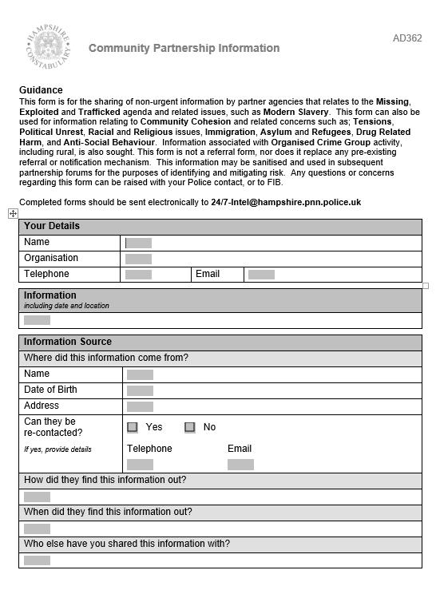
Completing the CPI Form
Please Check……..
The information provided is concise
Full contact details have been provided
Full details of how the information was passed/known to you is included
Full and comprehensive details of the information
The provenance is detailed (how you know the information)
It is clear who else knows or may be aware of the information (only police)

Slide 50
CPI Examples: Best Practice Document
Shares examples of best practice
Explains level of information needed/what police need to know
Establish importance of information being clear, concise and relevant
Explains when it may be more appropriate for information to be reported to police as a crime or a safeguarding referral.
Details where to get further advice/support
Document located in Safe4me: Reporting & Sharing Information page

Slide 51
Accessing the CPI Form and Supporting Information
COMMUNITY PARTNERSHIP INFORMATION FORM (CPI)
Hampshire Constabulary Safe4me website: https://www.safe4me.co.uk/resources/
Go to resources section
Select Reporting & Information Sharing
Contains a link to the CPI form
Provides MASH referral details
Information and advice
Form provides an email link to the specialist 24/7 intelligence team.

Slide 52
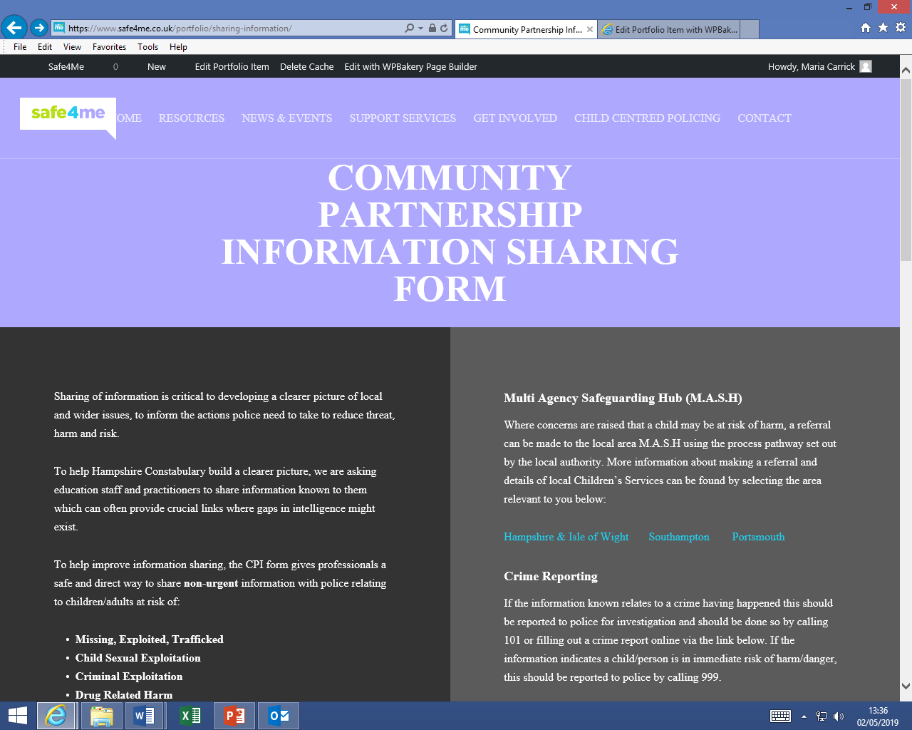
Accessing the CPI Form and Supporting Information
COMMUNITY PARTNERSHIP INFORMATION FORM (CPI)

Slide 53
Safe4me Additional Resources
Safe4me www.safe4me.co.uk/
CCE/County Lines Toolkit
Knife Crime Toolkit
Go to place for a range of topics
News & Events Bulletin Signup
Central support contact
schoolyouthengagement@hampshire.pnn.police.uk
All available in Safe4me
County Lines
Fearless: Free Lesson Plans KS3/4/5
Knife Crime:
#knifefree: Free PSHE Association Resources for KS3/4/5
Fearless: Free Street Crime Lesson Plan Pack for KS3/4/5
Resources for KS2: The Ben Kinsella Trust & No Knives Better Lives - Scotland (Playing it Safe)

Slide 54
Going Forward…. What we will do?
COMMUNITY PARTNERSHIP INFORMATION FORM (CPI)
Scoping digital submission portal
Improve CPI form: introduction and highlight the need for provenance
Provide relevant guidance to support content and submission
Provide partners with monthly CPI data performance reports
Continue events for professionals across county

Slide 55
Going Forward…. What can you do?
COMMUNITY PARTNERSHIP INFORMATION FORM (CPI)
Discuss: talk about this with the relevant people within your organisation
Action: consider a plan/strategy formed on what your organisation could do to tackle the threat and risk of drug-related harm and crime in communities - County Lines, CCE and CSE
Awareness: share your knowledge - encourage others to use the CPI form and increase quality of information

Slide 56
Questions

