Slide 1
Cognitive Load Theory

Slide 2
Session outcomes
By the end of today’ session you should
Be able to give an overview of what Cognitive Load theory is.
Be able to identify strategies to support learners in retaining new information.

Slide 3
What is cognitive load?
Notes:
The Cognitive Load Theory (CLT) was developed by John Sewell in the 80s and it focused on the learner’s cognitive process when learning new topics or problem solving (Chandler & Sweller, 1991).
Cognitive load theory builds on the premise that working memory (or short-term) has a limited capacity and that overloading it reduces the effectiveness of teaching.
Given that the goal of learning is to move new information from the working memory into the long term memory,
Cognitive load theory suggests that instructional materials and environments should be designed by practitioners to reduce this load, thus removing distractions enables a more efficient passage of the desired learning from working memory to the long term memory.
This is because as we learn the working memory can be overloaded reducing the capacity to store information in our long term memory. – a bit like when you have too many windows open on your computer – it slows down.

Slide 4
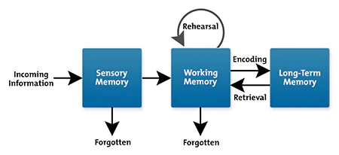
Information procession model
Notes:
Neurodiversity: some learners will find sensory elements overload their brain – creating a barrier to learning

Slide 5
Let’s test your working Memory
Task 1:
How many Fs do you see?

Slide 6
Answer: 6

Slide 7
Cognitive Load & Working Memory
Notes:
Cognitive load refers to the amount of information the working memory can hold at any one given time.
Most people can handle a cognitive load of between 3 to 7 separate pieces of information.
Intrinsic cognitive load
Sometimes a task is just hard. Consider calculus vs. arithmetic. Perhaps you’re great with math and this wouldn’t be a heavy lift for you. For others, this task would require a great deal of mental concentration.
Germane cognitive load
This refers to the actual processing of information. How will we organize it in our brains? Does this information connect with anything we’ve previously learned? Making connections is part of learning, and strengthens knowledge moving forward.
Extraneous cognitive load
This is the part that teachers have the most control over. It is generated by the way the information is presented and has nothing to do with the task. Are you learning calculus in a rock concert or a library? Have you used a PowerPoint slide theme that is distracting or clean?
Learner emotional level will also impact here (stress, worry, anxiety, mood)
Intrinsic – the actual difficulty of the subject matter itself. Instructional design has less influence on this than the other load types.
Extraneous – unnecessary distraction and increase in cognitive load without benefiting the learning such as decorative graphics that don’t serve a learning purpose.
Germaine – highly beneficial and can help the learners move information from working to long-term memory via models and mental connections.

Slide 8
Cognitive Load Theory 3 - intrinsic, extraneous, germane
Notes:
Cognitive Load Theory 3 - intrinsic, extraneous, germane. – YouTube
Cognitive Load Theory 3 - intrinsic, extraneous, germane. - YouTube

Slide 9
It’s too confusing
It’s too much
My brain hurts
I give up
I can’t do it
Notes:
What phrases to you hear when learners are struggling to process the information
When we apply cognitive load theory we are trying to prevent
I give up
My brain hurts
It’s too much to remember
Overload causes stress
Stress prevent concentration
leads to not remembering

Slide 10
I get it!
I remember…
Look I’ve done it!
I understand now
Notes:
Managing cognitive load leads to.. Eureka!

Slide 11
Applying the theory to practice
The coherence principle
Signalling principles
Redundance principle
Spatial contiguity
Split attention effect
Notes:
There are things we have control over to aid learning, however there are factors we do not have control over
There are five key factors that we can apply to prevent cognitive overload.

Slide 12
The Coherence Principle
This involves reducing the amount of information on each slide/page/worksheet to only that that is necessary.
Notes:
Images, sounds and words that are not essential, add to cognitive load.
Giving the student’s working memory fewer stimuli to focus on enables more processing power to be used by the germane load (remember this is our goal).

Slide 13
The Signalling Principle
highlighting the important details.
Notes:
We can do this via arrows or rings around the information. This reduces cognitive load by taking the work of scanning this visual away from the working memory.
This results in more juice for the germane load!

Slide 14
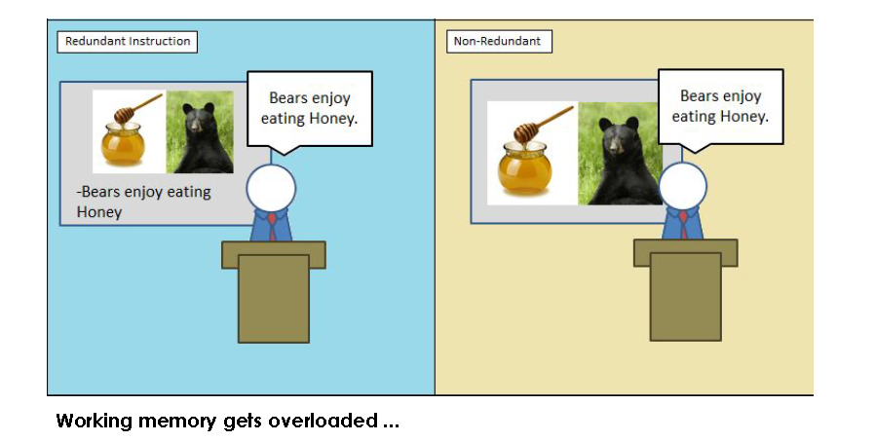
Redundancy Effect
Notes:
The Redundancy Effect often hinders learning due to inefficient use of working memory resources. For educators, this means reducing the unnecessary cognitive load of redundant information for students and focusing primarily on what matters most.
When a students’ working memory becomes clogged up by unnecessary information, they may remember the irrelevant information and forget what they actually need to know

Slide 15
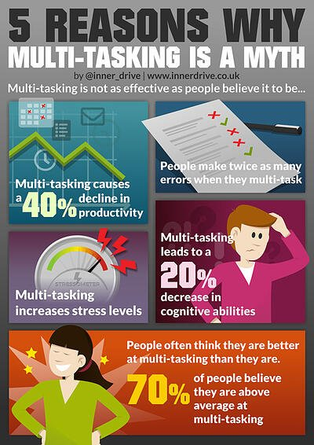
Split Attention Effect
Notes:
Using more than a single piece of visual information, such as graphs, diagrams and explanatory text, may divide a students' attention between them. This increase in the memory load may make it more difficult to establish new schemas.
The Split Attention Effect occurs when learners have to refer to two different sources of information simultaneously when learning something.
This creates an extra load on their brain as switching between tasks takes time, effort and energy.
Prevents learners decoding lost of text/information/images

Slide 16
Spatial Contiguity
Notes:
Placing labels next to the thing they are describing, so students don’t have to waste cognitive load juice working anything out.

Slide 17
How can we do this within our sessions?
Breakout rooms:
Decide who will feedback three key points to manage each type of memory load
Intrinsic: The content | Extraneous The packaging | Germane The Processing

Slide 18
Strategies to reduce cognitive load
Discourage multi-tasking (reading/listening/writing)
Provide cognitive helpers
Manage the emotional atmosphere
Teach thinking routines
Notes:
Memory has 2 points of entry – audio and visual – use both to establish strong learning path

Slide 19
Intrinsic
Break tasks down into smaller sequenced chunks
Give examples of new concepts
Simplify content
Reduce redundant information

Slide 20
Extraneous
Keep related text and images in close proximity
Reduce visual and audio competition
Remove decorative graphics
Notes:
distractions

Slide 21
Germane
Activate prior learning or experiences
Provide opportunities to practice exchange of information between the memory types
Notes:
Making connections – linking to existing schemas
Recall, sequencing, retrieval practice

Slide 22
In conclusion
…when teaching
Avoid overloading one store with information
Don’t speak when you need learners to be reading
Stop talking when there is text on the board
Use two separate stores to present new information
Talk when you are displaying images
Use coloured font to show links or differences
Make explicit links with prior learning to help learners integrate the new information into their long-term memories
Reduce unnecessary visual distractions from the front of the classroom

Slide 23
Further reading
Cognitive Load Theory - Learning Skills From MindTools.com
The importance of cognitive load theory | Society for Education and Training (et-foundation.co.uk)
Cognitive Load Theory: A teacher's guide (structural-learning.com)
Using Cognitive Load Theory To Reduce Learning Barriers For Students – Thinkific
Cognitive Load Theory 1 - An introduction - YouTube

Slide 24
Blog #1 What is Cognitive Load Theory (CLT)? How does it affect learning? (tech-eds.com)
Cognitive Load Theory - gerardfriel.com

